Slide 1
Strategies for Building Educator Resilience from Panorama’s Playbook
Access strategies from Panorama’s expert SEL curriculum partners
www.panoramaed.com

Slide 2
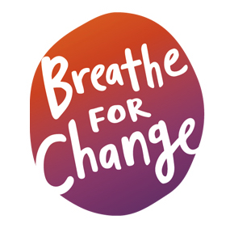
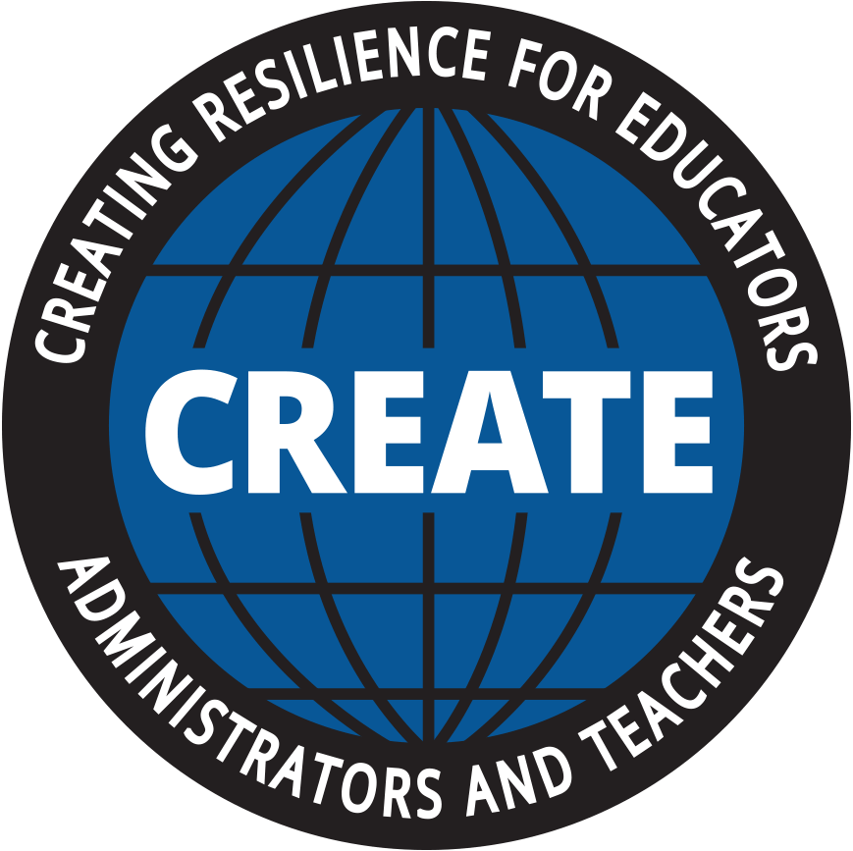
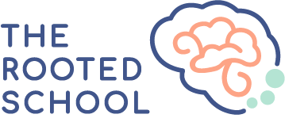
About Panorama’s Playbook
Panorama’s Playbook is an online professional learning library of evidence-based and research-backed social-emotional learning (SEL) interventions available to Panorama customers. Playbook includes resources from expert organizations vetted by Panorama’s team for CASEL alignment and research backing. Playbook assists school leaders and educators with low-lift, actionable strategies to act on their Panorama student and adult SEL data.
In this resource, you’ll gain access to three strategies from Panorama’s Playbook focused on building adult capacity for SEL and fostering overall well-being during periods of transition. To learn more about Panorama for Social-Emotional Learning and Playbook, please visit this link.
Inside This Resource:
Strategy #1:
Self-Care Practice for Educators (via Breathe for Change) ……………………... 3
Strategy #2:
Caring Practice (via CREATE) …………………………………………...………………...…….. 4
Strategy #3:
Growth Mindset and Resilience Meditation (via The Rooted School) …..… 5
www.panoramaed.com

Slide 3
Strategy #1: Self-Care Practice for Educators
via Breathe for Change
GOAL: This self-care practice allows us to increase our ability to love ourselves which, in turn, enhances our ability to extend love to the partners, family, friends, colleagues and students in our lives. Research shows that mind-body practices such as meditation increase our capacity for compassionate behavior.
INTRODUCTION:
This exercise can be done anywhere that people congregate – at a school, in the grocery store, on the bus, at a park, or in your home. It can be practiced, first, unobtrusively from some distance. As you gain comfort with your compassion practice, you may try it with a partner, a colleague, or someone who presents a challenge in your teaching.
Make sure to do all five steps on the same person.
STEP-BY-STEP TECHNIQUE:
Repeat to yourself: "Just like me, this person is seeking some happiness for their life.
Repeat to yourself: "Just like me, this person is trying to avoid suffering in their life."
Repeat to yourself: "Just like me, this person has known sadness, loneliness, and despair.
Repeat to yourself: "Just like me, this person is seeking to fulfill their needs."
Repeat to yourself: "Just like me, this person is learning about life."
VARIATIONS:
Practice this with your partner and family members to increase your understanding of each other.
Practice this on someone who challenges, antagonizes, or bothers you.
Practice this on a challenging student.
(For more information, download the self-care practice guide.)
About Breathe For Change Breathe for Change is on a mission to foster individual and collective well-being for all humankind. The organization offers mind-body and social-emotional wellness trainings that unite, train, and support educators in enhancing individual and collective well-being. Breathe For Change envisions all people inspired, educated, and empowered to be their whole and brilliant selves in their lives, relationships, and communities. Click here to learn more.

Slide 4
Strategy #2: Caring Practice
via CREATE
GOAL: This 9-minute mindfulness practice focuses on cultivating compassion to help care for oneself and others. The goal of this Caring Practice is to generate compassion for yourself and for others.
HOW IT WORKS:
This mindfulness practice is developed specifically for educators to use for themselves. Many individuals prefer to listen to this recording in the evening to relax, and some use it when they cannot fall asleep.
Click here to play a recording of this guided mindfulness exercise.
WHY THIS WORKS:
There is a large body of research showing that when mindfulness practices focuses on caring or compassion, individual well-being is improved along with one’s physiological response to stress.
About CREATE CREATE was established in 2018 as a non-profit organization to serve educators with evidence-based programs and practices to nurture healthy, caring, equitable school communities that support social and emotional learning and teacher and principal wellness. Prior to the establishment of CREATE, many years of research and development led to the founding of the CARE and CALM programs. Mark Greenberg, one of the original founders of CASEL, sits on CREATE's Board of Directors. Click here to learn more.

Slide 5
Strategy #3: Resilience Meditation
via The Rooted School
GOAL: Building strength and resilience can help you deal with the stress of teaching and managing a classroom. This mindful activity aims to help you become aware of biases and provides a mindful self-awareness meditation that combines self-resilience and positive self-talk to help decrease negativity bias.
INTRODUCTION:
Building strength and resilience can help you deal with the stress of teaching and managing a classroom. Believing that you can ‘bounce back’ or figure out issues goes a long way in supporting mental health.
You can try this meditation once a day or as often as needed to boost your overall resilience.
STEP-BY-STEP TECHNIQUE:
Find a quiet space to sit or lay down. Place your palms face-up on your lap. Close your eyes if it feels comfortable, and begin to breathe deeply, connecting with your breath.
Begin to tap your fingers together, starting with your thumb and pointer, then thumb and middle, and so forth. Take a breath with each tap.
When you are ready, begin tapping on the breath in, and with the breath out, mentally or out loud, say: “I HAVE ____________” and insert something that you have as a support in your life. (For example: I have co-workers that care for me. I have a healthy body. I have a kind heart. I have the ability to change the situation.) Continue until you have tapped to the pinky finger.
For the next round, shift to “I CAN” statements. Continue tapping on the breath in, and with the breath out, express things you can do. (For example: I can choose to answer others with kindness. I can ask for help if needed. I can ask for a moment to formulate my thoughts.) Again, continue until you have tapped your thumb to the pinky finger.
Finally, repeat with the word I AM, tapping on the breath in, and with the breath out, express positive or productive words that support who you are. (For example: I am strong enough to get through this. I am smart enough to figure this out. I am able to change my thoughts or mindset on this subject.) Tap until you reach the pinky finger.
About The Rooted School The mission of The Rooted School is to partner with schools and communities to make mindful social-emotional skills and brain-boosting techniques a part of everyday life as a way to increase academic potential, self-awareness, and resiliency. The Rooted School offers SEL curriculum, a school employee wellness program, and resources for building a stronger home-school connection. Click here to learn more.

