Slide 1
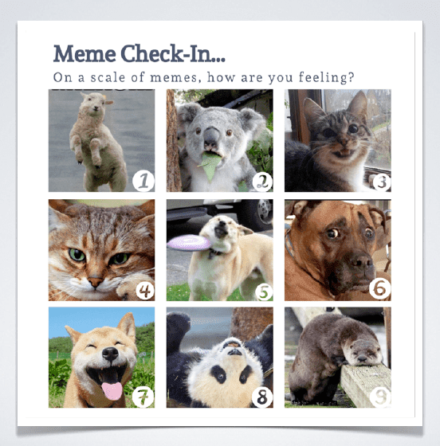
While we wait: Complete the poll by indicating the number that matches your spirit animal today.
Notes:
Use this as participants enter the room so they can “check in” can also be done in-person on the sign in sheet

Slide 2
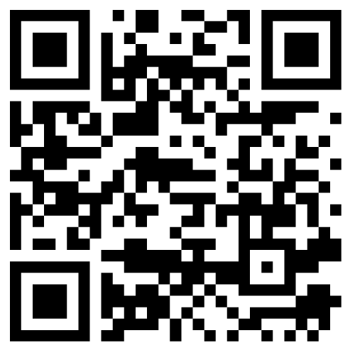
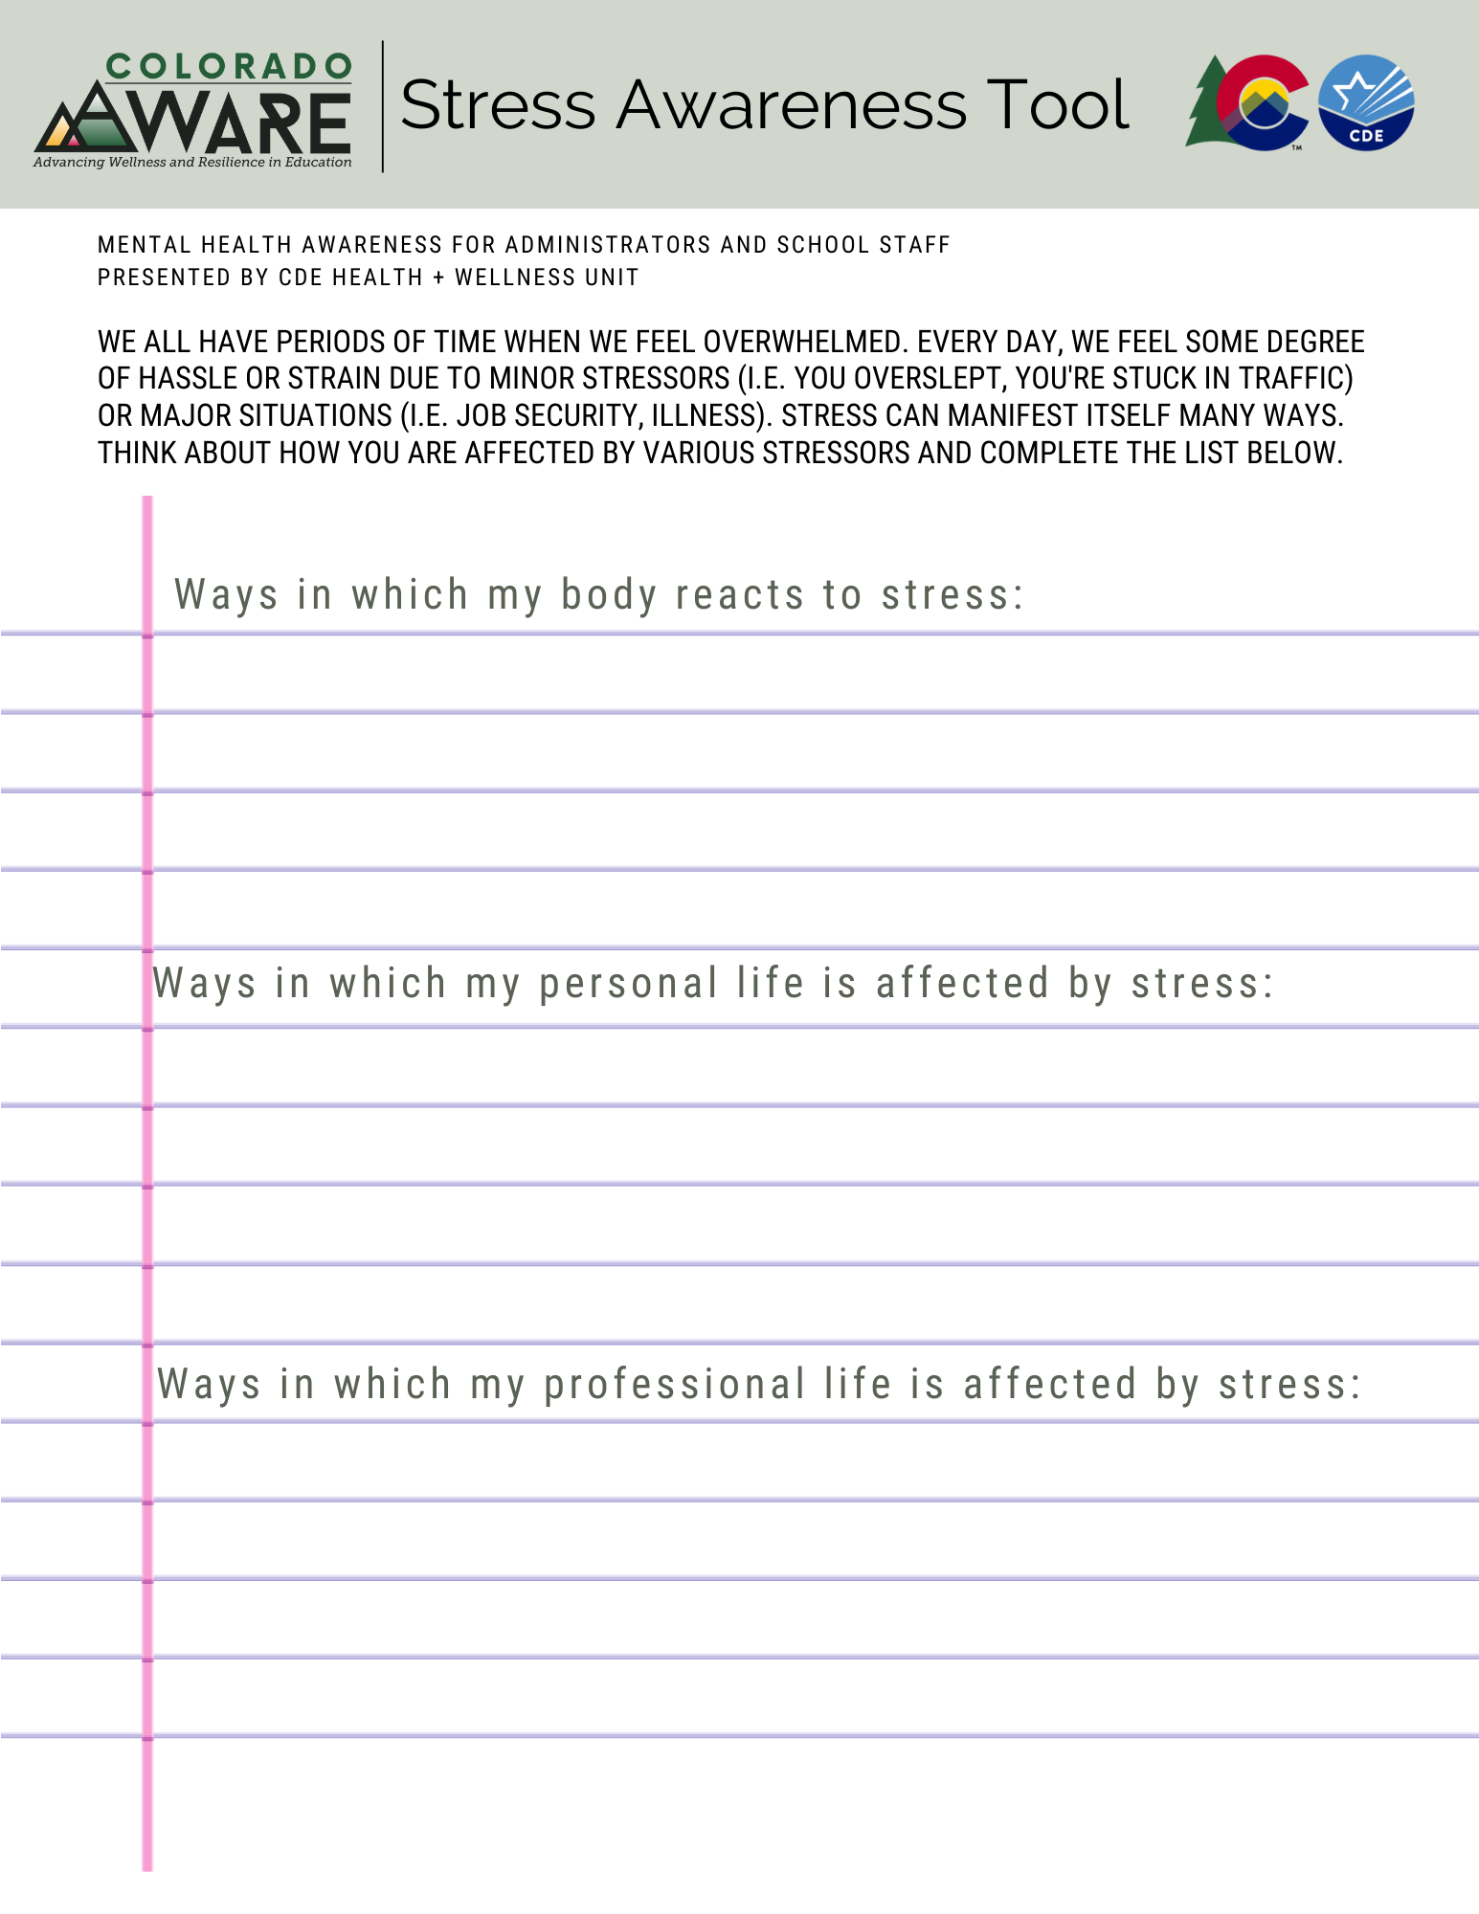
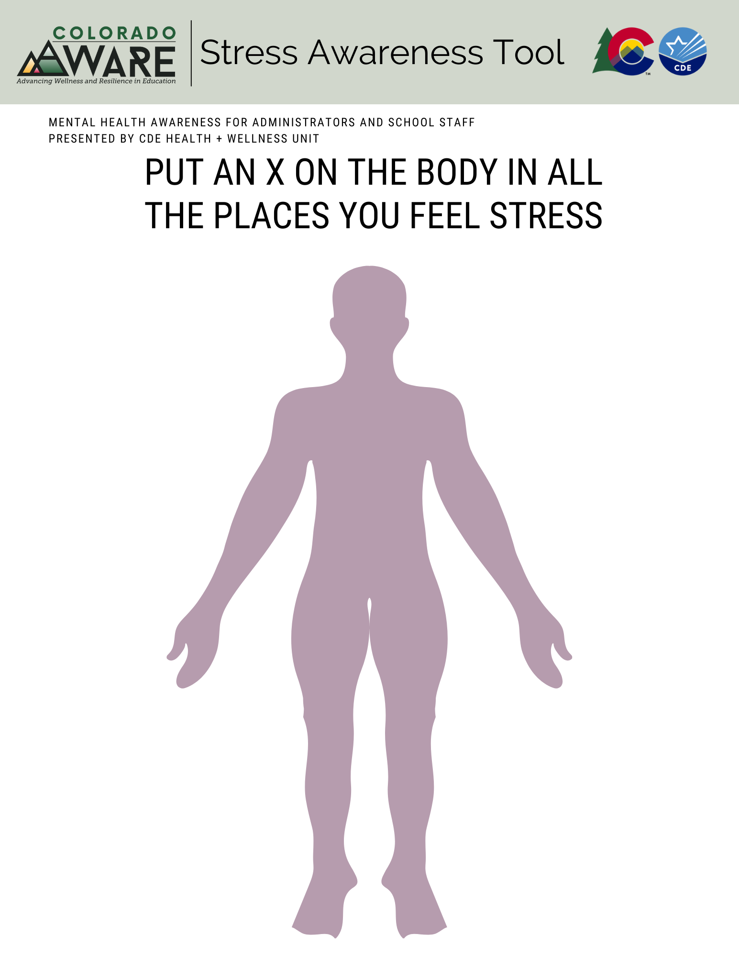
Stress Awareness Tool
https://bit.ly/cdestressawareness
Notes:
Make sure everyone has a device that can open the QR code: this can be used as a warm-up activity for in-person trainings especially--can have printed copies for people to begin exploring the places in their body they feel stressed and what might be coming up for them in today’s training.
This is a tool that can be used to help people identify where they feel stress and how to identify stress from work and stress from non-work settings.

Slide 3
Mental Health Awareness and Connectedness Training for School Staff

Slide 4
Learning Objectives
Participants will:
Understand why mental health awareness and connectedness is important, particularly in our current climate
Utilize strategies, tools, and resources provided to enhance well-being and psychological health in your work environment
Notes:
Our focus today is for all of us to:
Understand why mental health awareness and connectedness is important, particularly in our current climate
Utilize strategies, tools, and resources provided to enhance well-being and psychological health in your work environment
understand the value of investing in self-care work in the education environment
Participants will acknowledge that resistance exists and the need to reframe our thinking around self-care, and
identify 2-3 ways they can embed we-care strategies into their current structures and routines

Slide 5
Kaiser Permanente Course Review
The Notice, Engage, and Support (N.E.S.) Model
SUPPORT
ENGAGE
NOTICE
Notes:
As educators/colleagues/team members we have a responsibility to care for ourselves and our colleagues. One way to do this is by promoting a mental health stigma-free workplace. In the KP self-paced mental health awareness training you were introduced to the Notice, Engage, Support, or N.E.S.model.
In the NES model, the first step is to notice, or become aware of change in someone. Common behavior changes can include being frequently late or absent, mood swings, or engaging less with others.
The second step is engage, or what to do in situations when you notice someone is not emotionally OK. This can mean asking someone if they would like to talk, and then listen compassionately without judgement. Sometimes the best way to engage in a conversation is to let a person know you noticed their behavior and ask them about it. When engaging with a person you want to encourage them to open up. Understand you aren’t there to fix problems, accept they may not be ready to talk, or they may not want to talk to you.
Finally, support, or letting someone know what resources are available so they can choose what’s best for them. In the support step, you want to focus on listening and not about giving advice or solving problems. Acknowledge not everyone needs or wants support. If that’s the case, recognize giving someone space is a way to respect their needs.
Think about which step is the most challenging? Why?
Following the NES model isn’t easy and may be uncomfortable. You’ll have an opportunity to practice this in the next section. First, let’s look at how implementing this model can impact your workplace culture.

Slide 6
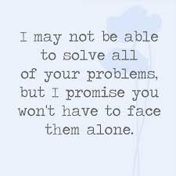
Support Might Look Different Than You Think
Notes:
When it comes to the NES model, support might look different than you think! How often do you feel like supporting staff looks like solving their problem or finding a way to fix what seems to be broken? Today let’s think about how we help each other regulate our feelings and emotions so that we are at a place to solve the problem together.

Slide 7
What did the KP self-paced course bring up for you as a professional?
Notes:
What did the KP Self-paced course bring up for you? How does MH currently show up in our roles?

Slide 8
What is a Psychologically Healthy Workforce?
Notes:
It’s important to remember that each day we all arrive with varied experiences, and consequently we are impacted in different ways. We have to build in time for all of us to share our experiences and to identify our needs as well as ways we can be supported. The ability to advocate for our needs is an important resilience characteristic. This requires us to build a psychologically safe environment where we all feel comfortable engaging in this type of communication.
I’ll spend the next several slides covering a psychologically healthy workforce. And, for the purpose of grounding us moving forward, I’d like to share a definition.
According to the American Psychological Association, a psychologically healthy workforce is one that operates in an environment that “fosters employee health and well-being and enhances organizational performance.”
Many of you may already focus on areas that foster this kind of environment. Things like prioritizing communication, emphasizing work/life balance, promoting staff recognition, and supporting professional growth opportunities. Given the additional stressors of our current world, we need take it a step further and consciously make an effort to promote a psychologically healthy work environment.

Slide 9
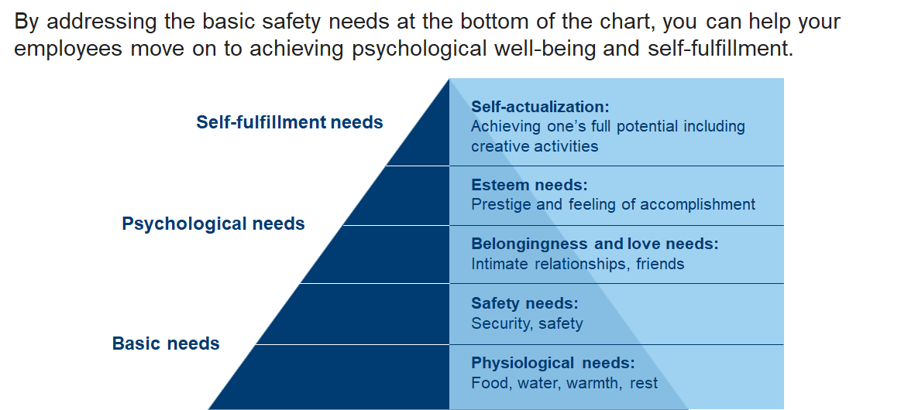
Basic Needs First, Then Psychological Needs
Notes:
Let’s talk about actionable ideas we can do to promote this kind of environment. On the screen is Maslow’s Hierarchy of Needs. It provides foundation for understanding our needs as humans and gives an overview of areas that must be proactively addressed before focusing on higher elements in the pyramid.
On the lowest level are the most basic needs like food, water, shelter. Think about a time that you didn’t have a basic need met--were you prepared for the demands of the day? How do we ensure that when someone on our team has a basic need that isn’t being met, they feel like they have a support system to get assistance in that area?
Moving up is the need for safety and security. Staff need to feel safe – both physically and psychologically. They need to feel grounded in their work environment.
As you think about physical safety, ask yourself: What protocols do we have in place to protect ourselves?
Then there’s psychological safety: What is our system for asking questions and giving feedback? Are we comfortable reporting problems and proposing new ideas without fear of consequences? Is there a safe way for us to communicate when our needs aren’t being met?
Only once these basic physiological and psychological needs are met, can we move up hierarchy and understand needs around belonging, esteem and fulfilment. We all need to feel supported and know that we will be treated with respect by colleagues and leadership. We need to feel confident that we have the appropriate resources to care for ourselves and to do our jobs successfully.
Next, we’ll look at a model that we can use to impact the psychological health of our organization.

Slide 10
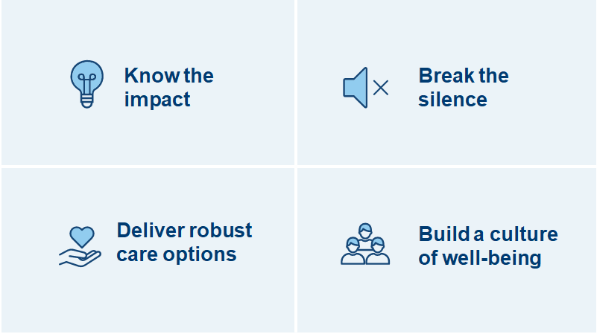
Kaiser Permanente’s Framework for a Psychologically Healthy Workforce
Notes:
Kaiser Permanente’s framework for fostering a psychologically healthy workforce is a model that includes 4 main elements which are listed in the slide. We’ll go over each of these in the slides that follow.

Slide 11
Know the Impact by Gathering Facts
Formal Data Gathering:
Employee Assistance Program utilization
School-based survey for staff
Participation and utilization of wellness programs
RISE Assessment and other school culture assessments
Informal Data Gathering:
Leverage wellness champions
1:1 check-ins with staff
Leadership office hours
Solicit questions prior to staff meetings
Regularly touch base with instructional coaches and counselors
How To Complain Effectively
Notes:
The last year took a disproportionately hard toll on teachers and school staff. Workplace stress has always been around; however, given the stressors of the past 18 months, let’s consider some formal and informal ways we can acknowledge the needs of our workforce. How do we work collectively to make sure we all have what we need?
Here are some ideas for both formal and informal data gathering. Also keep in mind that complaining can be an effective way for us to communicate their needs. It’s important to provide guidance on how to complain effectively to reach a solution. Let’s check out this guide on How to Complain Effectively

Slide 12
Deliver Robust Care Options to Support Full Mental Health Spectrum
Notes:
It’s in our interest to understand how mental health operates. It isn’t cut and dry; it exists on a continuum. Understanding the continuum can ensure that we all have access to, and understand, a wide range of care options to support ALL of our mental health needs.
Let’s start on the far-left side with emotional wellbeing. People who are emotionally well are calm and confident, have strong social connections, and can handle life’s ups and down. However, even people with no emotional distress need to take preventive measures to help them stay resilient. Think of preventive things you do to stay physically healthy – maybe take vitamins, exercise, eat healthy, focus on getting quality sleep. To stay emotionally healthy, we must emphasize similar preventive measures, or self-care. These can include things like practicing meditation, breathing exercises or keeping a gratitude journal. .
Moving down the continuum is mild distress. The past 16 months have been hard, and everyone has been impacted in some way. Many people have been, or are still living, in a heightened state of distress. You start to see signs - changes from normal behavior. Loss of interest, poor focus, irritable. You may notice some of your colleagues or staff in this mode. Here, a person needs to recover, build resilience and move back to being emotionally well. They should connect with someone who cares about them while still practicing self-care.
As we continue to shift down the continuum, this is where stress is taking a toll, and there may be concerning behaviors – trouble sleeping, self-medicating, social isolation. Individuals who are here should talk to a person with some professional experience – their primary care doctor, a faith advisor, or an EAP specialist. And, it’s important to continue practicing self-care. A note about EAPs – if your District offers an EAP that great, but let’s make sure we all know how to access it. (link to district EAP)
Finally, on the far-right side of the continuum is a chronic mental health condition. People who are here experience conditions like depression, anxiety or substance use disorders. This where we recommend professional mental health treatment. Someone here could still benefit from talking to a counselor or practicing self-care, but they may need a clinical intervention as well. We can each provide support to each other by reminding staff of the specialty services available for mental health and substance use disorders, and encouraging them to seek treatment if needed.
Finally, we’ll look at the last pillar, building a culture of wellbeing.

Slide 13
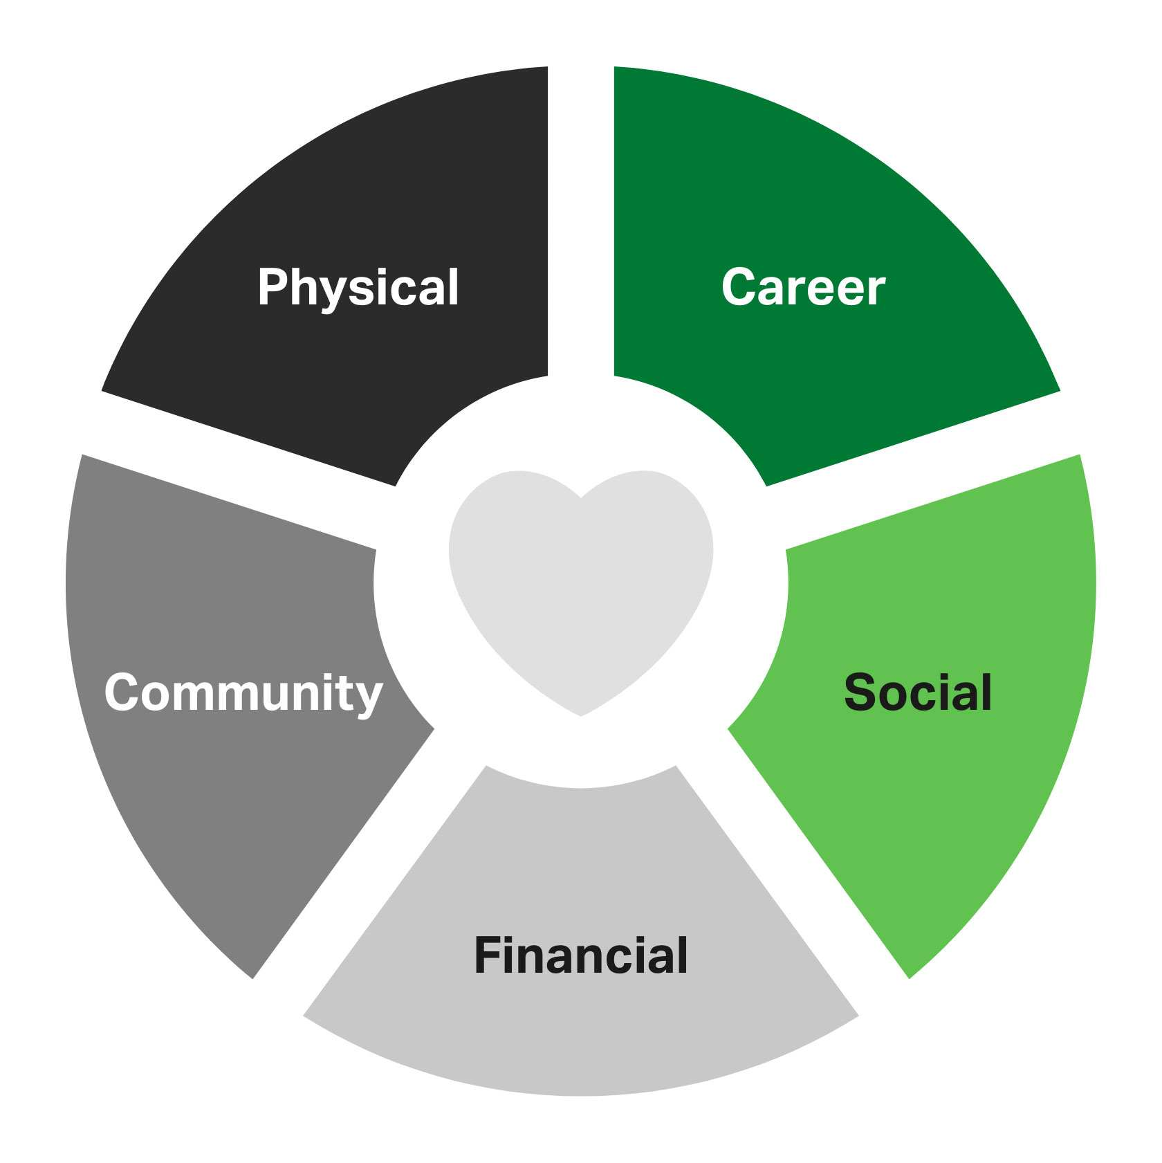
Build a Culture of Wellbeing
Be a part of creating a work environment where people feel connected, engaged, and supported:
Provide clear information and communicate often
Recognize and reward yourself and your colleagues
Promote work/life balance
Acknowledge feelings and experiences related to stress of current events
Be actively engaged in wellness opportunities
Notes:
Addressing a culture of wellbeing in your current work environment can include things like:
Be a part of creating a work environment where people feel connected, engaged, and supported:
Provide clear information and communicate often
Recognize and reward yourself and your colleagues
Promote work/life balance
Acknowledge feelings and experiences related to stress of current events
Be actively engaged in wellness opportunities

Slide 14
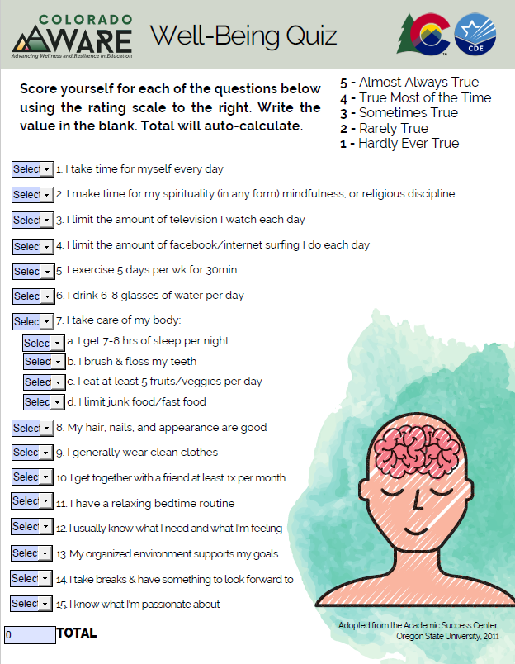
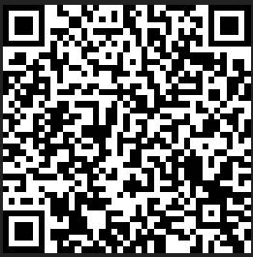
Well-Being Check
Download to complete the fillable PDF:
https://bit.ly/wellbeingquizcde
OR complete the quiz on your phone by scanning the QR code:
Did you score higher, lower, or right where you thought you’d be?
Notes:
So now we are going to take a pulse of where we all are in terms of our well-being. This last year and a half has been challenging for all. Please go gently with your score and remember this assessment is fluid depending on the day, week, month, and reflects only this current moment. Once you have your result we are really interested not in your raw score but whether you are higher, lower, or right where you thought you’d be.
If you did this training in your school you might have small group processing around this question or perhaps a poll in an virtual environment.

Slide 15
Results Interpretation
72-90: Way to go! You are taking excellent care of yourself. Now you can delve further into things like getting massages, simplifying your life, and getting rid of as many stressors as you can.
54-71: You know how to take care of yourself. Now, do it consistently. Would it help to track your daily self-care? What can you do that would allow for some of these self-care habits to happen regularly?
36-53: You may value yourself, but can you prioritize self care a bit more? Set an evening just for you every week with no outside obligations. Examine your calendar to get rid of unimportant meetings, etc. Turn off the TV/Facebook/the internet after an hour of watching/surfing, etc. Put in a daily half hour for you in your appointment book. Let go of unrealistic standards of how much you can get done in a day. Cut your to do list for the day in half. Now use that time to work on one thing on the checklist above until you form a habit. Then move onto another one.
18-35: You feel guilty every time you take time for yourself. You need to realize that your family, friends, school and work don't want an empty vessel. They want a vibrant, authentic, energetic you. Talk with your family and friends about how you want to start taking better care of yourself. Is there a way you can use your friends and family to build in time for your self care? If they are supportive, see if they are open to having you be accountable to them. Which thing from the above checklist do you think would have the most impact on your energy and well-being? Work on that action until it becomes a habit.
0-17: Your actions don’t seem to reflect that you prioritize taking care of yourself. What are you prioritizing instead? You need to realize that your family, friends, school and work don't want an empty vessel. They want a vibrant, authentic, energetic you. Talk with your family and friends about how you want to start taking better care of yourself. Remember, you are just as important as the other people in your life. Shine for them! Pick an easy, non-threatening action to start caring for yourself. Maybe you can drink one more glass of water or take 5 minutes alone. Start small and work your way up.
Notes:
Here’s the scoring guide which also page 2 of the PDF, and displays automatically at the end of the electronic version. Please complete the poll to indicate whether you were higher, lower, or right you thought you might be. Remember all of these tools will be made available to you in the context of a Google folder you can use freely.

Slide 16
The Time is Now
Notes:
Read Slide
Adult resilience and wellness have a direct impact on our ability to effectively support students. Research from John Hattie shows that collective teacher
efficacy has the largest positive effect on student achievement. When adults feel a sense of safety and self-efficacy, they’ll be able to cultivate an inclusive learning environment that meets students’ needs both in school and at home.

Slide 17
Stress is Systemic
Notes:
Stress is systemic in the educational setting and educational leaders need to support their staff in many ways. Let’s talk about stress in the educational workplace:
read slide

Slide 18
The Stress Response Cycle
Notes:
Here’s a short video from social scientist and author of the book “Burnout”, Emily Nagoski, and her twin sister Emilia regarding the Stress Response Cycle
video is 2 minutes

Slide 19
Burnout, the Brain, and Completing the Stress Response Cycle
Notes:
So we don’t have lions in our 21st century set of stressors, however we still need to find a way to relieve the pent up energy we experience when stressors arise. Here are 7 ways to complete the stress response cycle

Slide 20
Burnout and the Brain
Notes:
read through the slide graphic

Slide 21
What do you do to take care of your mental well-being?
What does your school do to promote psychological wellness?
Notes:
2-3 minute partner or small group chat

Slide 22
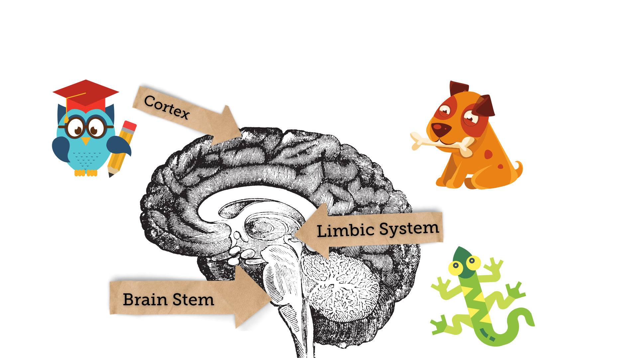
Neuroscience Made Simple
Notes:
The brain is very complex, but we can simplify some basic neuroscience by breaking the brain down into three major areas. The brain stem which we call the lizard which is responsible for your safety and basic functions that keep you alive; the limbic system which we call the dog and which houses your emotional responses; and the cortex which we call the owl and this where you keep memories, analyze information, make decisions and solve problems.

Slide 23
Signs You’re Stressed
Notes:
Read slide

Slide 24
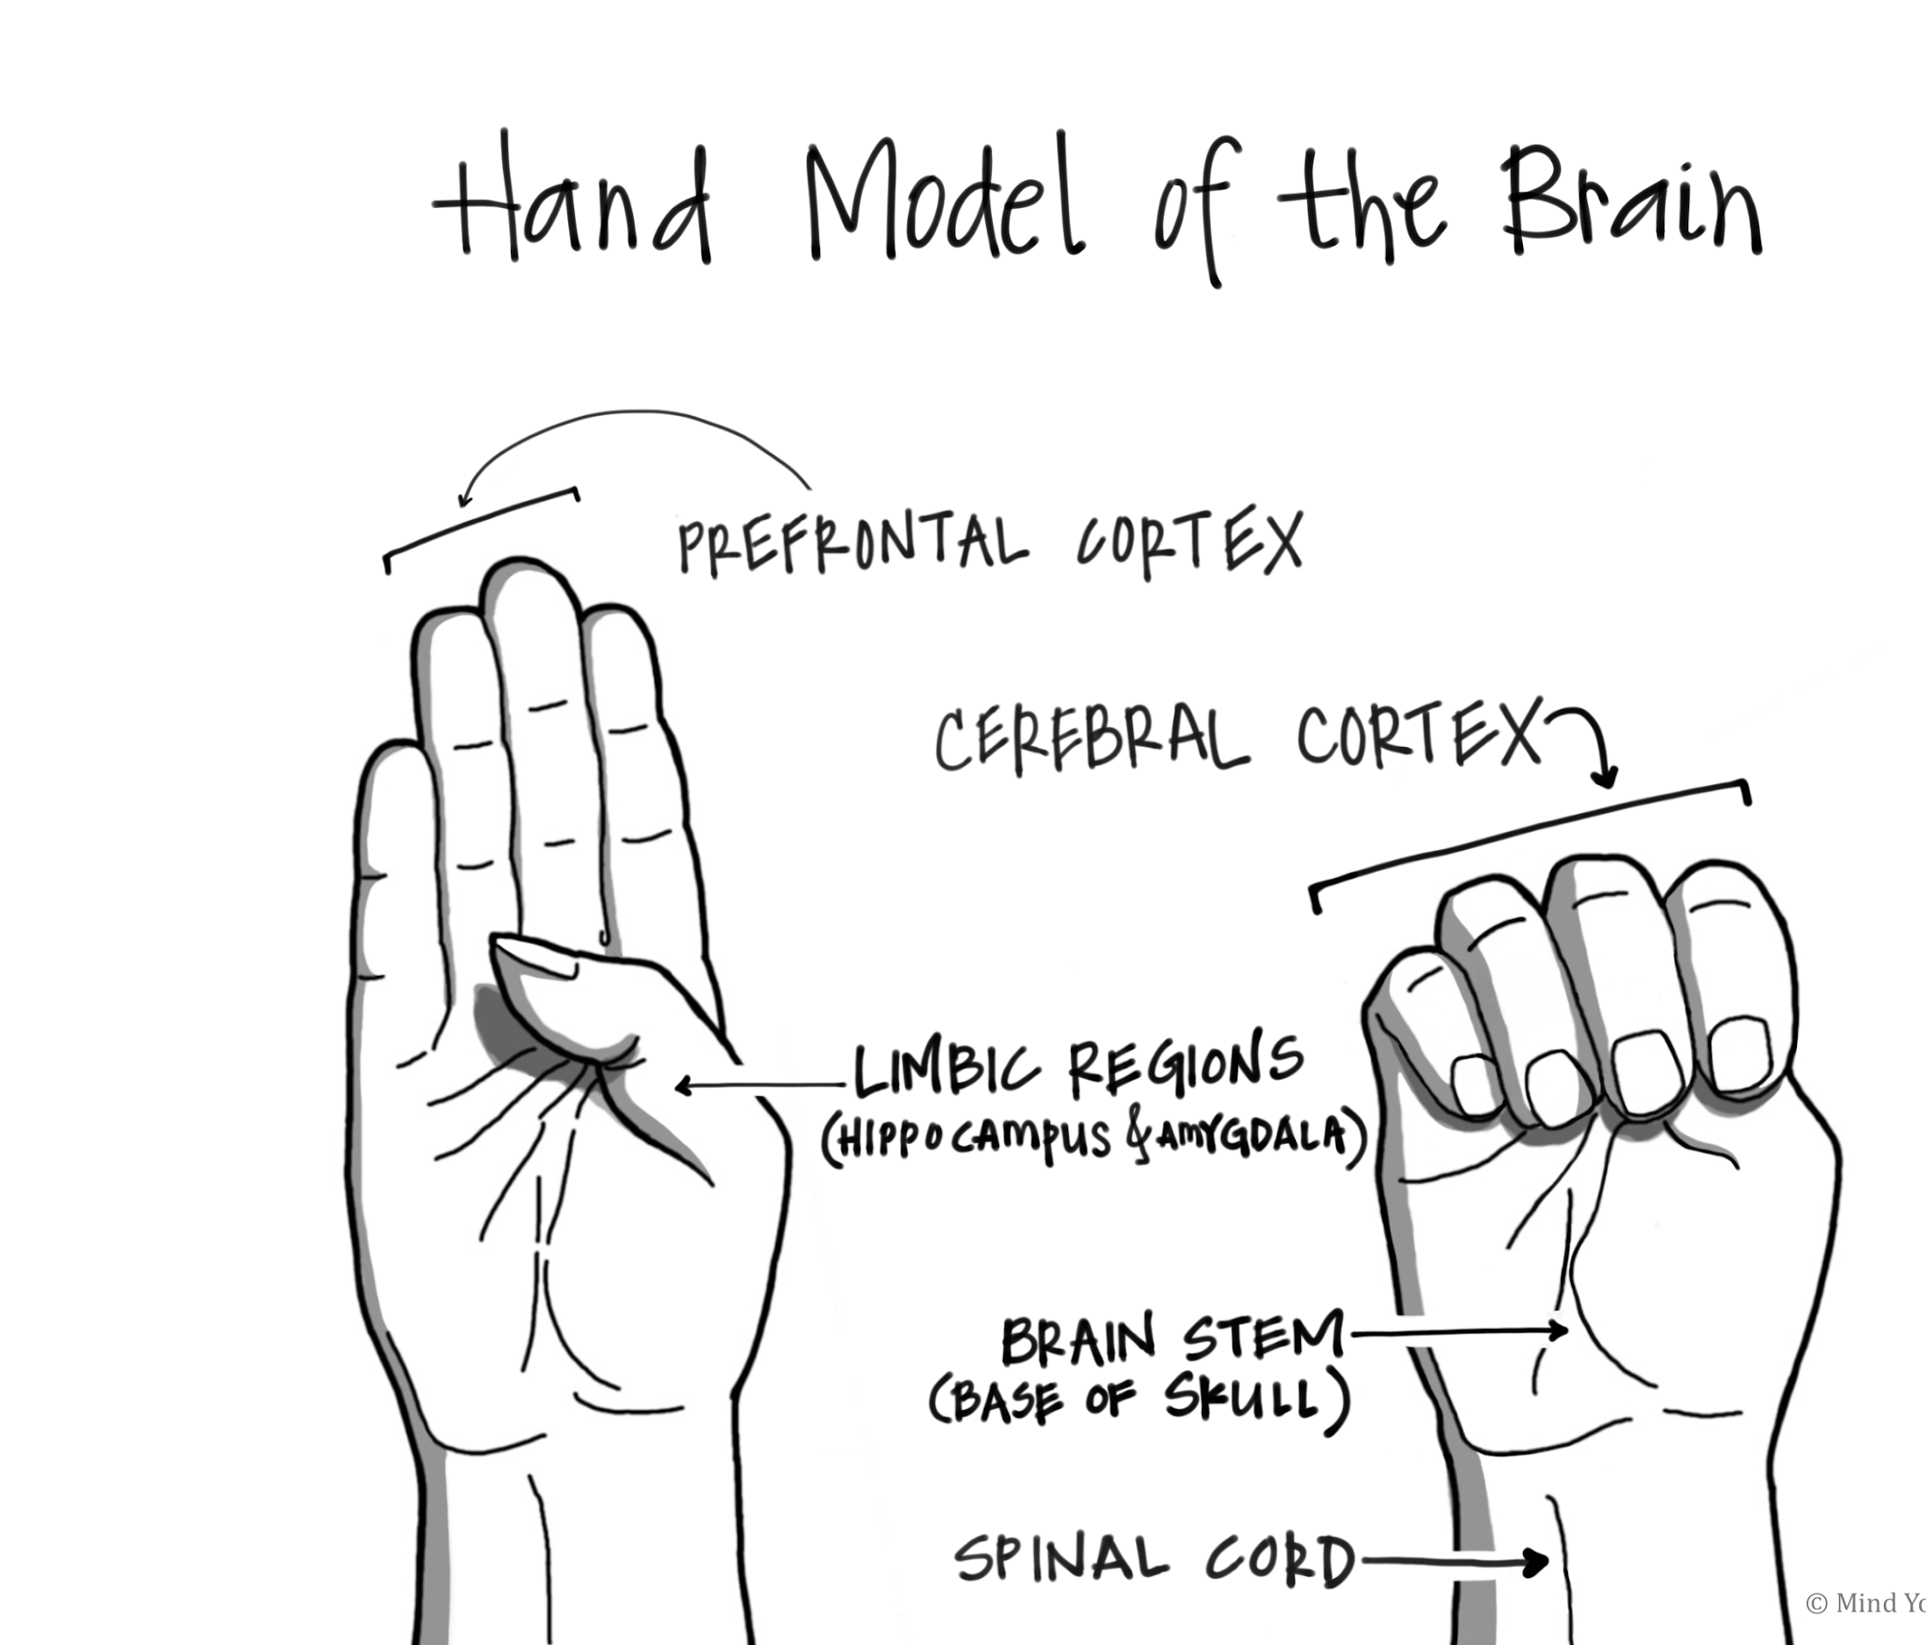
Stress Response & Amygdala Hijack
Hand-Brain Model Explains Stress Response in the Brain
The amygdala is the seat of emotion. It is a psychological guard that is continually asking of all experiences:
Is this something I hate?
Is this something I fear?
Is this something that can hurt me?
If the answer is “yes”, chemical messages are immediately sent out to all parts of the brain.
Notes:
Dan Siegel’s hand brain model is another way to teach otherwise complicated neuroscience for what’s happening in the brain on stress to students--and adults! When someone is being controlled by their amygdala, they cannot reach their prefrontal cortex to solve the problem, make a decision, think rationally, etc. In those cases, you can become that person’s hippocampus and help close the brain and allow them to access their owl brain. Until that happens, it doesn’t matter how much talking or “helping” you do--a person just cannot accept that help or assistance when their amygdala has been hijacked. #bethehippocampus

Slide 25
Cognitive Triangle
The cognitive triangle used in CBT therapy can help us intervene
Feelings
Thoughts
Behavior
Situation
Notes:
Therapists often use the cognitive triangle to help patients/clients work through unhealthy thought patterns or thinking that doesn’t serve them. The triangle is usually just thoughts, feelings, and behavior--however I like to add situation to the mix. This leaves room for power dynamics, systemic circumstances, nuance, and removes the idea that we have complete and total control in situations we find ourselves and that there are others involved. This process is fluid and ever changing in almost every interaction we have, because our background and past experience and current mood/other stressors influence the ways we show up in situations everyone on this call today would like have different thoughts, feelings, and behavior.

Slide 26
Cognitive Triangle EXAMPLE
Shame Embarrassment
Feelings
I am not doing a good job
Heat rises to skin, stress response active, may be defensive in reaction
Thoughts
Behavior
Supervisor provides corrective feedback about your work with a student
Situation
Notes:
For example this is one example of what filling in this process might look like. (read slide) Through the power of reframing we can implore strategies within our locus of control to alter our thoughts, feelings, and behavior--which in turn will have an inevitable impact on the situation.

Slide 27
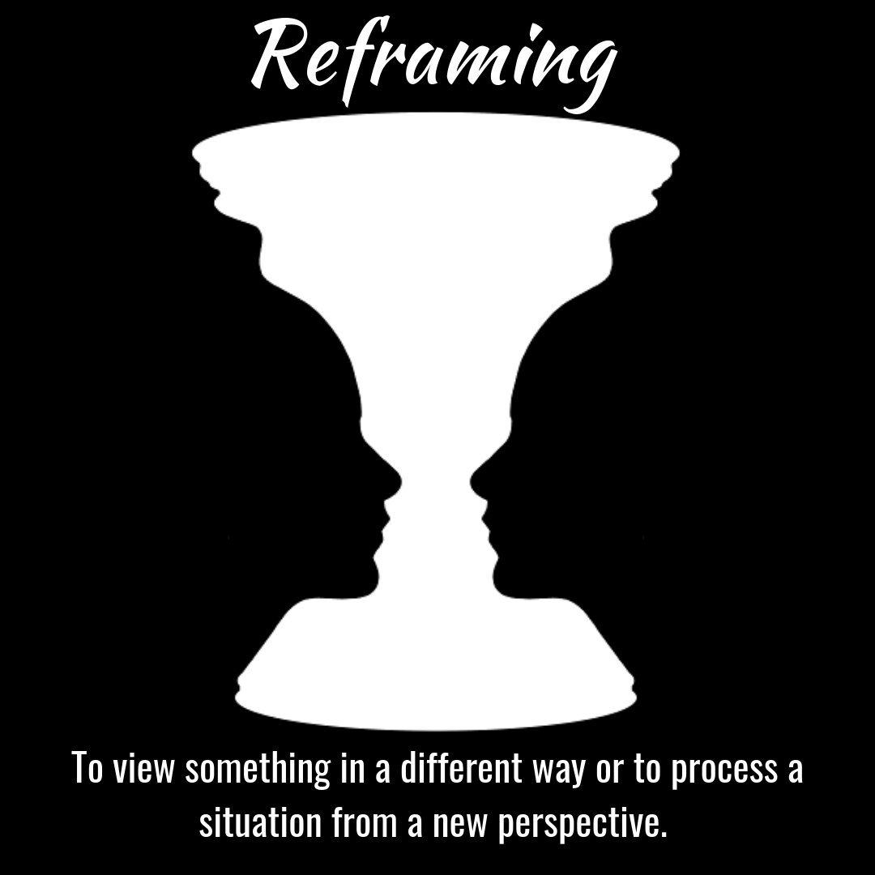
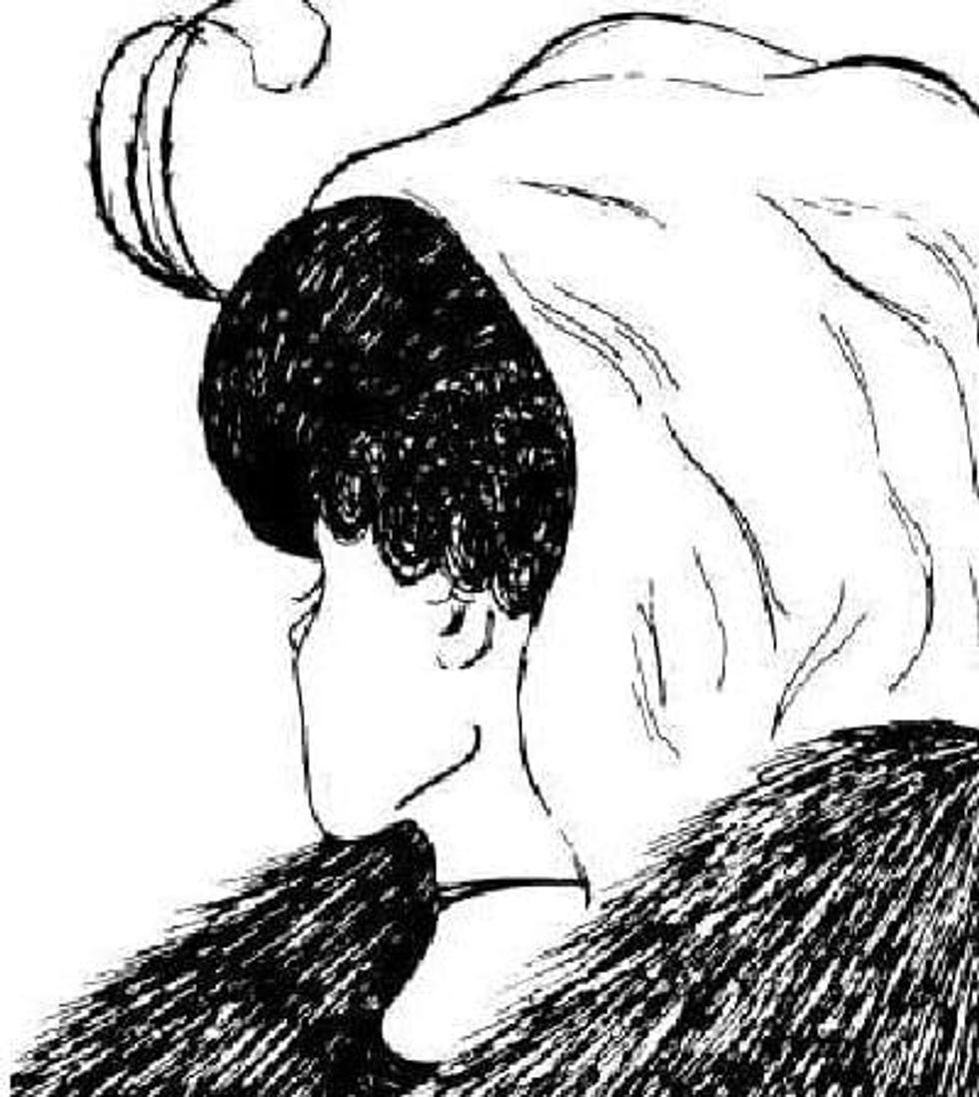
Reframing and Perspective Taking
To view something in a different way or to process a situation from a new perspective.
Notes:
Let’s talk about what reframing means for us. I’m sure you have seen these type of images. Do you see an urn or two people’s faces in the first picture? In the second picture do you see a duck or a bunny? On the third image, do you see an older woman with a scarf over her hair or do you see a younger woman with a necklace and a feather in her hair? We can sometimes get stuck in what we see so easily and have a hard time thinking of it from another perspective.
Keep these images in mind as you work on the upcoming scenario. Keep in mind that you might see a duck, but it might really be a bunny and that can make all of the difference in how you work through a situation.

Slide 28
Scenario 1
You are co-planning with two other grade level teams and your teaching partner(s). One of the other grade level teachers seems to be very negative and argumentative about the ideas you bring up for how to teach the next shared unit. (S)he says things like, “I don’t think that will work.” and “I guess we will do it your way.”.
Another staff member is monitoring students in the cafeteria and as you walk by (S)he is disciplining one of your students in a way that you don’t agree with. When you begin to ask questions about what is happening, (S)he says “Of course, you don’t think (s)he was breaking the rules.” and “I don’t know why I even try to teach these kids right from wrong.”.
Notes:
5 minutes partner or small group chat--use questions from next slide to guide the conversation
Choose between these two scenarios to discuss in your partner or small groups. Even if you aren’t directly involved in these situations, you may be in attendance when they take place or you may hear about them after they have occurred. Either way, disagreements happen between people, youth and adults, and we have to be able to frame our thinking in different ways in order to help our staff through these situations.

Slide 29
Breakouts
Please discuss these questions with your partner/small group. Given this scenario:
1. How did you reframe your thinking?
2. How did reframing impact your feelings, emotions, and behaviors in this scenario?
Notes:
post questions for partners/small groups to use

Slide 30
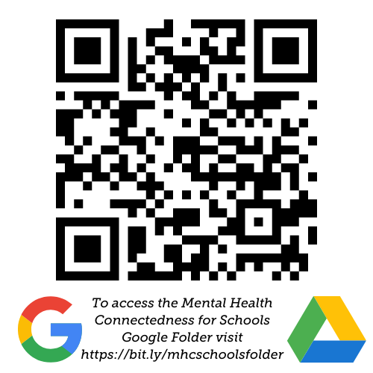
Resources (Google Folder)
Resources
https://bit.ly/mhcschoolsfolder
Important!
Download to Use Materials

