Slide 1
2020 Colorado Academic Standards . What to Look For in World Languages

Slide 2
Improve Clarity and Alignment for the Discipline of World Languages

Slide 3
Revised World Language Standard Statements
2009/2010 World Language Standards
1.) Communication in Languages Other Than English
2.) Knowledge and Understanding of Other Cultures
3.) Connections with Other Disciplines and Information Acquisition
4.) Comparisons to Develop Insight into the Nature of Language and Culture
2020 Revised World Language Standards
1.) Communication: Communicate effectively in more than one language in order to function in a variety of situations and for multiple purposes.
2.) Cultures – Intercultural Communication: Interact with cultural competence and understanding.
3.) Connections: Connect with other disciplines and acquire information and diverse perspectives in order to use the language to function in academic and career-related situations.
4.) Comparisons: Develop insight into the nature of language and culture in order to interact with culture competence.
Notes:
The 2009/2010 World Language Standards organized content into 4 main standards: Communication, Cultures, Connections and Comparisons. The Standards Statements were revised to the following (Read the 2020 right side) Within these standards conceptual learning was organized as evidence outcomes (EOs) under range level expectations (RLEs).

Slide 4
Improve Clarity and Alignment for the Discipline of World Languages
Evidence Outcomes (EOs)
Revised to align with the NCSSFL – ACTFL Can-Do Statements to provide key components that define the range level expectation
The 2020 EOs guide learners to identify and set learning goals to chart progress towards language and intercultural proficiency
Notes:
Educators to write communication learning targets for curriculum, unit and lesson plans;
Stakeholders to clarify how well learners at different stages can communicate.
The statements are organized according to the Interpretive, Interpersonal, and Presentational Modes of Communication as described in the World-Readiness Standards for Learning Languages:
Interpretive Communication: Learners understand, interpret, and analyze what is heard, read, or viewed on a variety of topics.
Interpersonal Communication: Learners interact and negotiate meaning in spoken, signed, or written conversations to share information, reactions, feelings, and opinions.
Presentational Communication: Learners present information, concepts, and ideas to inform, explain, persuade, and narrate on a variety of topics using appropriate media and adapting to various audiences of listeners, readers, or viewers.

Slide 5
Academic Context and Connections
Colorado Essential Skills and Real-World Application
Captures the usage of language that go beyond the classroom in producing global citizens for the ongoing demands of a workforce and post-secondary readiness
Inquiry Questions
Align with the NCCSSFL – ACTFL Can-Do Statements to promote goal setting and analysis of student learning within the range level expectation.
Notes:
Academic Context and Connections section of the 2020 standards document had some exciting revisions. The 21st Century Skills and Readiness Competencies was revised to the section of Academic Context and Connections in order to capture the unique elements of language learning to create context for learning. These 2 sections highlight essential skills, practices and other important connections necessary for student to understand, apply and transfer the Range Level Expectations.
This section includes Colorado Essential Skills and Real-World Application. The Colorado Essential Skills and Real World Application captures the usage of language that go beyond the classroom in producing global citizens for the ongoing demands of a workforce and post-secondary readiness.
Inquiry Questions were revised to better align with the NCCSSFL – ACTFL Can-Do Statements to promote goal setting and analysis of student learning within the range level expectation.

Slide 6
Wider Range of Proficiency Levels

Slide 7
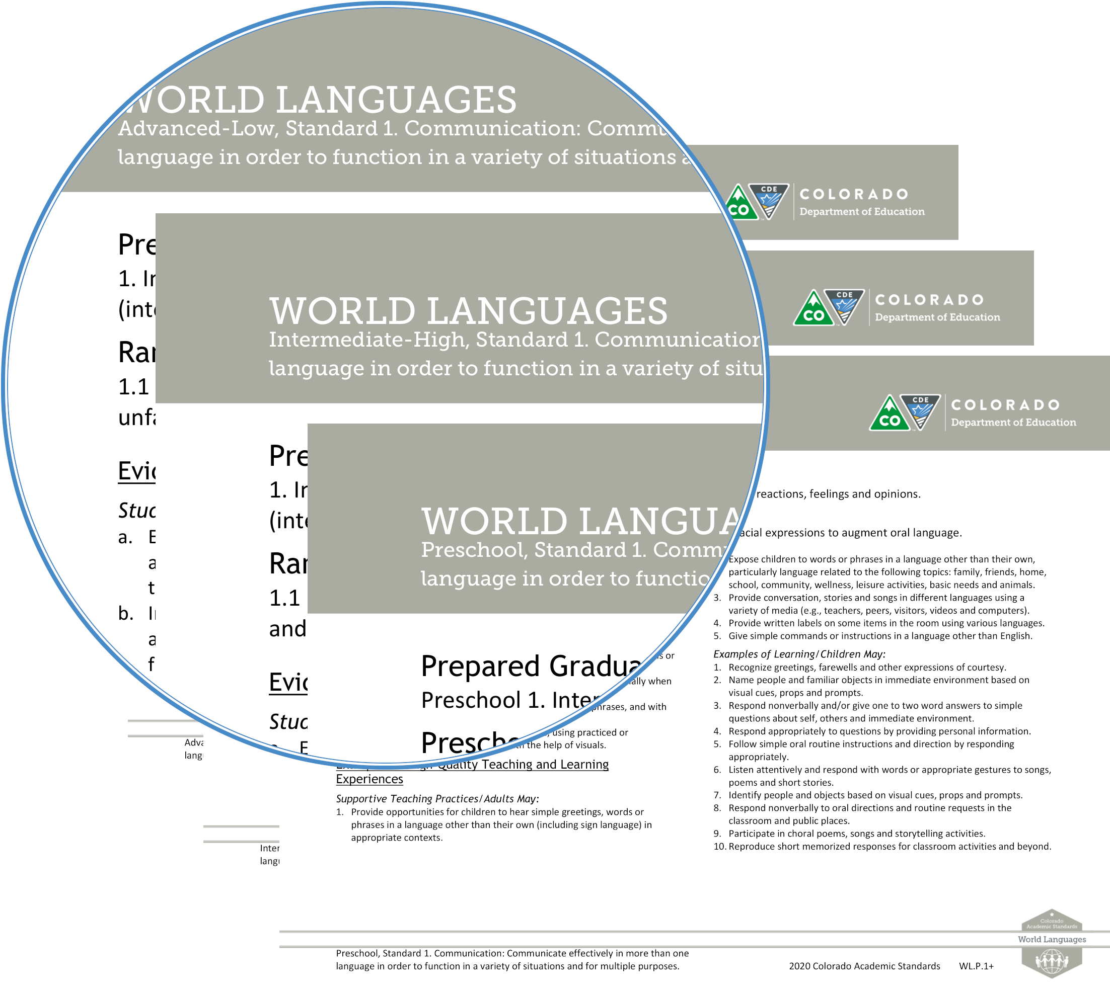
Wider Range of Proficiency Levels
2009/2019 World Language Standards
Fewer Range Levels
Standards ended at the Intermediate-Mid Range Level
Research and Feedback
2009/2010 Standards lacked feedback for students and educators that go beyond the Range Level of Intermediate-Mid
Preschool and Range Levels to Advanced-Low are needed for all 4 standards for multiple needs
Notes:
The 2009 World Language Standards Proficiency Range ended at the Intermediate-Mid Range.
Guided by public feedback there was a lack of a continuum of proficiency levels for language development. These issues were cited in a benchmarking report performed by the American Council on the Teaching of Foreign Languages, ACTFL. The 2018 Review and Revision Committee reorganized the standards into a longer range of proficiency and including all 4 standards making it optimal for language development. The Review and Revision Committee also clarified the language throughout the revised 2020 standards in the new range of World Language standards.
The newest development of World Language Range Levels includes Preschool (being at the very beginning of the range) and Intermediate-High ,and Advanced-Low (both of this being at the top of the range) – all 3 additions offer a complete spectrum allowing multiple entries and exit points for language learning and teaching.

Slide 8
Preschool Standards
The revised 2020 Preschool World Language Standards
All Elements within the standards are included in each Preschool standard
Example: Standard 1 Communication, Element 1.1m 1.2 and 1.3 are all in one Element in Preschool standard labeled +1
Preschool Prepared Graduate Statements
Preparing early learner for Prepared Graduate Statements beginning at Novice-Low
Notes:
Preschool Standards are all encompassing of all elements of the Standards. For Example: Standard 1 Communication, element 1.1, 1.2 and 1.3 are all in one element in Preschool standard labeled 1+. The element is encompassing all the elements appropriate for the Preschool language learner. The natural next step for the young language learner would be Novice-Low Range Level.
Also new are Prepared Graduate statements for specific to the Preschool language learner.

Slide 9
For more information and support: Lourdes “Lulu” Buck ELD & WL Content Specialist email: buck_l@cde.state.co.us

