Slide 1
Colorado Academic Standards 2020 Visual Arts

Slide 2
Information and Purpose
Provide an overview of the standards review and revision process
What to look for in the revised Colorado academic standards document.

Slide 3
Guiding Principles for the Review and Revision
Transparent
Inclusive
Research-informed
Consistent
Substantive
Improvement-oriented
Notes:
Transparent: The department will make every attempt to ensure the decisions and processes for the standards review and revision process are public.
Inclusive: The department will strive to engage key stakeholders in each phase of the standards review and revision process. The review process will include substantial and frequent opportunities for the public to weigh in on every standard.
Research-informed: Throughout the standards review and revision process, the department will base its recommendations on research, lessons learned from other states, and objective, third-party reviews of the Colorado Academic Standards.
Consistent: The standards review and revision process will be consistent with statutory requirements and with past standards reviews.
Substantive: The standards review and revision process will focus on the substance of the actual standards themselves.
Improvement-oriented: The purpose of the standards review and revision process is to improve what exists today rather than start from scratch. The review process will improve Colorado’s current standards based on the feedback of Colorado educators, education leaders, parents, students, community and business leaders, and higher education leaders.

Slide 4
Standards Review and Revision: Roles and Responsibilities
State Board of Education
Made decisions to guide the review and revision process; approve revisions
Stakeholders
Provided feedback on standards review process and proposed revisions
Review Committees
Proposed revisions to the standards for State Board consideration
CDE Staff
Facilitated the review and revision process and staff the content area committees

Slide 5
Committee Decision Making Process
The committees considered the following factors as they proposed revisions to the standards:
How high is the demand for change (i.e., number of stakeholders, variety of stakeholders, number of sources)?
What is the scope of the proposed change (i.e., one grade level, many grade levels, many subject areas)?
What would be the effect (positive or negative) on classroom teaching and student learning?
What might be the potential cost (i.e., financial, staff time and training)?
Do the benefits of a proposed change outweigh the costs?

Slide 6
Turn and Talk Consider your school or district staff and other stakeholders: What impact do you anticipate the revisions might have on the work you do collectively with them?

Slide 7
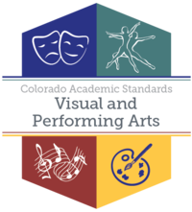
Standards Final Approval
8 Sets of Standards/16 Subjects
Drama/ Theatre
Dance
Music
Visual Arts
2
4
History
Geography
Economics
Civics
Financial Literacy
5

Slide 8
Revisions – All Subjects
New Preschool Template- all content was written in collaboration with Office of Early Childhood and Development team
Prepared Graduate Competencies changed to Prepared Graduate Statements
Right side of template changed from 21st Century Skills and Readiness to Academic Context and Connections
1st bullet-Essential Skills (previously 21st century skills)
2nd bullet- Inquiry Questions (as applicable)
Remaining bullet/s-Unique to Discipline

Slide 9
Revised Visual Arts Standards Document

Slide 10
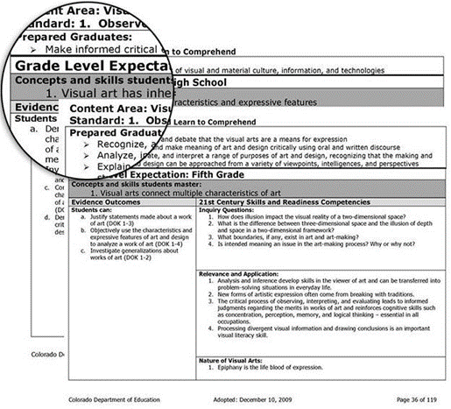
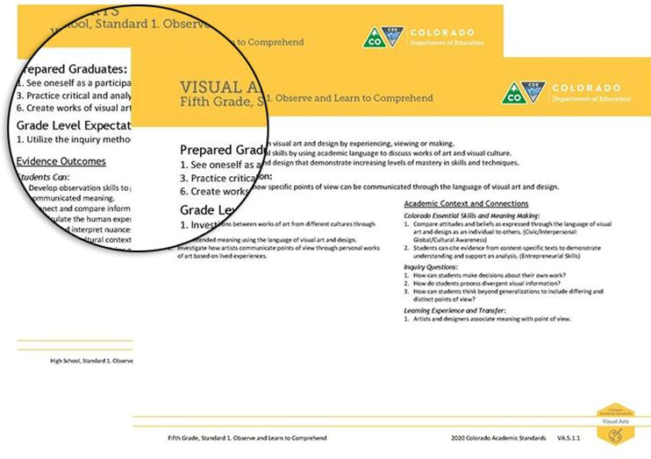
Revised Colorado Academic Standards Document
A Reorganization to Bring Alignment of Skills and Concepts across Grades
2009 Visual Arts Standards
2020 Visual Arts Standards

Slide 11
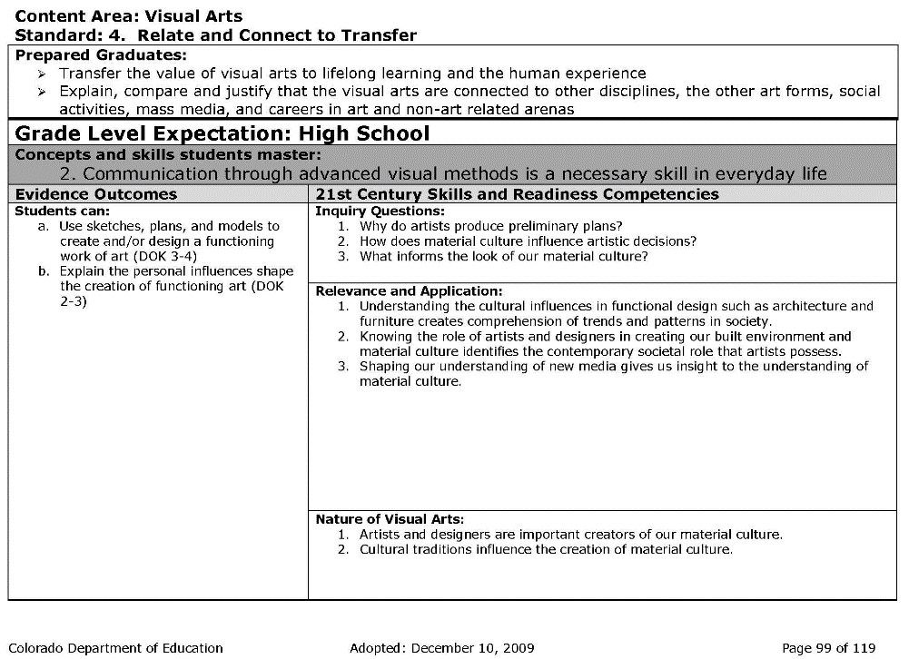
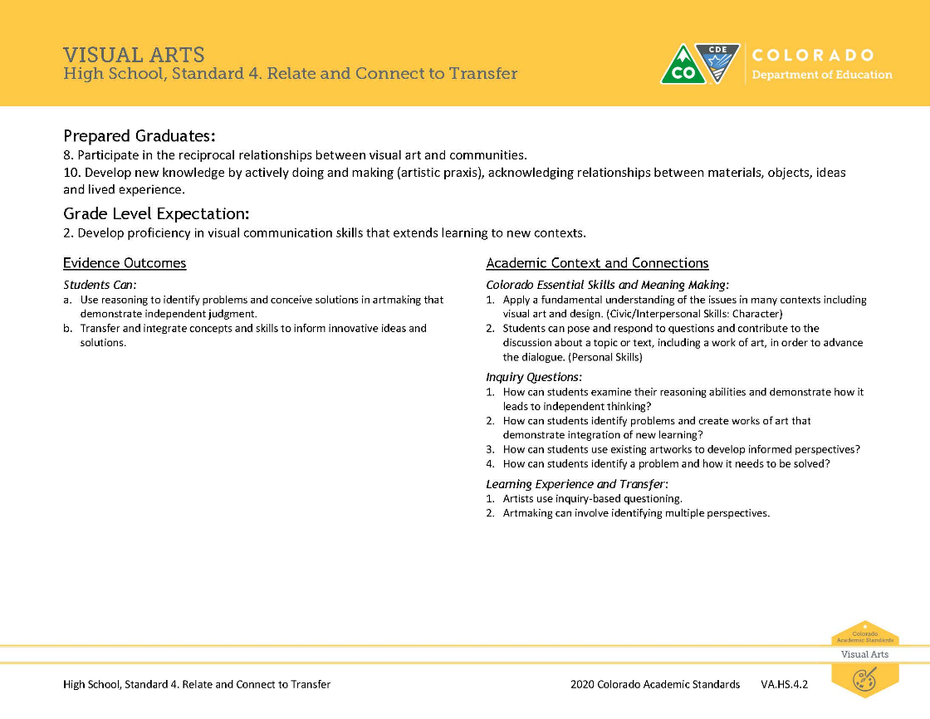
Revised Colorado Academic Standards Document
Verbs Added to Grade Level Expectations for Greater Clarity and Measurability
2009 Visual Arts Standards
2020 Visual Arts Standards

Slide 12
Revised Colorado Academic Standards Document
Reducing Seventeen Prepared Graduate Statements into Ten
2009 Prepared Graduate Competencies
Recognize, articulate, and debate that the visual arts are a means for expression
Make informed critical evaluations of visual and material culture, information, and technologies
Analyze, interpret, and make meaning of art and design critically using oral and written discourse
Explain, demonstrate, and interpret a range of purposes of art and design, recognizing that the making and study of art and design can be approached from a variety of viewpoints, intelligences, and perspectives
Identify, compare, and interpret works of art derived from historical and cultural settings, time periods, and cultural contexts
Identify, compare and justify that the visual arts are a way to acknowledge, exhibit and learn about the diversity of peoples, cultures and ideas
Transfer the value of visual arts to lifelong learning and the human experience
Explain, compare and justify that the visual arts are connected to other disciplines, the other art forms, social activities, mass media, and careers in art and non-art related arenas
Recognize, interpret, and validate that the creative process builds on the development of ideas through a process of inquiry, discovery, and research
Develop and build appropriate mastery in art-making skills, using traditional and new technologies and an understanding of the characteristics and expressive features of art and design
Create works of art that articulate more sophisticated ideas, feelings, emotions, and points of view about art and design through an expanded use of media and technologies
Recognize, compare, and affirm that the making and study of art and design can be approached from a variety of viewpoints, intelligences, and perspectives
Recognize, demonstrate, and debate philosophic arguments about the nature of art and beauty (aesthetics)
Recognize, demonstrate, and debate the place of art and design in history and culture
Use specific criteria to discuss and evaluate works of art
Critique personal work and the work of others with informed criteria
Recognize, articulate, and implement critical thinking in the visual arts by synthesizing, evaluating, and analyzing visual information
2020 Prepared Graduate Statements
1. See oneself as a participant in visual art and design by experiencing, viewing or making.
2. Visually and/or verbally articulate how visual art and design are a means for communication.
3. Practice critical and analytical skills by using academic language to discuss works of art and visual culture.
4. Critique connections between visual art and historic and contemporary philosophies.
5. Interpret works of art and design in the contexts of varied traditions, histories and cultures.
6. Create works of visual art and design that demonstrate increasing levels of mastery in skills and techniques.
7. Allow imagination, curiosity and wonder to guide inquiry and research.
8. Participate in the reciprocal relationships between visual art and communities.
9. Persist in the creative process and innovate from failure.
10. Develop new knowledge by actively doing and making (artistic praxis), acknowledging relationships between materials, objects, ideas and lived experience.

Slide 13
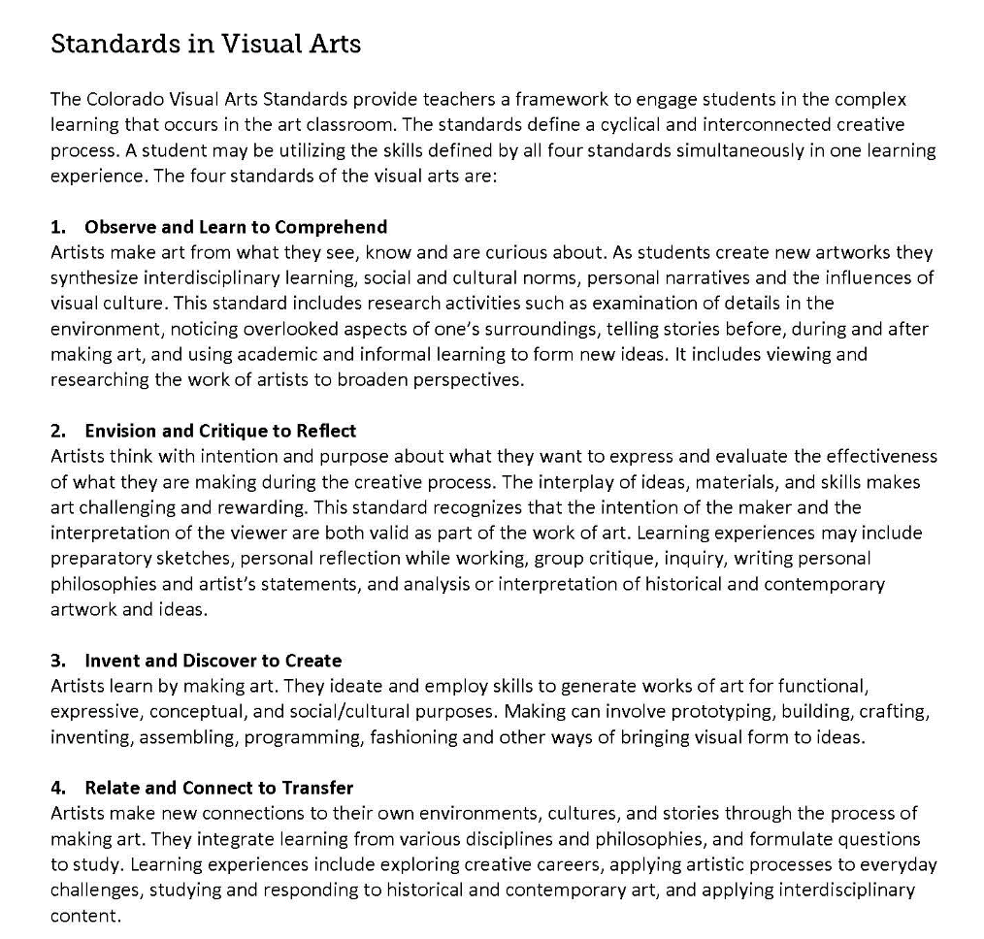
Revised Colorado Academic Standards Document
Defining the Four Standards and how each Fit in the Creative Process of Artmaking
2020 Visual Arts Standards

Slide 14
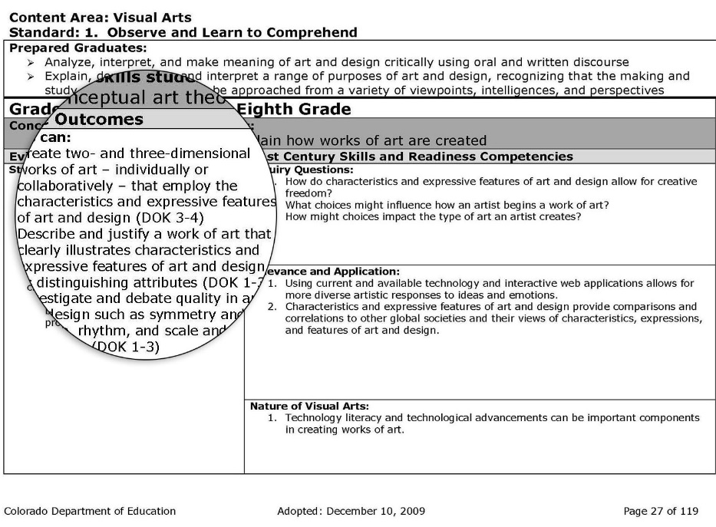
Revised Colorado Academic Standards Document
Intentional use of Academic Art Vocabulary
2009 Visual Arts Standards
2020 Visual Arts Standards

Slide 15
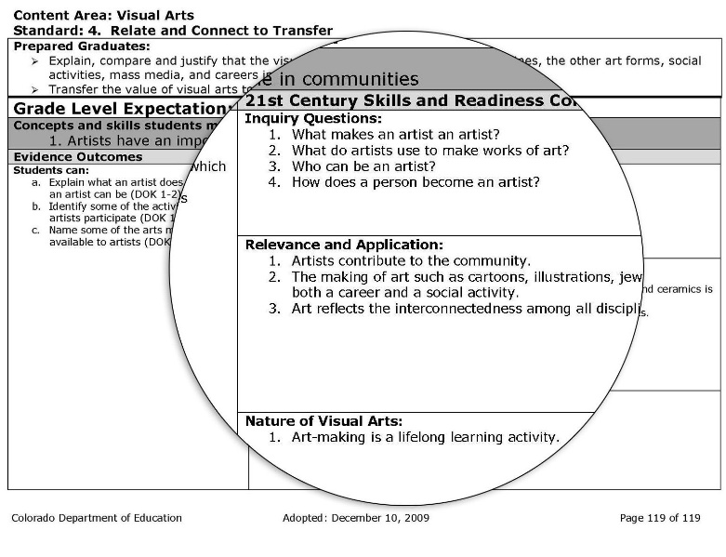
Revised Colorado Academic Standards Document
Academic Context and Connections
2009 Visual Arts Standards
2020 Visual Arts Standards

Slide 16
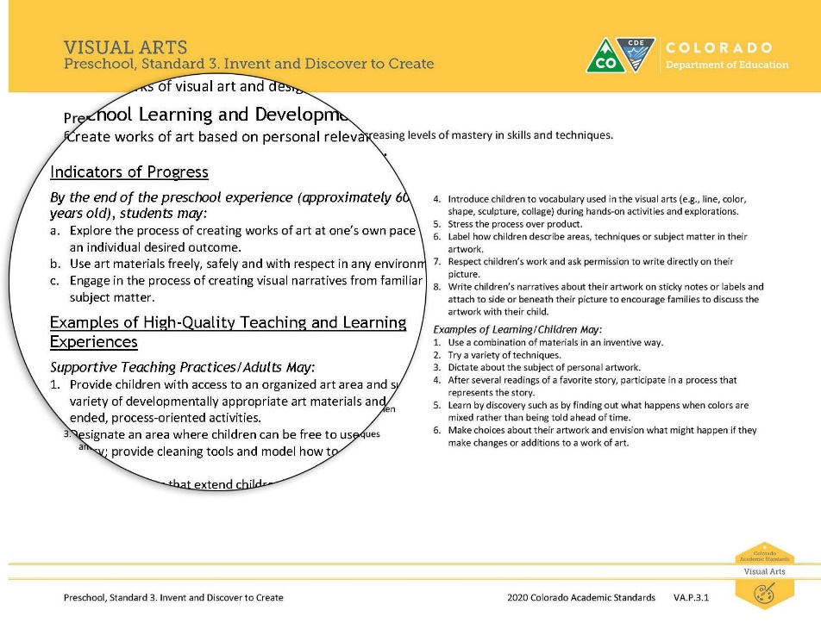
Revised Colorado Academic Standards Document
Preschool standards
2020 Visual Arts Standards

Slide 17
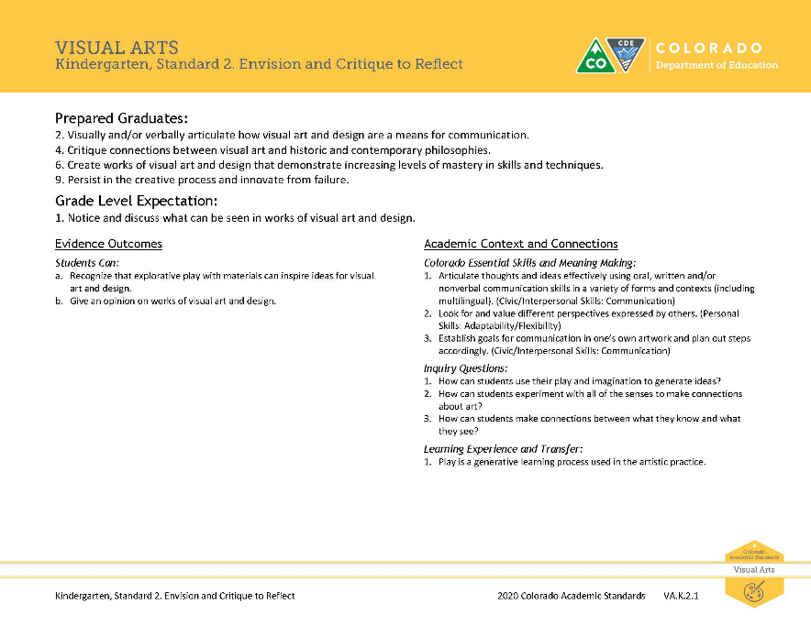
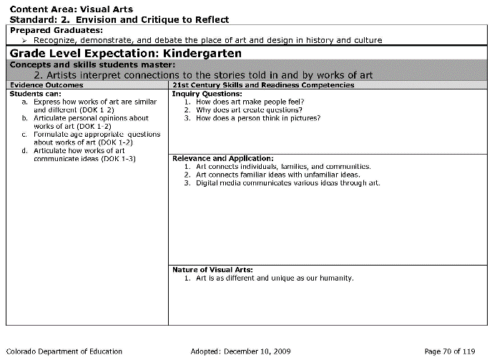
Revised Colorado Academic Standards Document
Elementary standards
2009 Visual Arts Standards
2020 Visual Arts Standards

Slide 18
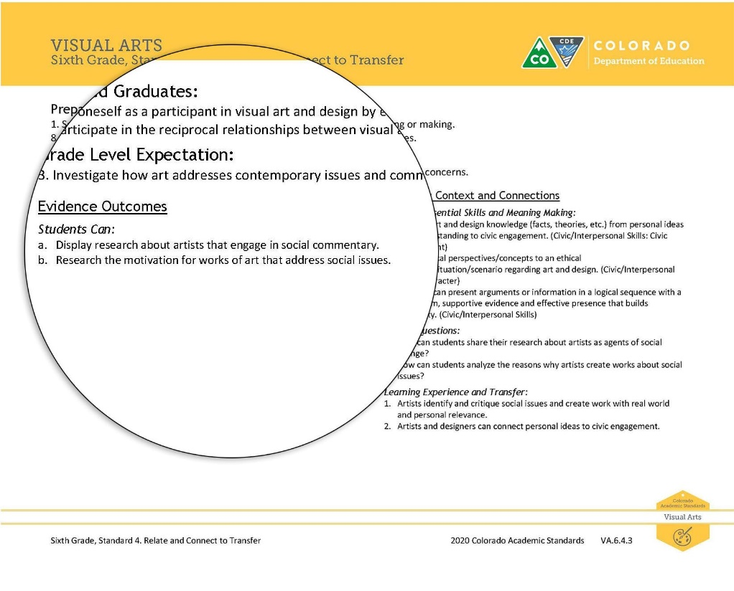
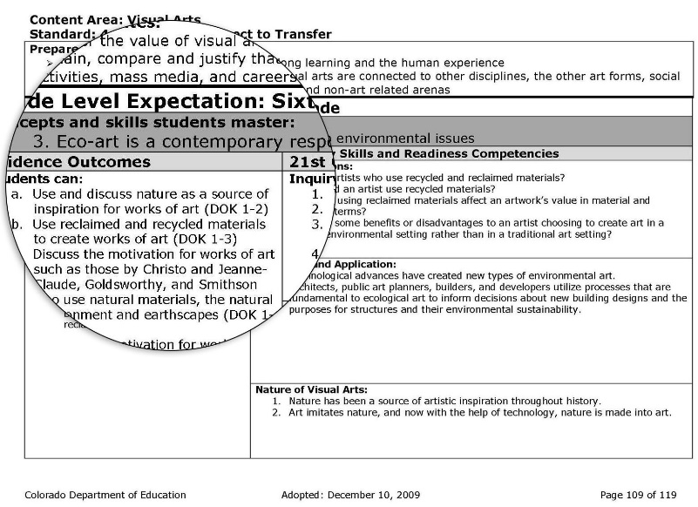
Revised Colorado Academic Standards Document
Middle school standards
2009 Visual Arts Standards
2020 Visual Arts Standards

Slide 19
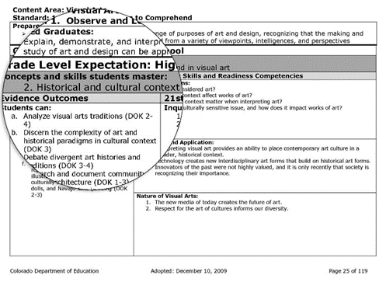
Revised Colorado Academic Standards Document
High school standards
2009 Visual Arts Standards
2020 Visual Arts Standards

Slide 20
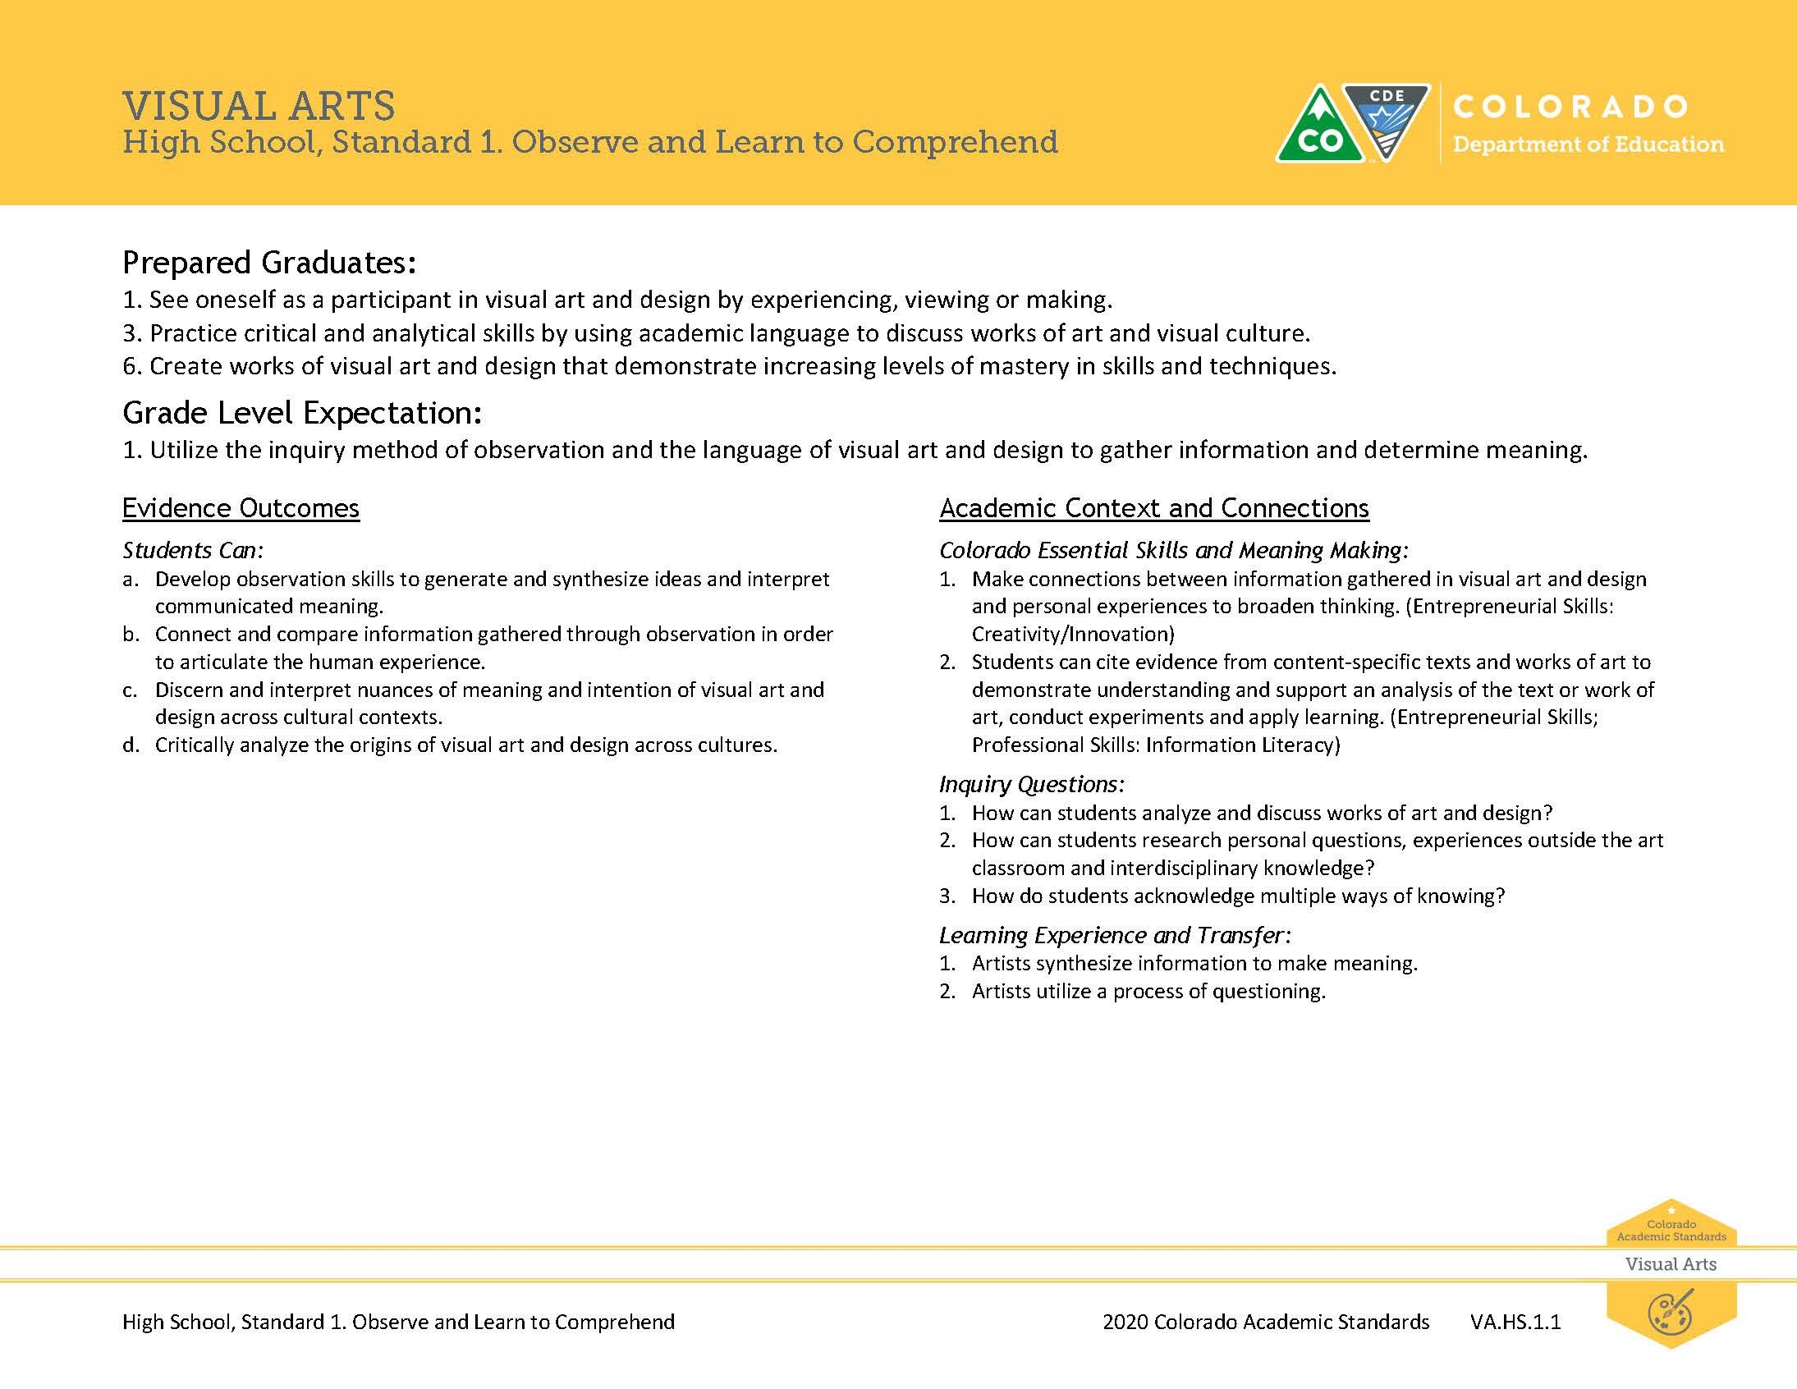
Revised Colorado Academic Standards Document
Donna Goodwin, PhD Visual Arts Consultant Goodwin_D@cde.state.co.us

