Slide 1
Colorado Academic Standards 2020 Music

Slide 2
Information and Purpose
Provide an overview of the standards review and revision process
What to look for in the revised Colorado academic standards document.

Slide 3
Guiding Principles for the Review and Revision
Transparent
Inclusive
Research-informed
Consistent
Substantive
Improvement-oriented
Notes:
Transparent: The department will make every attempt to ensure the decisions and processes for the standards review and revision process are public.
Inclusive: The department will strive to engage key stakeholders in each phase of the standards review and revision process. The review process will include substantial and frequent opportunities for the public to weigh in on every standard.
Research-informed: Throughout the standards review and revision process, the department will base its recommendations on research, lessons learned from other states, and objective, third-party reviews of the Colorado Academic Standards.
Consistent: The standards review and revision process will be consistent with statutory requirements and with past standards reviews.
Substantive: The standards review and revision process will focus on the substance of the actual standards themselves.
Improvement-oriented: The purpose of the standards review and revision process is to improve what exists today rather than start from scratch. The review process will improve Colorado’s current standards based on the feedback of Colorado educators, education leaders, parents, students, community and business leaders, and higher education leaders.

Slide 4
Standards Review and Revision: Roles and Responsibilities
State Board of Education
Made decisions to guide the review and revision process; approve revisions
Stakeholders
Provided feedback on standards review process and proposed revisions
Review Committees
Proposed revisions to the standards for State Board consideration
CDE Staff
Facilitated the review and revision process and staff the content area committees

Slide 5
Committee Decision Making Process
The committees considered the following factors as they proposed revisions to the standards:
How high is the demand for change (i.e., number of stakeholders, variety of stakeholders, number of sources)?
What is the scope of the proposed change (i.e., one grade level, many grade levels, many subject areas)?
What would be the effect (positive or negative) on classroom teaching and student learning?
What might be the potential cost (i.e., financial, staff time and training)?
Do the benefits of a proposed change outweigh the costs?

Slide 6
Turn and Talk Consider your school or district staff and other stakeholders: What impact do you anticipate the revisions might have on the work you do collectively with them?

Slide 7
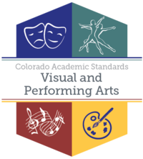
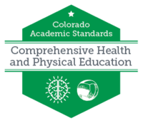
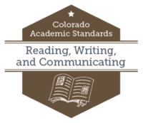
Standards Final Approval
8 Sets of Standards/16 Subjects
Drama/ Theatre
Dance
Music
Visual Arts
2
4
History
Geography
Economics
Civics
Financial Literacy
5

Slide 8
Revisions – All Subjects
New Preschool Template- all content was written in collaboration with Office of Early Childhood and Development team
Prepared Graduate Competencies changed to Prepared Graduate Statements
Right side of template changed from 21st Century Skills and Readiness to Academic Context and Connections
1st bullet-Essential Skills (previously 21st century skills)
2nd bullet- Inquiry Questions (as applicable)
Remaining bullet/s-Unique to Discipline

Slide 9
Revised Music Standards Document

Slide 10
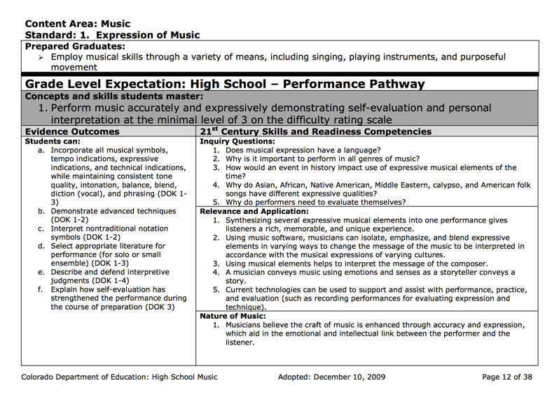
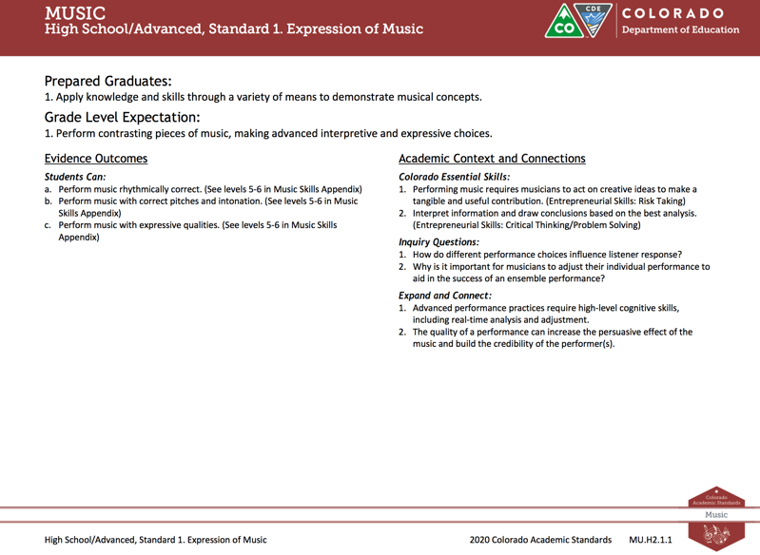
Revised Colorado Academic Standards Document
Improved Clarity and Alignment
2010 Music Standards
2018 Music Standards

Slide 11
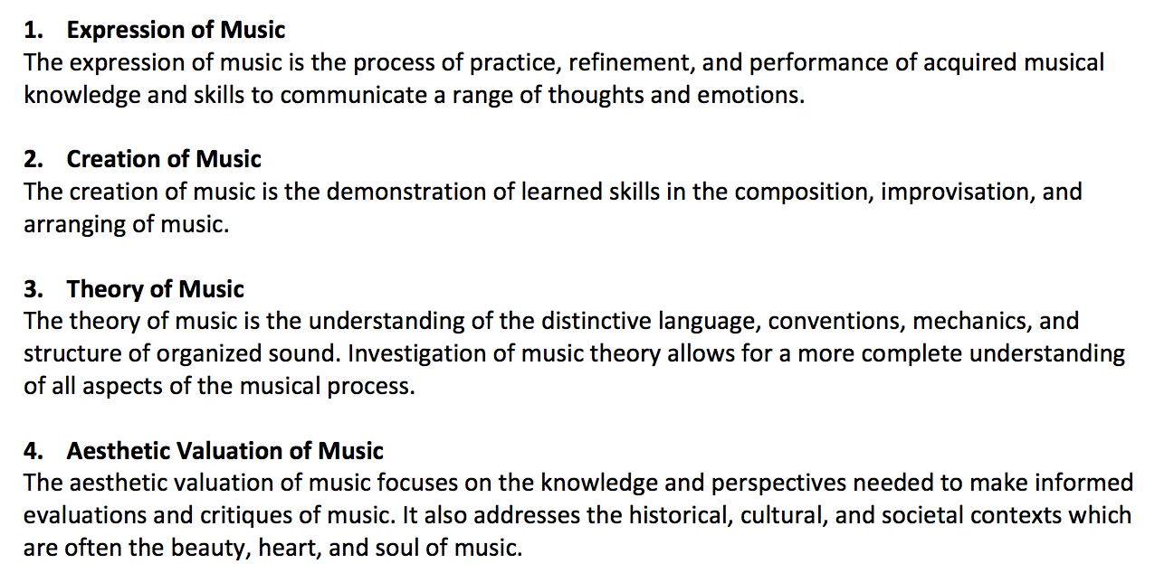
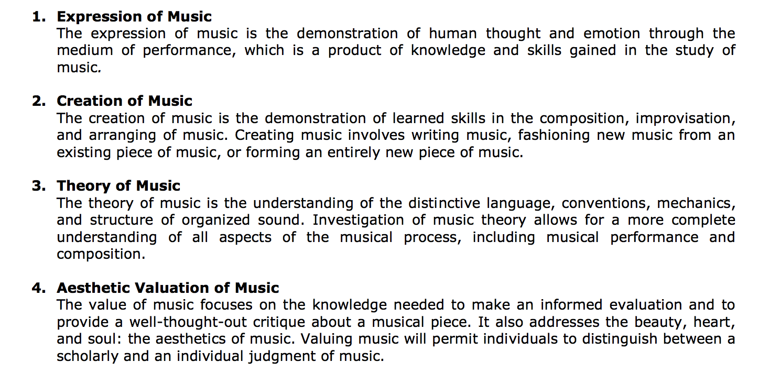
Revised Colorado Academic Standards Document
Updated Definitions of the Four Music Standards
2018 Music Standards Definitions

Slide 12
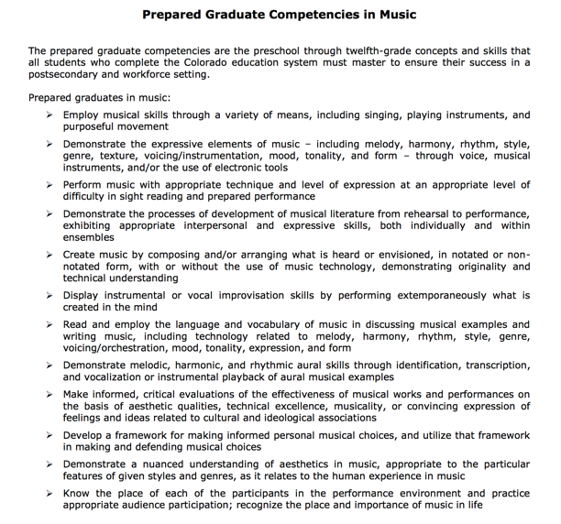
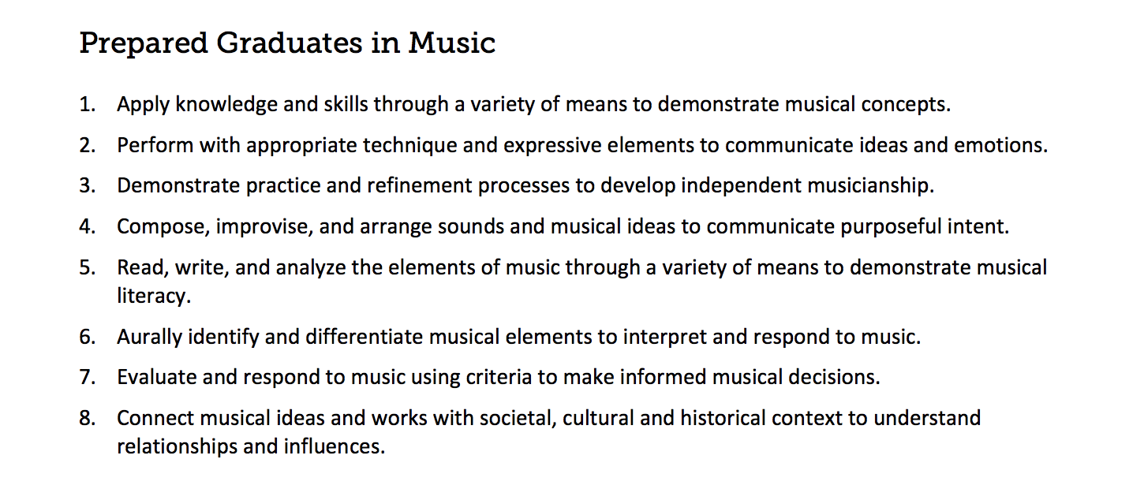
Revised Colorado Academic Standards Document
Reducing Seventeen Prepared Graduate Statements into Eight

Slide 13
Revised Colorado Academic Standards Document
Academic Content and Connections: Essential Skills, Inquiry Questions, and Expand and Connect

Slide 14
Revised Colorado Academic Standards Document
Preschool standards

Slide 15
Revised Colorado Academic Standards Document
Skill Acquisition Levels in Secondary Music
Sixth Grade/Novice
Seventh Grade/Intermediate
Eighth Grade/Proficient
High School/Accomplished
High School/Advanced

Slide 16
Revised Colorado Academic Standards Document
Carla E. Aguilar, PhD Music Consultant Aguilar_C@cde.state.co.us

