Slide 1
Colorado Academic Standards 2020 Drama and Theatre Arts

Slide 2
Information and Purpose
Provide an overview of the standards review and revision process
What to look for in the revised Colorado academic standards document.

Slide 3
Guiding Principles for the Review and Revision
Transparent
Inclusive
Research-informed
Consistent
Substantive
Improvement-oriented
Notes:
Transparent: The department will make every attempt to ensure the decisions and processes for the standards review and revision process are public.
Inclusive: The department will strive to engage key stakeholders in each phase of the standards review and revision process. The review process will include substantial and frequent opportunities for the public to weigh in on every standard.
Research-informed: Throughout the standards review and revision process, the department will base its recommendations on research, lessons learned from other states, and objective, third-party reviews of the Colorado Academic Standards.
Consistent: The standards review and revision process will be consistent with statutory requirements and with past standards reviews.
Substantive: The standards review and revision process will focus on the substance of the actual standards themselves.
Improvement-oriented: The purpose of the standards review and revision process is to improve what exists today rather than start from scratch. The review process will improve Colorado’s current standards based on the feedback of Colorado educators, education leaders, parents, students, community and business leaders, and higher education leaders.

Slide 4
Standards Review and Revision: Roles and Responsibilities
State Board of Education
Made decisions to guide the review and revision process; approve revisions
Stakeholders
Provided feedback on standards review process and proposed revisions
Review Committees
Proposed revisions to the standards for State Board consideration
CDE Staff
Facilitated the review and revision process and staff the content area committees

Slide 5
Committee Decision Making Process
The committees considered the following factors as they proposed revisions to the standards:
How high is the demand for change (i.e., number of stakeholders, variety of stakeholders, number of sources)?
What is the scope of the proposed change (i.e., one grade level, many grade levels, many subject areas)?
What would be the effect (positive or negative) on classroom teaching and student learning?
What might be the potential cost (i.e., financial, staff time and training)?
Do the benefits of a proposed change outweigh the costs?

Slide 6
Turn and Talk Consider your school or district staff and other stakeholders: What impact do you anticipate the revisions might have on the work you do collectively with them?

Slide 7
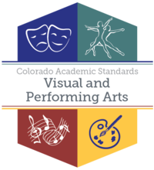
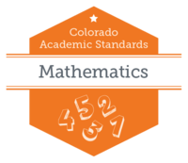
Standards Final Approval
8 Sets of Standards/16 Subjects
Drama/ Theatre
Dance
Music
Visual Arts
2
4
History
Geography
Economics
Civics
Financial Literacy
5

Slide 8
Recommendations – All Subjects
New Preschool Template- all content was written in collaboration with Office of Early Childhood and Development team
Prepared Graduate Competencies changed to Prepared Graduate Statements
Right side of template changed from 21st Century Skills and Readiness to Academic Context and Connections
1st bullet-Essential Skills (previously 21st century skills)
2nd bullet- Inquiry Questions (as applicable)
Remaining bullet/s-Unique to Discipline

Slide 9
Revised Standards Document

Slide 10
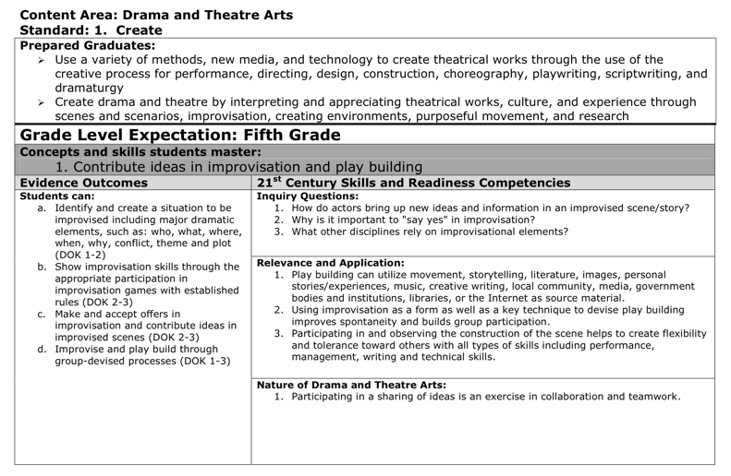
Revised Colorado Academic Standards Document
A Reorganization to Bring Greater Focus and Stronger Connections to Process in Drama and Theatre Arts (DTA)
2010 DTA Standards
2018 DTA Standards
The committee combined and refined the language of individual EOs. Any changes made were to add specificity and clarity, not to fundamentally change what students are expected to learn.

Slide 11
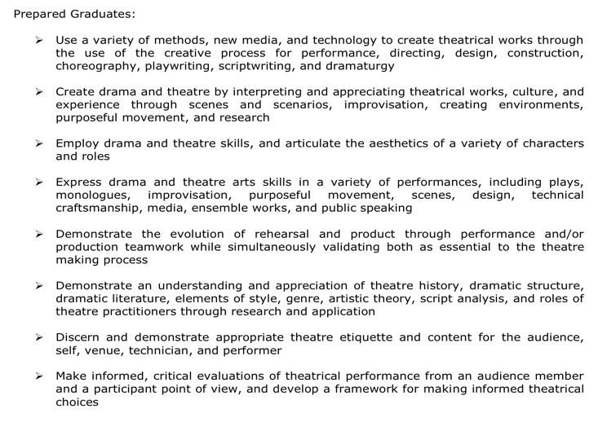
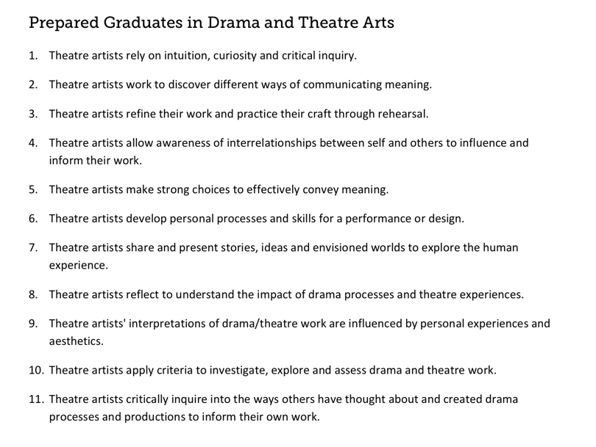
Revised Colorado Academic Standards Document
Prepared Graduate Competencies VS Prepared Graduate Statements in DTA
2010 Prepared Graduate Competencies in DTA
2018 Dance Prepared Graduate Statements in DTA
In the 2018 revision, the term Prepared Graduate Competencies was changed to Prepared Graduate statements and the eight DTA concepts and skills were expanded to eleven statements.

Slide 12
Revised Colorado Academic Standards Document
In addition, the committee aligned all Prepared Graduate statements and Grade Level Expectations to span across grade levels preschool through twelfth-grade. This insures that students gain consistency of instruction, information and creative skills from one grade to the next and also across all grade bands.
Preschool - 12th Grade
Standard |  | Grade Level Expectation | Prepared Graduate Statement
1. Create |  | Generate and conceptualize artistic ideas and work | Theatre artists rely on intuition, curiosity, and critical inquiry
 |  | Organize and develop artistic ideas and work | Theatre artists work to discover different ways of communicating meaning
 |  | Refine and complete artistic work | Theatre artists refine their work and practice their craft through rehearsal.
 |  | Synthesize and relate knowledge and personal experience to make art | Theatre artists allow awareness of interrelationships between self and others to influence and inform their work.
2. Perform |  | Select, analyze, and interpret artistic work for presentation | Theatre artists make strong choices to effectively convey meaning.
 |  | Develop and refine artistic techniques, choices, and work for presentation | Theatre artists develop personal processes and skills for a performance or design.
 |  | Convey meaning through the presentation of artistic work | Theatre artists share and present stories, ideas, and envisioned worlds to explore the human experience.
3. Critically Respond |  | Perceive and analyze artistic work | Theatre artists reflect to understand the impact of drama processes and theatre experiences
 |  | Interpret intent and meaning in artistic work | Theatre artists' interpretations of drama/theatre work are influenced by personal experiences and aesthetics
 |  | Apply criteria to evaluate artistic work | Theatre artists apply criteria to investigate, explore, and assess drama and theatre work
 |  | Relate artistic ideas and works with societal, cultural, and historical context to deepen understanding | Theatre artists critically inquire into the ways others have thought about and created drama processes and productions to inform their own work

Slide 13
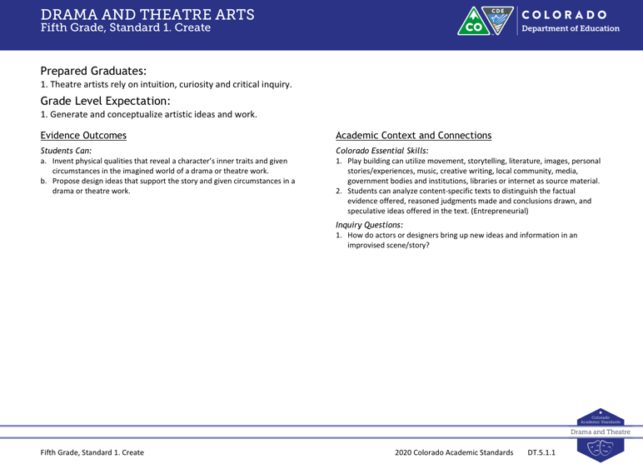
Revised Colorado Academic Standards Document
Right Side categories for DTA
2010 DTA Standards
2018 DTA Standards
The committee replaced the 21st Century Skills and Readiness Competencies subheading with Colorado Essential Skills. These skills are content specific and connect directly to the Essential Skills Guidance Resource document. The categories of Relevance and Application and Nature of Drama and Theatre Arts were deleted all together, leaving the category of Inquiry Questions.

