Slide 1
Colorado Academic Standards 2020 ADD SUBJECT AREA HERE

Slide 2
Information and Purpose
Provide an overview of the standards review and revision process
What to look for in the revised Colorado academic standards document.

Slide 3
Guiding Principles for the Review and Revision
Transparent
Inclusive
Research-informed
Consistent
Substantive
Improvement-oriented
Notes:
Transparent: The department will make every attempt to ensure the decisions and processes for the standards review and revision process are public.
Inclusive: The department will strive to engage key stakeholders in each phase of the standards review and revision process. The review process will include substantial and frequent opportunities for the public to weigh in on every standard.
Research-informed: Throughout the standards review and revision process, the department will base its recommendations on research, lessons learned from other states, and objective, third-party reviews of the Colorado Academic Standards.
Consistent: The standards review and revision process will be consistent with statutory requirements and with past standards reviews.
Substantive: The standards review and revision process will focus on the substance of the actual standards themselves.
Improvement-oriented: The purpose of the standards review and revision process is to improve what exists today rather than start from scratch. The review process will improve Colorado’s current standards based on the feedback of Colorado educators, education leaders, parents, students, community and business leaders, and higher education leaders.

Slide 4
Standards Review and Revision: Roles and Responsibilities
State Board of Education
Made decisions to guide the review and revision process; approve revisions
Stakeholders
Provided feedback on standards review process and proposed revisions
Review Committees
Proposed revisions to the standards for State Board consideration
CDE Staff
Facilitated the review and revision process and staff the content area committees

Slide 5
Committee Decision Making Process
The committees considered the following factors as they proposed revisions to the standards:
How high is the demand for change (i.e., number of stakeholders, variety of stakeholders, number of sources)?
What is the scope of the proposed change (i.e., one grade level, many grade levels, many subject areas)?
What would be the effect (positive or negative) on classroom teaching and student learning?
What might be the potential cost (i.e., financial, staff time and training)?
Do the benefits of a proposed change outweigh the costs?

Slide 6
Turn and Talk Consider your school or district staff and other stakeholders: What impact do you anticipate the revisions might have on the work you do collectively with them?

Slide 7
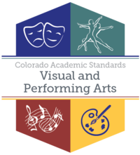
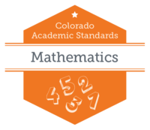
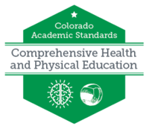
Standards Final Approval
8 Sets of Standards/16 Subjects
Drama/ Theatre
Dance
Music
Visual Arts
2
4
History
Geography
Economics
Civics
Financial Literacy
5

Slide 8
Recommendations – All Subjects
New Preschool Template- all content was written in collaboration with Office of Early Childhood and Development team
Prepared Graduate Competencies changed to Prepared Graduate Statements
Right side of template changed from 21st Century Skills and Readiness to Academic Context and Connections
1st bullet-Essential Skills (previously 21st century skills)
2nd bullet- Inquiry Questions (as applicable)
Remaining bullet/s-Unique to Discipline

Slide 9
Revised Standards Document

Slide 10
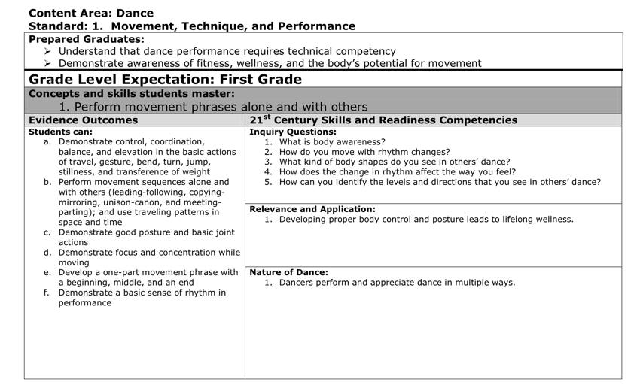
Revised Colorado Academic Standards Document
Consolidation of dance content to add clarity and stronger connections across grade levels
2010 Dance Standards
2018 Dance Standards
The revision committee combined EOs, specifically in grades K-5. In all but a small number of cases, the committee retained the language of individual EOs. Any changes made were to add specificity and clarity, not to fundamentally change what students are expected to learn.

Slide 11
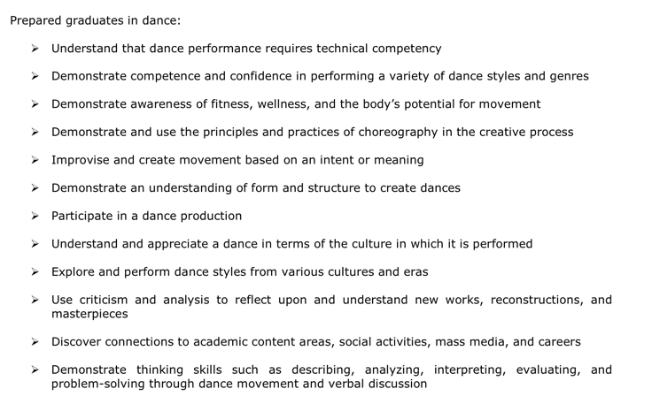
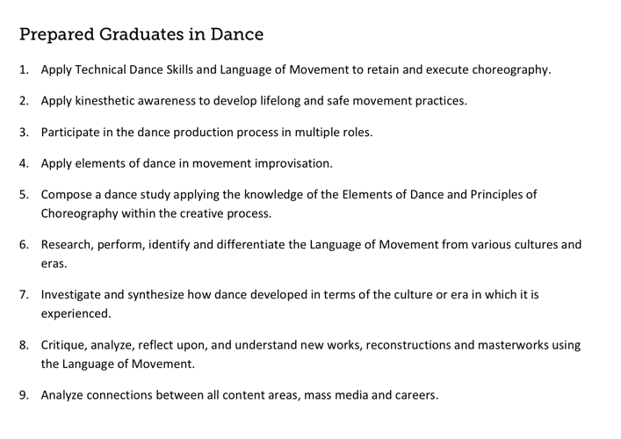
Revised Colorado Academic Standards Document
Prepared Graduate Competencies VS Prepared Graduate Statements in Dance
2010 Prepared Graduate Competencies in Dance
2018 Dance Prepared Graduate Statements in Dance
In the 2018 revision, the term Prepared Graduate Competencies was changed to Prepared Graduate statements and consolidated the twelve concepts and skills to nine statements.

Slide 12
Revised Colorado Academic Standards Document
Right Side categories for Dance
2010 Dance Standards
2018 Dance Standards
The committee replaced the 21st Century Skills and Readiness Competencies subheading with Colorado Essential Skills. These skills are content specific and connect directly to the Essential Skills Guidance Resource document. The category of Relevance and Application was deleted all together, leaving the categories of Inquiry Questions and Nature of Dance.

