Slide 1
Module 13:
Exploring the Instructional Shifts Inherent in the 2020 CAS
Notes:
[Estimated time for this module: 30 minutes]

Slide 2
Goals and Objectives
Educators will be able to:
Identify the implicit instructional shifts in the Revised 2020 CAS.
Explore what the students should be doing as evidenced in the Revised 2020 CAS.
Discuss the importance of matching instructional planning to what the students should be doing as evidenced in the Revised 2020 CAS.
Notes:
[Estimated time: 1 minute]
Read the slide.

Slide 3
Warm-up
On your notecatcher sign your name 5 times.
2. Sign your name 5 more times.
3. Switch hands and sign with your other hand 5 more times
Notes:
[Estimated time: 5 minutes]
Provide a piece of paper for each participant. Invite them to sign their name 5 times. This will take a minute or so.
Ask them to do it again.
Now, ask them to put the pen in their other hand and do 5 signatures again. This will cause much hilarity/huffing-and-puffing etc.
Then distract teachers by talking about how hard it was, how people struggled, anything really to take their mind off the 'exercise'.
Then ask them to sign their signature again 5 times.
Now, at this point, most people switch back to their normal hands and do 5 signatures. Let them do this.
Summarize... why did they switch back to their usual writing hand? You certainly didn't tell them to. As far as you were concerned, the pen should have been in the 'other' hand and you didn't say otherwise. Lesson: people will almost always revert to what they know unless there's a conscious effort not to.
This a light-hearted exercise and only takes a few minutes, but is a good intro to change and just why so many people struggle with it. For some educators, changing their instruction may seem daunting as they consider the student learning demands of the standards.

Slide 4
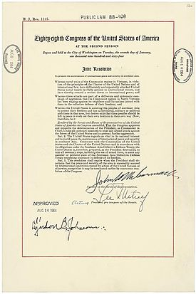
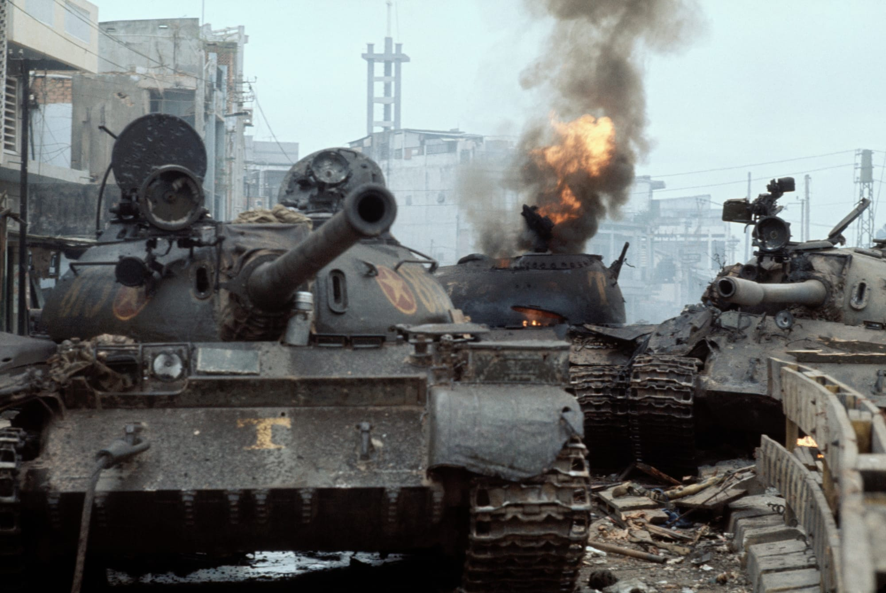
Is a Verb just a Verb?
Does your current instructional planning reflect the inclusion of the skills students should be demonstrating? For example, if students are “evaluating primary sources…,” what should instruction look like in order for the students to conduct an evaluation of primary sources? What should they be doing?
Notes:
[Estimated time: 5 minutes]
Ask teachers to think about the verbs in the standards… The verbs are indicative of what the students should be doing to demonstrate mastery of the standards. As such, instruction must reflect the and allow for opportunities for students to demonstrate their knowledge and understanding of the content and skills by doing.
Explain that instructional shifts means that teachers need to what the students are doing and match it to their instruction.
Have teachers discuss their current instructional planning strategies - how do they ensure that the “doing” (e.g., the verbs of the standards) are explicitly included?

Slide 5
Doing is a Verb!
Scenario:
High School Standard 1: History, GLE2, EO.b - Investigate causes and effects of significant events throughout United States History
The EO asks students to “investigate” (what the students are doing)
What should instruction look like so that students are conducting an investigation?
Instruction: Students are provided multiple primary sources to analyze for answering the question: What are the causes and effects of the Vietnam War?” The teacher collects the primary sources for analysis and facilitates learning stations.
Notes:
[Estimated time: 5 minutes]
Have teachers discuss the scenario. Ask them to brainstorm instructional strategies that would have students evaluating primary sources.
“Fly in” the instructional idea - Ask: how is this different than “traditional” instruction?

Slide 6
Notes:
[Estimated time: 5 minutes]
Explain to teachers that the instructional shifts may need to occur to effectively address the standards. Take special notice of the standards found throughout the standards page(s).
In this social studies example you will notice that evidence outcomes a-i focus on students demonstrating various historical thinking skills. In order for students to demonstrate mastery of these skills, the classroom, teaching strategies, procedures, and practices need to support student practice and demonstration of these skills. As a foundation, a classroom needs to have clear student norms and expectations, a supportive learning environment that encourages student collaboration. In addition, the instructional shifts that should take place allow for a student centered approach that is accessible, equitable, real, and relevant for all students.
Another aspect of the standards that can inform shifts in teaching strategies, procedure, and practices is the Academic Content and Connections. These essential personal and interpersonal skills should be considered when planning for instruction. Other standards content areas have other practices and content specific skills that should also be considered when teaching.

Slide 7
Think, Pair, and Share
With a partner, share your observations and discuss your rationale for the way you highlighted your document.
Did you have any “Ah ha” moments?
What do you still wonder about?
Notes:
[Estimated time: 5-10 minutes]
Have educators work in pairs or small groups (no more than 4) to share their observations and discuss their rationale and wonderings.
What are the standards asking students to understand, know, and be able to do?
Where do you see connections to disciplinary literacy?
How do you see the Colorado Essential Skills being incorporated throughout the document?
NOTE: The revised science standards incorporate the Next Generation Science Standards (NGSS), so teachers may identify the cross-coding within the evidence outcomes and elaboration on the GLE sections of the standards.

Slide 8
Assessment: Twitter Post
Summarize the important ideas from this module in 140 characters or less!
Notes:
[Estimated time: 2 minutes]
Educators should write their twitter post on the notecatcher.

Slide 9
Questions, Comments, & Concerns
Please contact the Office of Standards and Instructional Support for additional information. Refer to the Standards Implementation guide for contact information.
Notes:
[Estimated time: 2-3 minutes]
Address any Parking Lot questions, comments, and/or concerns

