Slide 1
Rubric Design for Performance Assessment

Slide 2
Key Questions
What is our rubric design goal? A common teacher designed rubric, a student generated rubric, or a combination of both that meet in the middle?
How do we create a tool that serves to provide both formative and summative feedback?
How can we intentionally design the rubric to ensure rigor is appropriate and relevancy/authenticity is more transparent to learners?

Slide 3
Using Rubrics Formatively
As you watch, consider:
Where do you see evidences of rubrics being used as a formative learning support?
Notes:
If the first time students encounter the rubric is when they receive feedback on their summative product, that is a missed opportunity for learning and growth.

Slide 4
Using Rubrics Summatively
As you watch, consider:
What structures did this school need to have in place to make an evidence-based determination of student competency?
Descriptive Feedback Helps All Students
EL Education

Slide 5
We’re focusing narrowly on designing Single Point Rubrics
Notes:
Meaghan

Slide 6
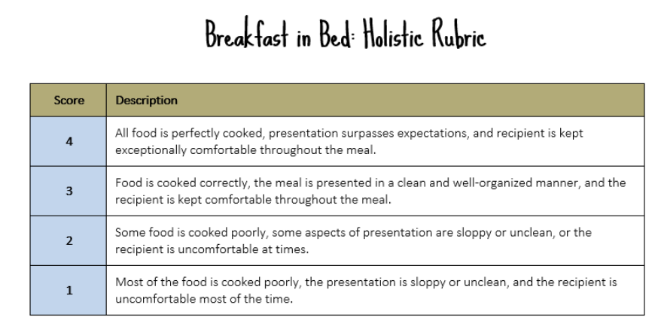
Not Holistic Rubrics
From Cult of Pedagogy
Notes:
Not holistic rubrics, where the student work product is given a high-level score

Slide 7
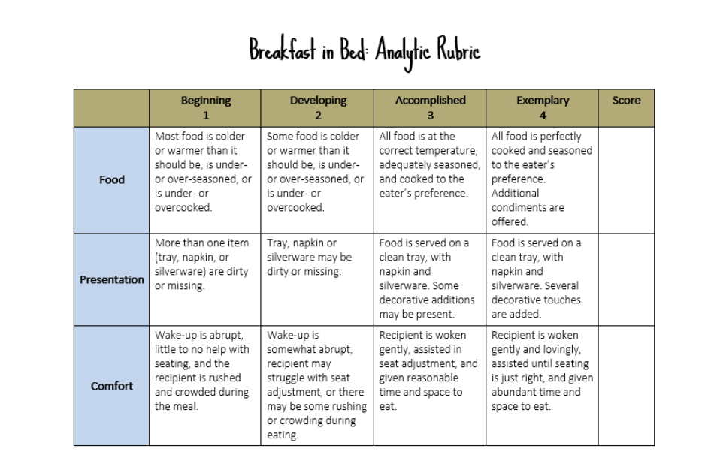
Not Analytic Rubrics
From Cult of Pedagogy
Notes:
Not analytic rubrics, where scoring criteria is broken down so that students get more detailed feedback about which specific parts of their work product are strong and which need improvement

Slide 8
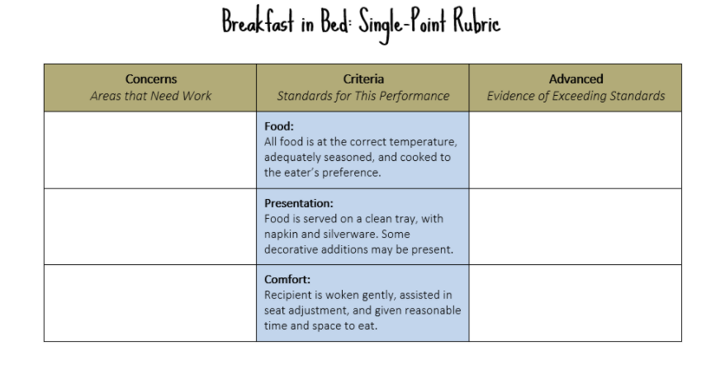
Single Point Rubrics
From Cult of Pedagogy
Notes:
But rather single point rubrics, which only describe the criteria for proficiency. They are distinct from the other two types of rubrics because they don’t describe multiple levels of performance. Instead, they focus in on a simple binary: meeting expectations or not yet.

Slide 9
Single Point Rubrics
Single Point Rubrics
Support student-centered learning because they
Give space to reflect on both strengths and weaknesses in student work
Don’t place boundaries on student performance
Work against the tendency for students’ to rank and compare themselves to each other
Emphasize the feedback rather than the grade
Create more flexibility without sacrificing clarity
Have less text, so they are easier for students to digest
From Edutopia
Notes:
Meaghan

Slide 10
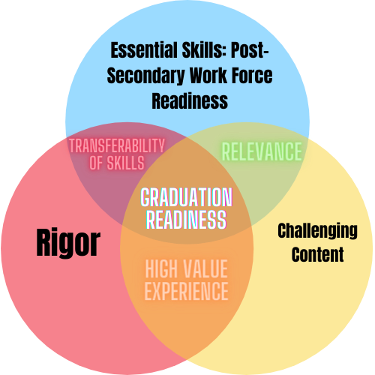
What does this look like in the Colorado context?
Rubrics clearly communicate what it looks like to integrate these 3 overlapping expectations
Notes:
Catherine: Performance assessment design is asking us to integrate pieces from these three strands: the Essential Skills, content standards and overall rigor. The choice learning sessions, rigor, formative feedback and authenticity, were designed to address the areas where these three overlap one another, as it is that overlap that really brings depth and richness to performance assessments. The rubrics for the performance tasks are where all three of these need to be intertwined in a way that is transparent and establishes a shared understanding of the expectations and evidence requirements.

Slide 11
What does this look like in the Colorado context?
Rubrics clearly communicate what it looks like to integrate these 3 overlapping expectations
Notes:
Performance assessment design is asking us to integrate pieces from these three strands: the Essential Skills, content standards and overall rigor. The choice learning sessions, rigor, formative feedback and authenticity, were designed to address the areas where these three overlap one another, as it is that overlap that really brings depth and richness to performance assessments. The rubrics for the performance tasks are where all three of these need to be intertwined in a way that is transparent and establishes a shared understanding of the expectations and evidence requirements.

