Slide 1
Rubric Design for Performance Assessment
A Step-by-Step Guide

Slide 2
Performance Assessment Cycle
Task Design
Rubric Design
Design or adapt an aligned rubric for the task
Analysis
Calibration
Validation
Instruction
Rubric Design

Slide 3
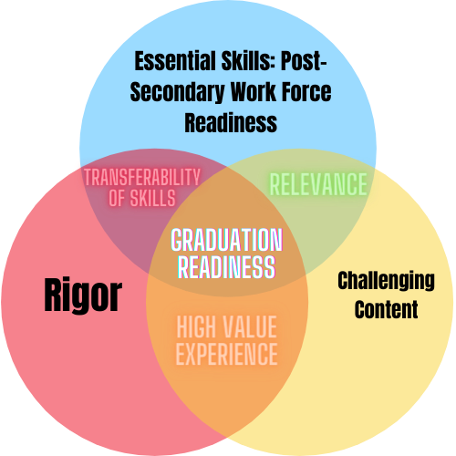
What does this look like in the Colorado context?
Rubrics clearly communicate what it looks like to integrate these 3 overlapping expectations
Notes:
Performance assessment design is asking us to integrate pieces from these three strands: the Essential Skills, content standards and overall rigor. The choice learning sessions, rigor, formative feedback and authenticity, were designed to address the areas where these three overlap one another, as it is that overlap that really brings depth and richness to performance assessments. The rubrics for the performance tasks are where all three of these need to be intertwined in a way that is transparent and establishes a shared understanding of the expectations and evidence requirements.

Slide 4
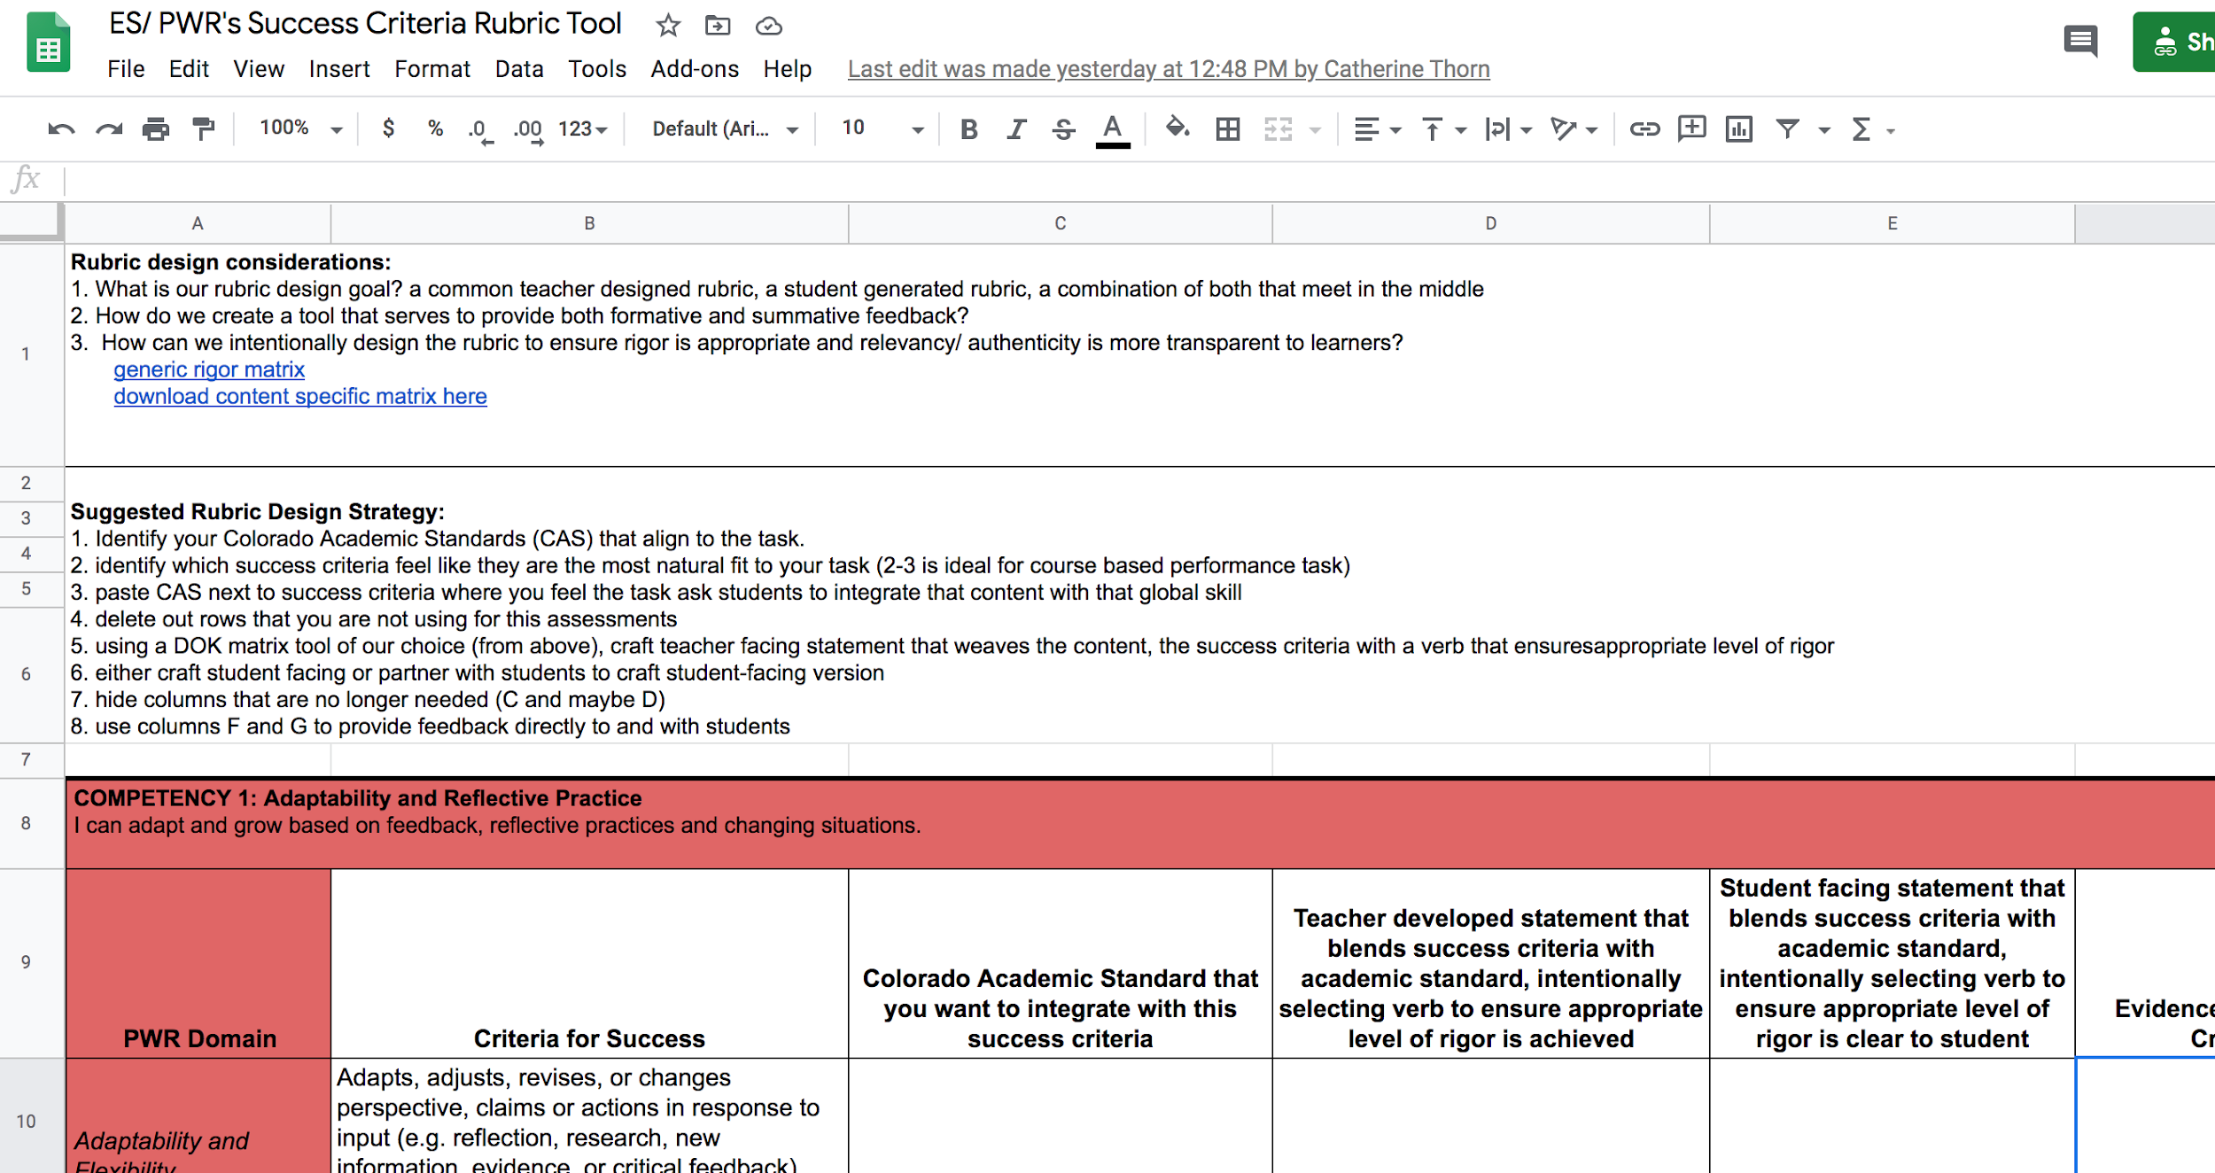
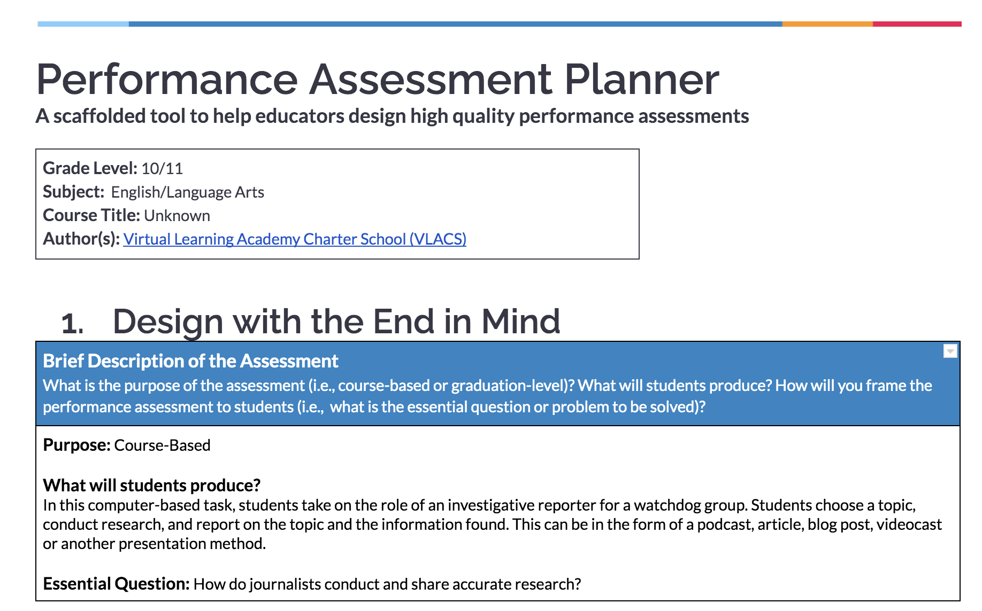
Key Documents
You will need these two documents open
#1
Rubric Design Tool
#2
Your Performance
Assessment Planner

Slide 5
STEP 1: Essential Skills for Postsecondary & Workforce Readiness

Slide 6
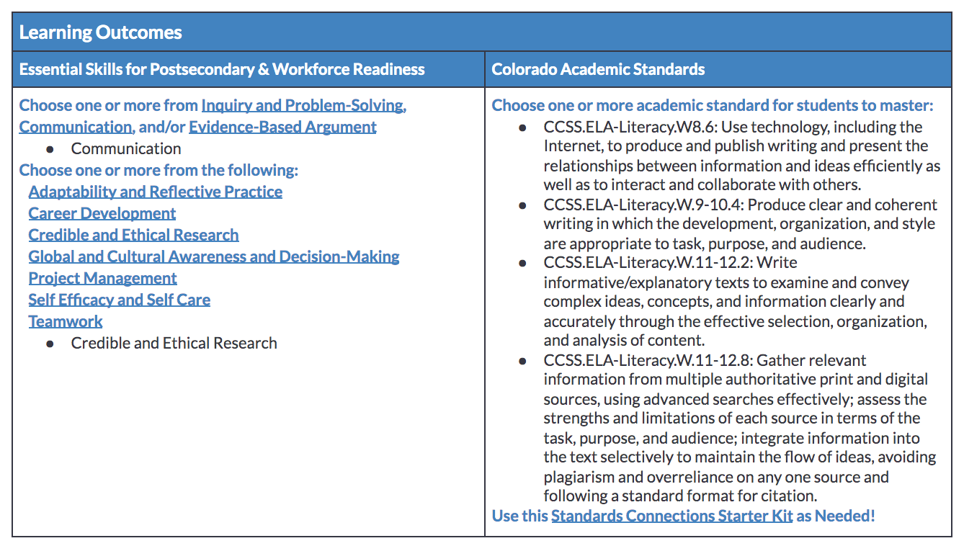
Aligning Essential Skills
Go into your planner and review the Essential Skills for Postsecondary & Workforce Readiness that you identified as most aligned to your task

Slide 7
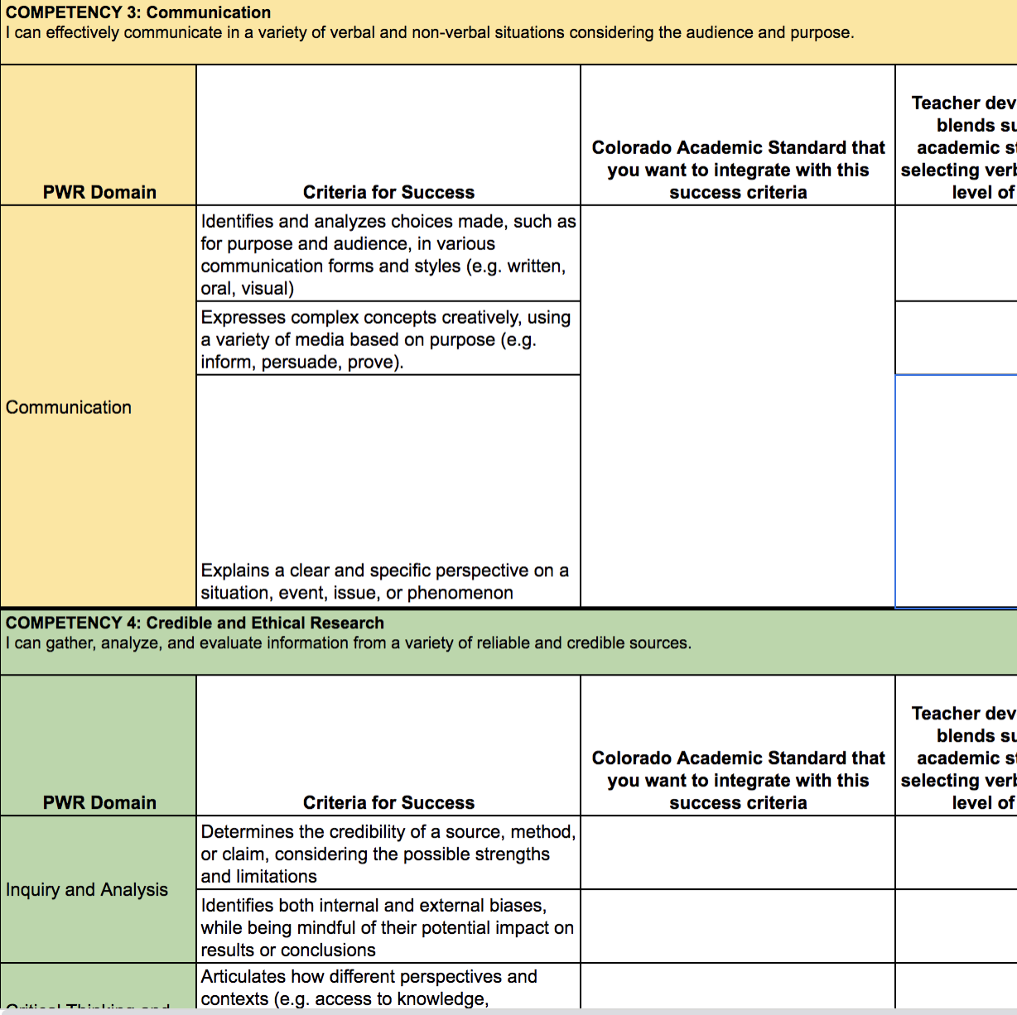
Aligning Essential Skills (cont.)
Go into your copy of the Rubric Design Tool and delete any of the Essential Skills competency rows that do not apply
For example, if you’re focusing on “Communication” and “Credible and Ethical Research” as your Essential Skills for this task, you can delete the other 8 sections that do not apply.

Slide 8
STEP 2: Colorado Academic Standards

Slide 9
Aligning Standards
Go into your planner and review the Colorado Academic Standards that you identified as most aligned to your task

Slide 10
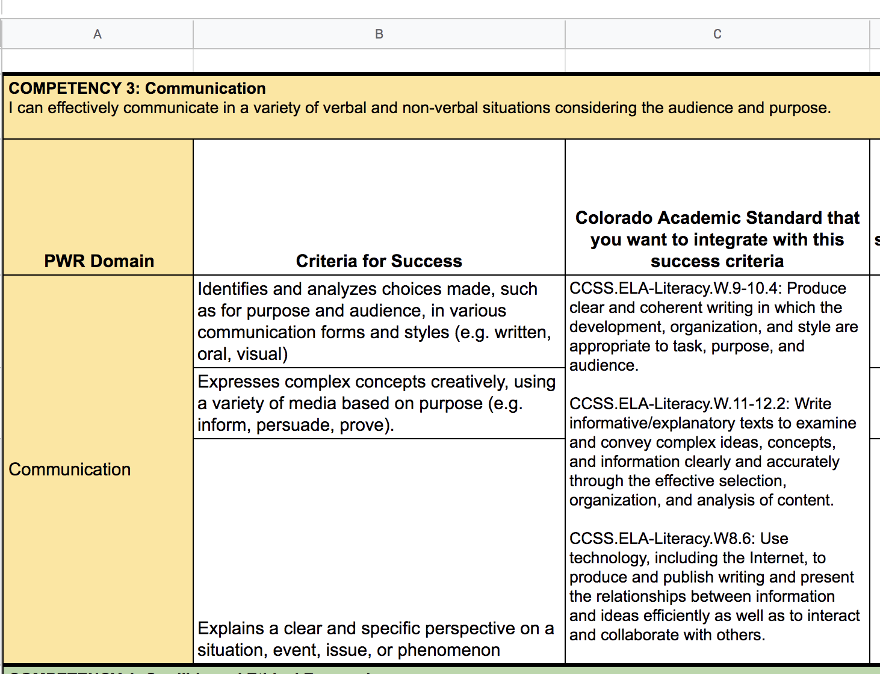
Aligning Standards (cont.)
Use “Column C” of your Rubric Design Tool to paste these Colorado Academic Standards next to the aligned criteria for success

Slide 11
STEP 3: Look-Fors

Slide 12
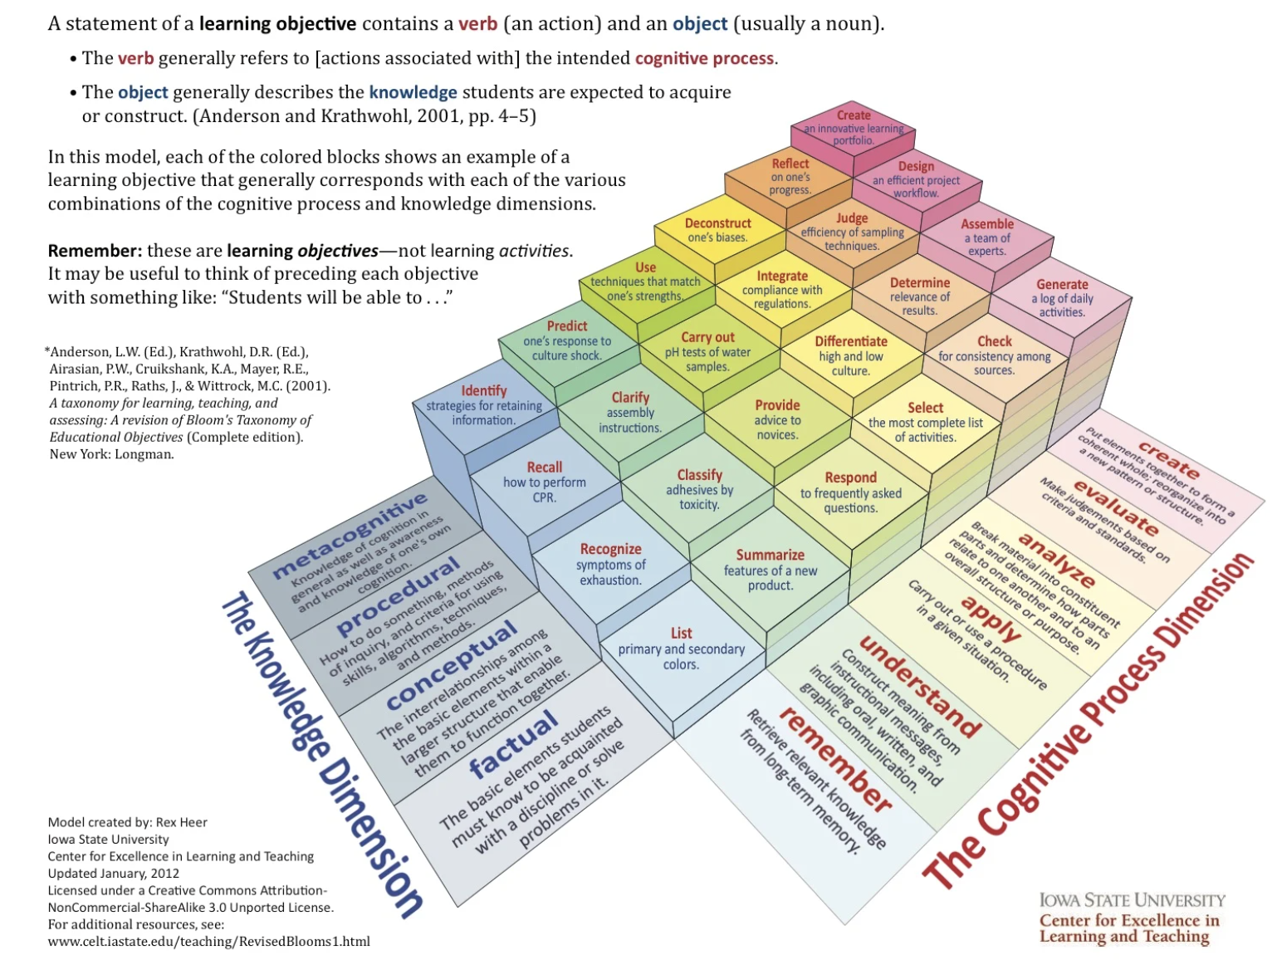
Cognitive Rigor Matrix
Choose a Cognitive Rigor matrix to reference
Generic Rigor Matrix
Content Specific Matrices
If you need a refresher on Cognitive Rigor, explore Module 2!

Slide 13
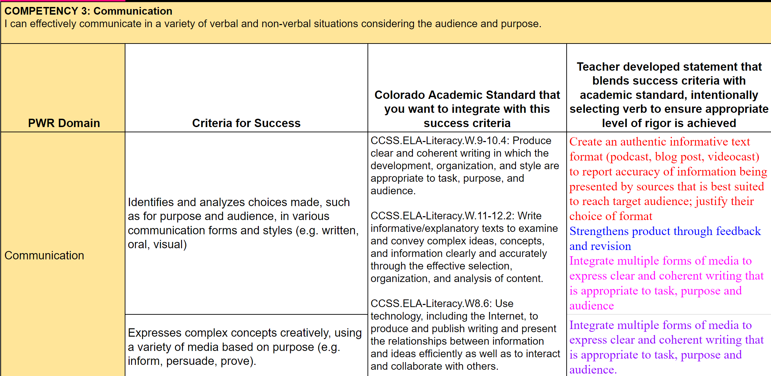
Cognitive Rigor: Teacher Statements
Use “Column D” of your Rubric Design Tool to craft teacher-developed statements that blends the criteria for success with the academic standard, intentionally selecting the verb with help from the Cognitive Rigor matrix

Slide 14
Success Criteria for Students
Use “Column E” of your Rubric Design Tool to craft or partner with students to develop a student-facing version

Slide 15
STEP 4: Use with Students

Slide 16
Collecting Evidence
Hide columns that are no longer needed (C and maybe D) and use Columns F and G directly with students as a feedback and evaluation tool

