Slide 1
Understanding Graduation Standards
Essential Skills for Post-Secondary Work Readiness

Slide 2
Background: Colorado Academic Standards
“In 2008, Colorado passed legislation (Senate Bill 08-212) that requires the State Board of Education to adopt content standards that prepare students for the 21st century workforce and for active citizenship upon receiving a high school diploma. In addition to the requirement that students meet those content standards, students must also (to the extent practicable) develop and demonstrate skills essential for success in professional life. The same law, amended in 2019, also requires a revision to approximately one-third of the Colorado Academic standards beginning in 2022 and an additional one-third every two years thereafter (22-7-1005(6) C.R.S.)”. https://www.cde.state.co.us/standardsandinstruction/essentialskills

Slide 3
Colorado Academic Standards (CAS)
Career & Technical Education
Comprehensive Health
Computer Science
Dance
Drama & Theatre Arts
Financial Literacy
Mathematics
Music
Physical Education
Reading, Writing and Communicating
Science
Social Studies
World Languages
Visual Arts

Slide 4
Essential Skills for Postsecondary & Workforce Readiness (ES/PWR)
Essential Skills Embedded in the Colorado Academic Standards
Adaptability & Flexibility
Career Awareness
Character
Civic Engagement
Collaboration & Teamwork
Communication
Creativity & Innovation
Critical Thinking & Problem Solving
Global and Cultural Awareness
Information Literacy
Initiative & Self-Direction
Inquiry & Analysis
Leadership
Perseverance & Resilience
Personal Responsibility
Productivity & Accountability
Risk Taking
Self-Advocacy
Self-Awareness
Task & Time Management
CDE Standards and Instruction Essential Skills
Notes:
The framework for the Essential Skills document was influenced by the groundwork laid by the in-demand skills identified in the 2015 Colorado Talent Pipeline Report: http://www.k12accountability.org/resources/For-Business-Leaders/CO_Talent_Pipeline_Report_Jan_2015.pdf
The updated 2022 report can be found here: https://drive.google.com/file/d/1Eo2NU2URi351YCA9FXexEpK3AN7UnIkA/view?pli=1

Slide 5
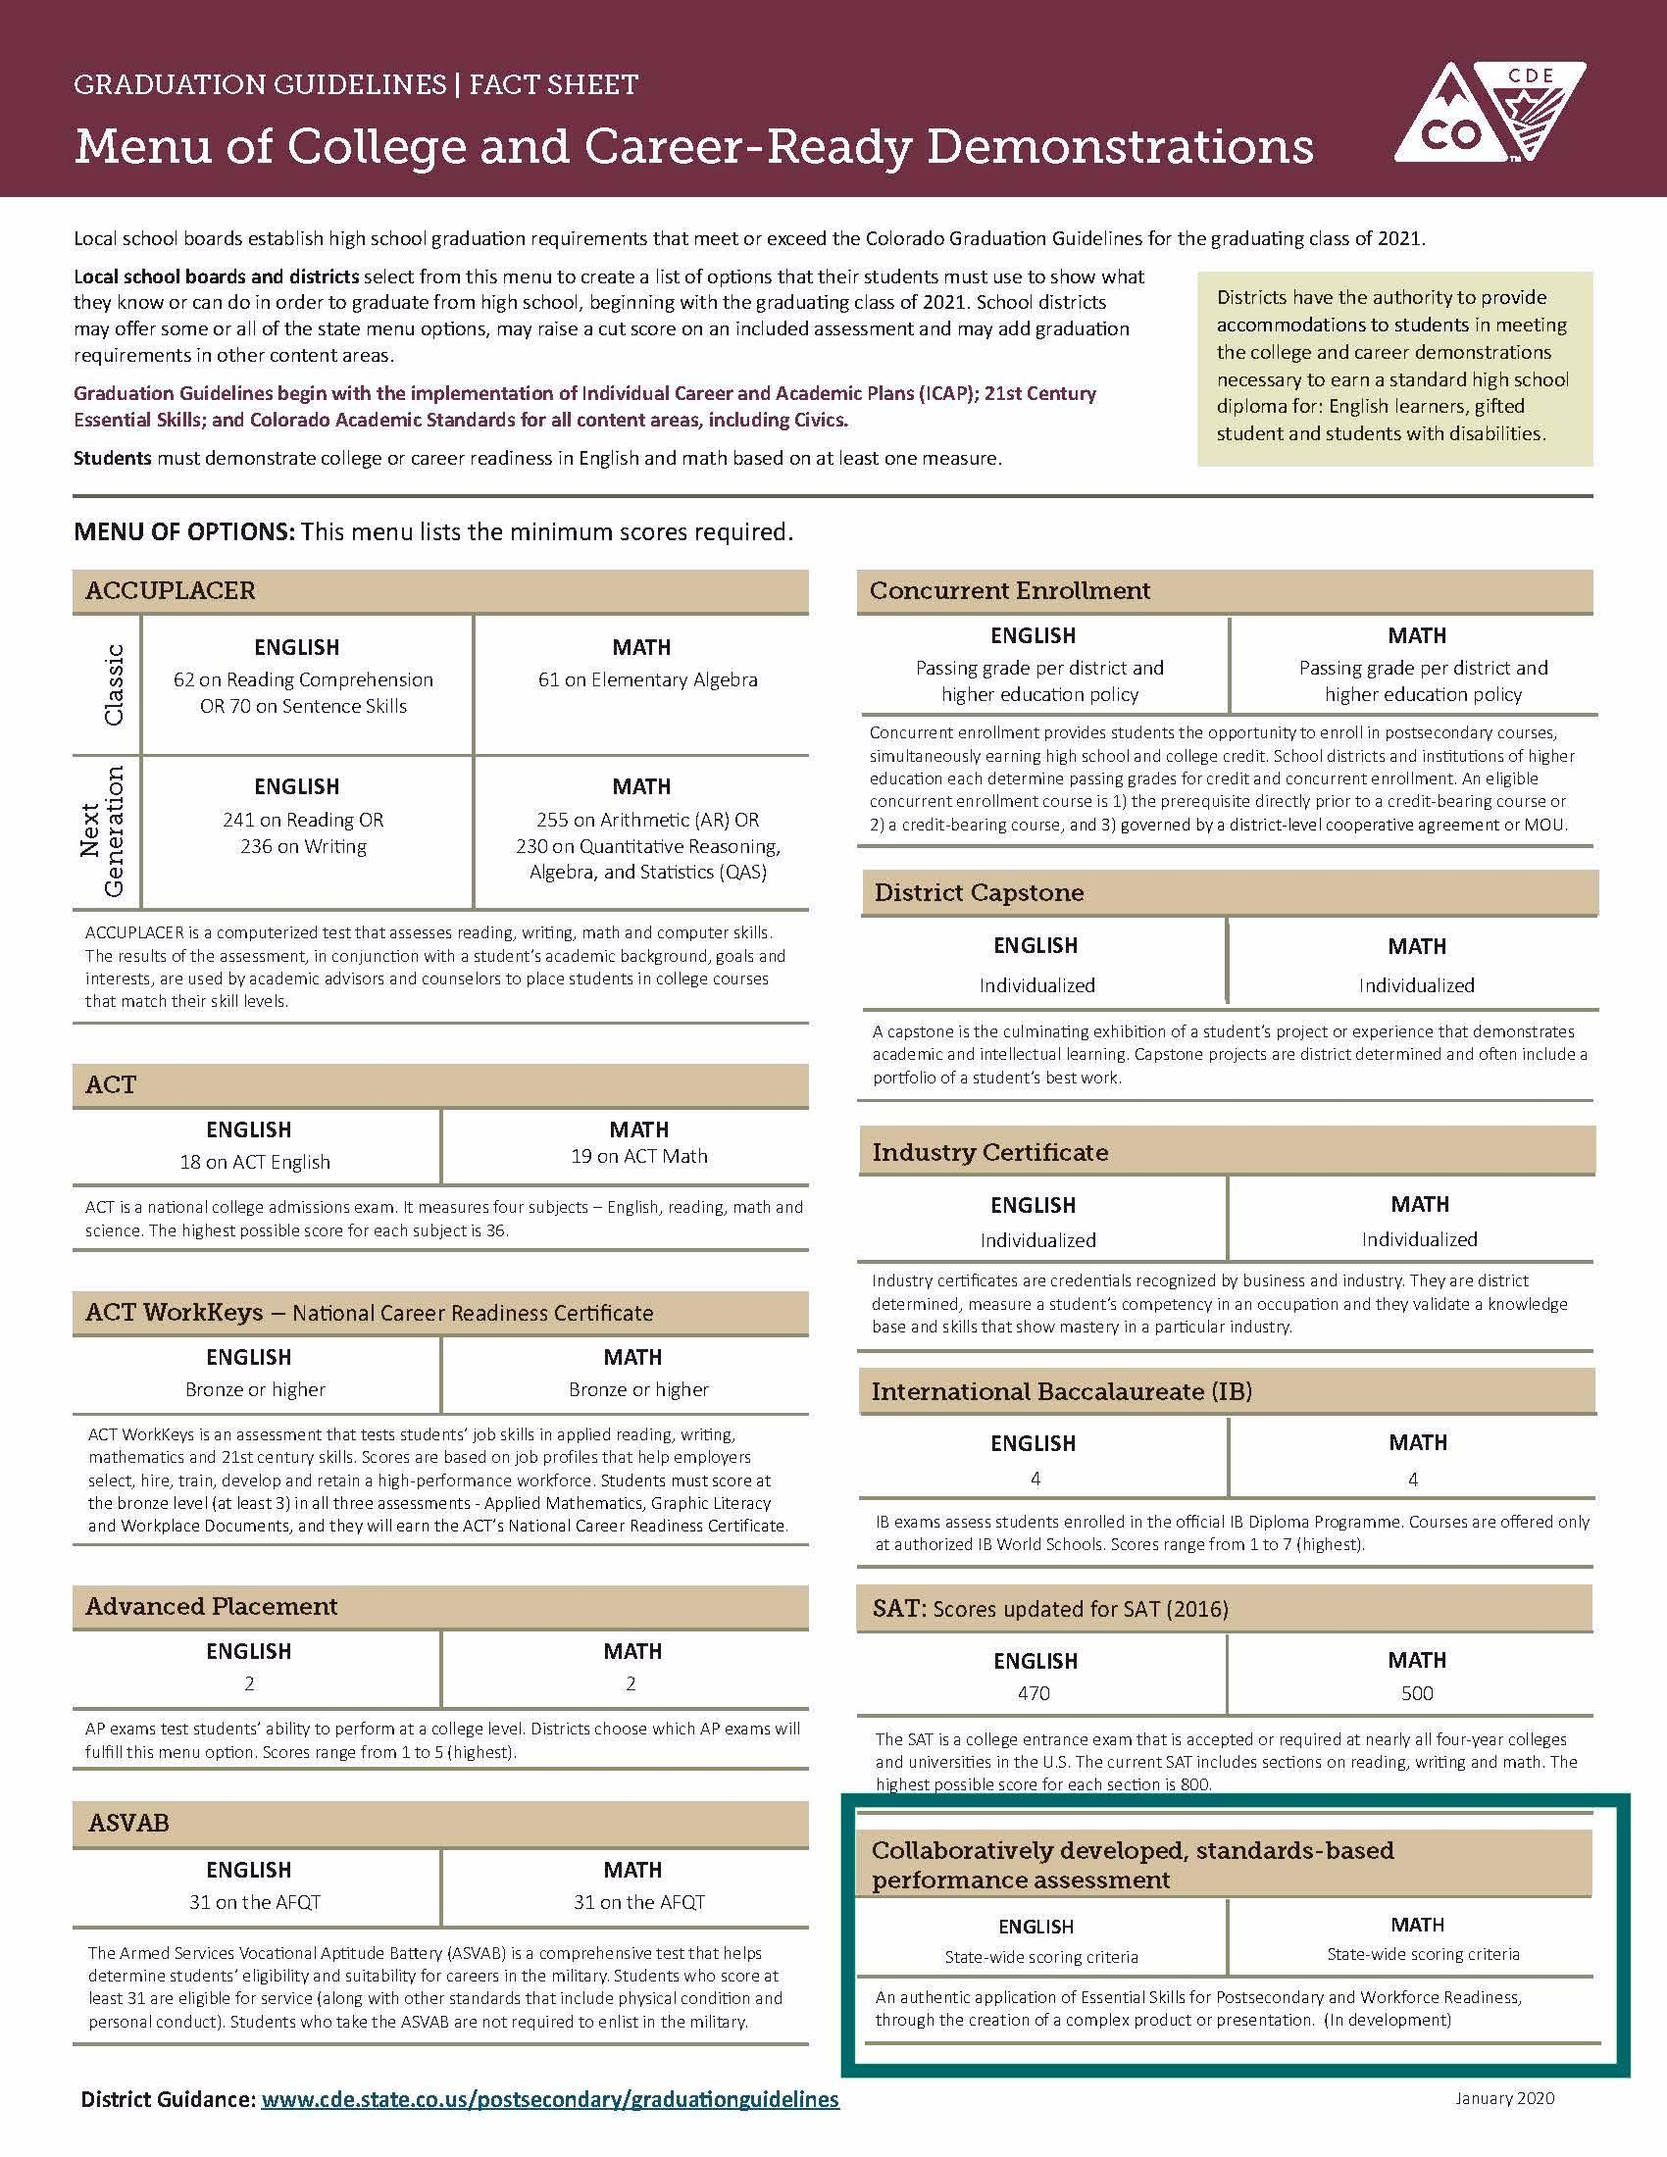
Essential Skills Framework Development
Groundwork laid by the in-demand skills identified in the 2015 Colorado Talent Pipeline Report (PDF).
18 core skills were identified as necessary to enter the workforce or continue education beyond high school.
These skills were grouped under four core categories of Entrepreneurial, Personal, Civic/Interpersonal and Professional skills, plus a category for Academic skills.
CDE sought feedback from the public and statewide stakeholders in business and industry, education, non-profit organizations and government sectors.
The 18 core skills were then organized into five categories with10 competency statements based on the 18 skills.
Graduation Guidelines includes evidence of college or career readiness using Collaboratively-developed, Standards-based Performance Assessment which is defined to be:
An authentic application of Essential Skills for Postsecondary and Workforce through the creation of a complex product or presentation.
Summarized from CDE Standards and Instruction Essential Skills

Slide 6
Essential Skills Framework Development (cont.)
Core Skills Embedded in 5 Domains
Personal Skills | Entrepreneurial Skills | Civic | Professional | Academic
initiative/ self-direction personal responsibility adaptability / flexibility self-advocacy | critical thinking/ problem solving** creativity/ innovation inquiry/ analysis** informed risk taking | collaboration communication global/ cultural awareness character civic engagement | time and task management career literacy work ethic; dependable and reliable | applies knowledge and skills critical thinking and problem solving** inquiry, analysis and evaluation**

Slide 7
Performance Outcomes for Collaboratively-developed, Standards-based Performance Assessment
In 2019, the Collaboratively-developed, Standards-based Performance Assessment Educator Workgroup pulled the 5 Essential Skills Domains together to create 9 competencies.
These Performance Outcomes are a group of intentionally chosen Essential Skills that students and teachers select for a performance assessment. Performance Outcomes are comprised of the Essential Skill, a Competency Statement, and a set of Measurable Success Criteria.

Slide 8
Performance Outcomes for Collaboratively-developed, Standards-based Performance Assessment
Adaptability and Reflective Practice
I can adapt and grow based on feedback, reflective practices and changing situations.
Career Development
I can articulate my strengths, preferences, and interests, as they relate to potential career paths.
Credible and Ethical Research
I can gather, analyze, and evaluate information from a variety of reliable and credible sources.
Social Responsibility
I can identify my own perspective and the perspectives of others in order to be an agent of change in the world.
Time and Work Management
I can design, manage, and follow-through with projects, and with meeting short and long-term goals.
Self-Efficacy and Self-Care
I take responsibility for my actions and personal well-being and implement strategies based on my needs.
Teambuilding
I can collaborate with others in order to achieve a common goal.
Inquiry and Problem Solving
I can use a variety of discipline-specific techniques and/or processes to conduct and follow-through on a complex investigation.
Communication
I can effectively communicate in a variety of verbal and non-verbal situations considering the audience and purpose.
Performance Outcomes with Single Point Rubrics and Examples can be accessed here.

Slide 9
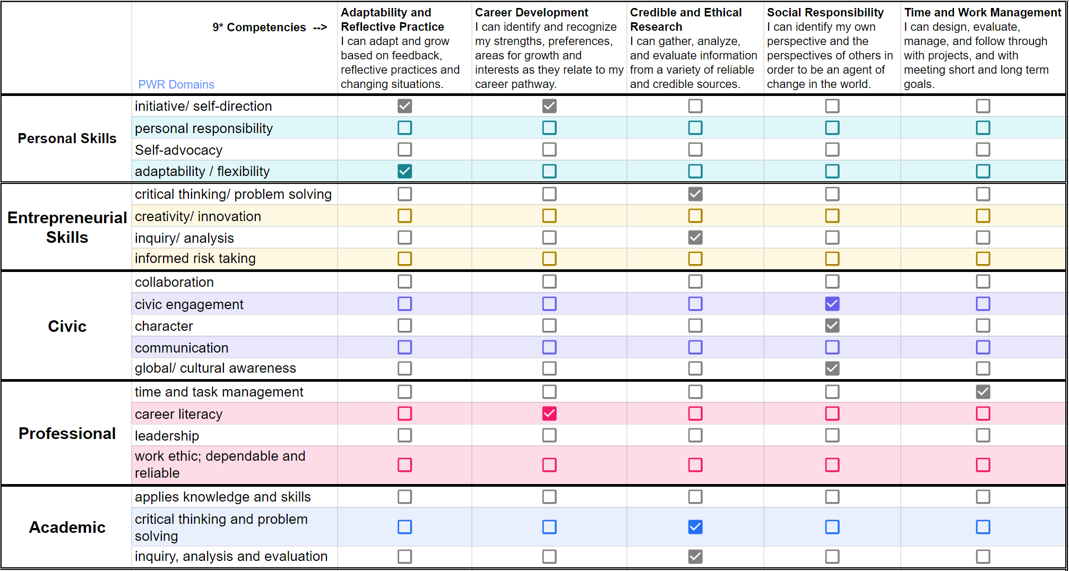
Performance Outcomes for Collaboratively-developed, Standards-based Performance Assessment
Crosswalk 1

Slide 10
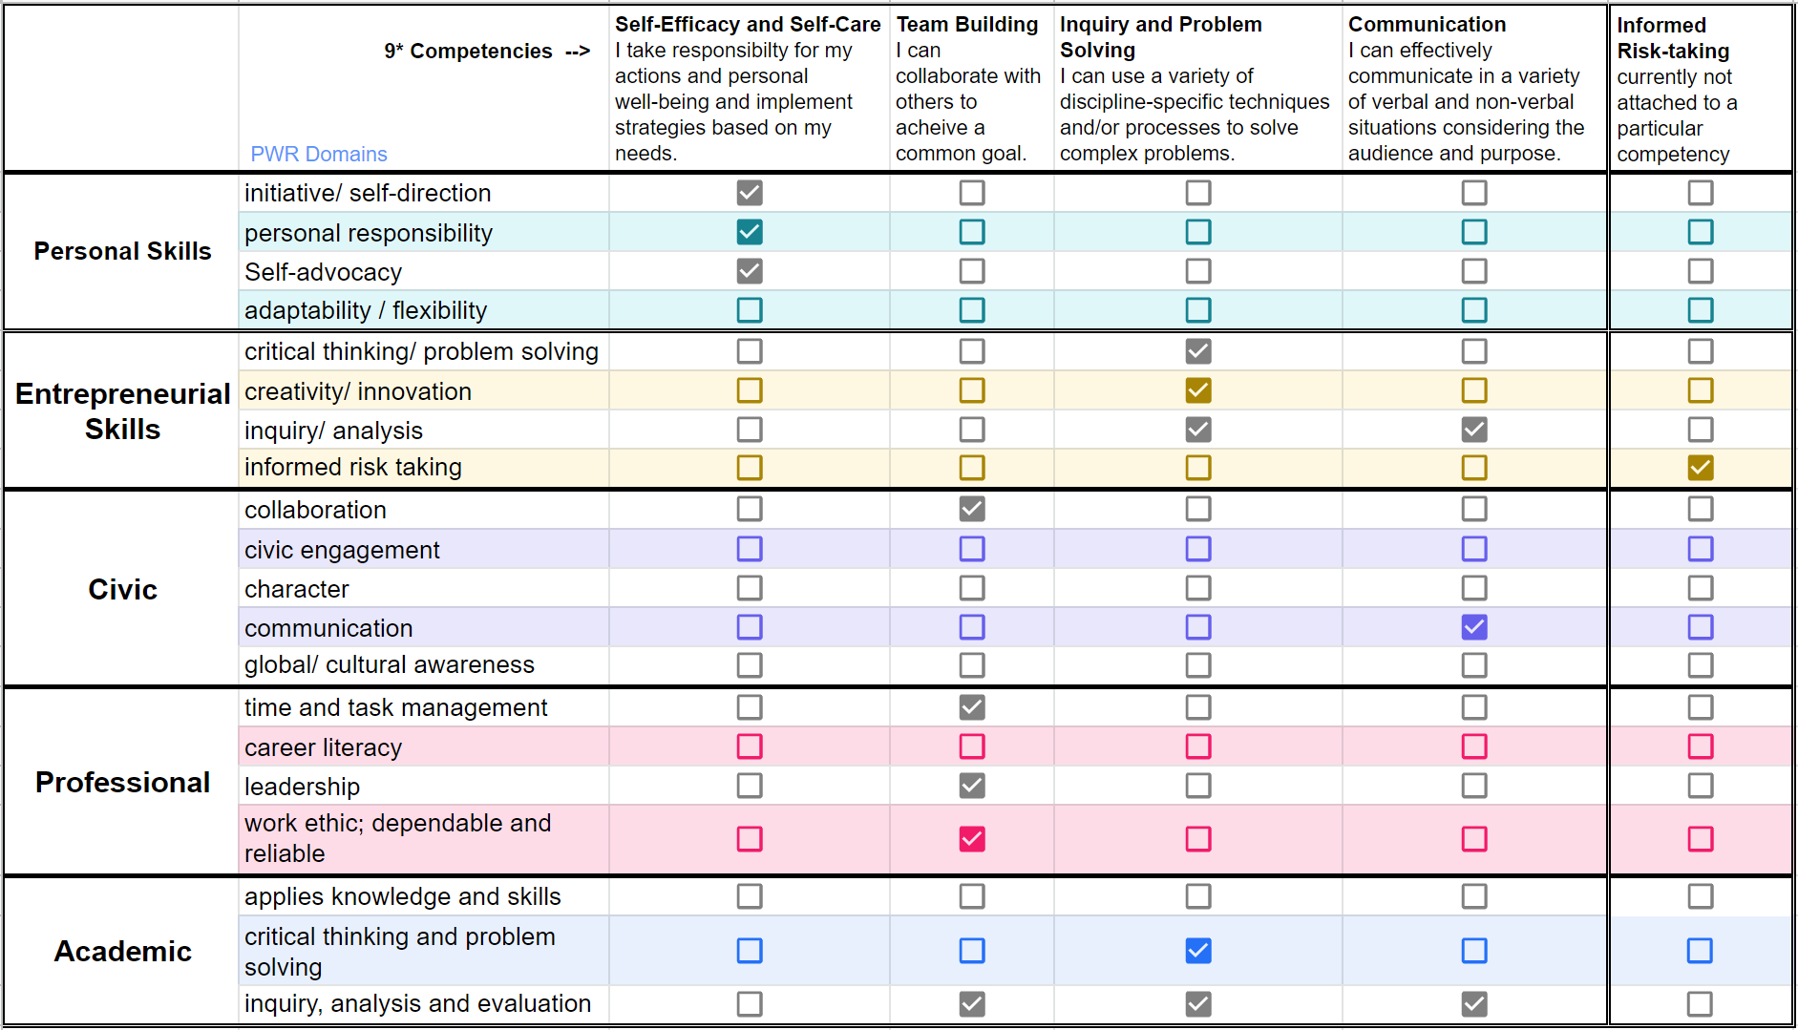
Performance Outcomes for Collaboratively-developed, Standards-based Performance Assessment
Crosswalk 2

Slide 11
Performance Outcomes for Collaboratively-developed, Standards-based Performance Assessment
Each competency is directly connected to specific success criteria linked to the domains

Slide 12
Performance Outcomes for Collaboratively-developed, Standards-based Performance Assessment
Example Competency with Rubric
Adaptability and Reflective Practice
I can adapt and grow based on feedback, reflective practices and changing situations.
PWR Domain | Success Criteria | Evidence of meeting criteria | Evidence of Revisions Needed
Adaptability and Flexibility | Adapts, adjusts, revises, or changes perspective, claims or actions in response to input (e.g. reflection, research, new information, evidence, or critical feedback)
 | Differentiates between a variety of competing variables to determine focus
Initiative and Self-direction | Reflects on progress, analyzing successes and failures, to alter an original plan of action when necessary, or to determine the next appropriate step

