Slide 1
Designing with a Purpose
Using Colorado Academic Standards to Inform Performance Assessment Design
Colorado Standards
Matching the Performance Assessment to the Goal

Slide 2
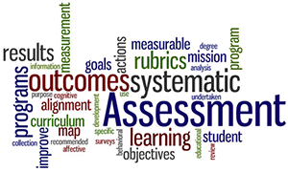
OPTION 1: Course Level Performance Assessment
Performance Assessment attributes:
  Embodies all six of the design elements (aligned, accessible, authentic, relevant, transferable, iterative)
  Task provides compelling evidence of mastery of a group of related content standards
  Integrates a small number of strategically selected essential skills/ performance outcomes from the PWR’s
    Provides opportunity for goal setting, formative feedback related to these skills
    Can be used as evidence to demonstrate growth over time
Possible Products:
  Newspaper article
  Live performance
  Blog
  Podcast
  Pamphlet
  Facilitation of a community meeting
  Authentic simulation

Slide 3
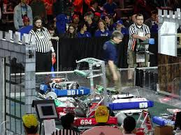
Example: Course Level Assessment
A group of robotics students are entering a competition. They must collaborate to engineer a robot that adheres to the design criteria and maximizes the efficiency of energy conversions.
Students will be engaging in science in engineering practices and meeting several science content standards
  Design, build, and refine a device that works within given constraints to convert one form of energy into another form of energy. (HS-PS3-3)
  Apply scientific and engineering ideas to design, evaluate, and refine a device that minimizes the force on a macroscopic object during a collision. (HS-PS2-3)

Slide 4
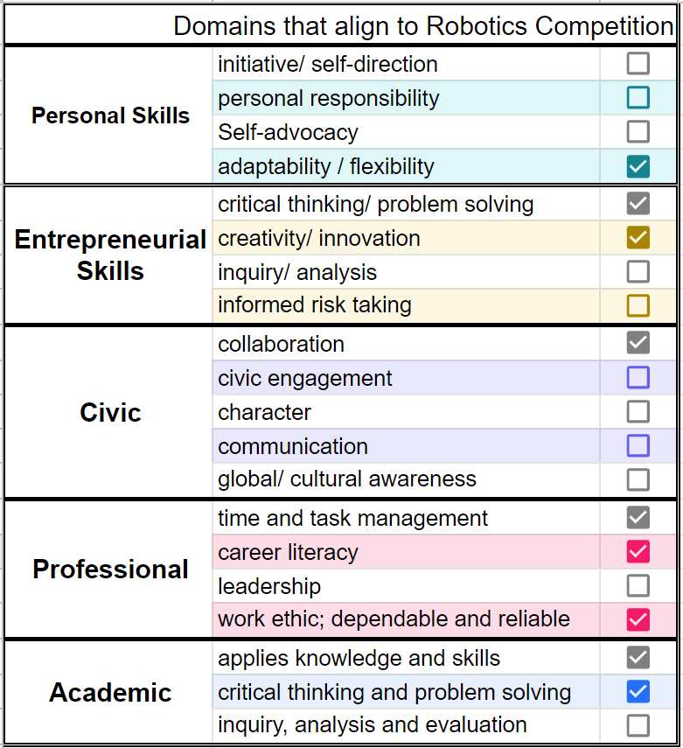
Example: Course Level Assessment (cont.)
Student will be engaged in several PWR domains connected to the 9 Competencies
  The teacher decides that all students working on this project will set goals, reflect and receive feedback directly related to creativity/ innovation & collaboration and their respective success criteria
  In a conference with a student, they identify 7 others that may apply to this task. Since this is 12th grade, the students choose a third personalized area of focus from the list of 7.
Evidence and feedback is directly connected to each domain through their respective success criteria

Slide 5
Student 1: Performance Outcomes
Essential Skill for PWR | PWR Domain | Success Criteria
Inquiry and Problem Solving: I can use a variety of discipline-specific techniques and/or processes to solve complex problems. | Creativity/ Innovation | Uses various processes (e.g. logical reasoning, design thinking, scientific method) to find reasonable and justifiable solutions or conclusions
Team Building: I can collaborate with other to achieve a common goal | Collaboration | Determines and assigns roles based on task, challenges, process, and group members’ strengths
 |  | Actively listens and evaluates ideas
Inquiry and Problem Solving: I can use a variety of discipline-specific techniques and/or processes to solve complex problems. | Critical Thinking and Problem Solving | Evaluates evidence from previous approaches and varied perspectives to plan actions for maximum impact

Slide 6
Student 2: Performance Outcomes
Essential Skill for PWR | PWR Domain | Success Criteria
Inquiry and Problem Solving: I can use a variety of discipline-specific techniques and/or processes to solve complex problems. | Creativity/ Innovation | Uses various processes (e.g. logical reasoning, design thinking, scientific method) to find reasonable and justifiable solutions or conclusions
Team Building: I can collaborate with other to achieve a common goal | Collaboration | Determines and assigns roles based on task, challenges, process, and group members’ strengths
 |  | Actively listens and evaluates ideas
Adaptability and Reflective Practice: I can adapt and grow based on feedback, reflective practices and changing situations. | Adaptability and Flexibility | Adapts, adjusts, revises, or changes perspectives, claims or actions in response to input
 |  | Differentiates between a variety of competing variables to determine focus

Slide 7

Option 2: Graduation Level
“An authentic application of Essential Skills for Postsecondary and Workforce Readiness (ES/ PWR), through the creation of a complex product or presentation.”
Performance Assessment attributes:
  Embodies all six of the design elements (aligned, accessible, authentic, relevant, transferable, iterative)
  Task is complex
  Evidence is substantial, broad and deep
  Opportunities for goal setting, reflection and responding
  Demonstrates growth over time
  Emphasis is on demonstration of a wide range of PWR’s performance outcomes as evidence of mastering the 10 competencies
Possible Products:
  Body of Evidence
  Portfolio Defense
  Capstone Experience

Slide 8
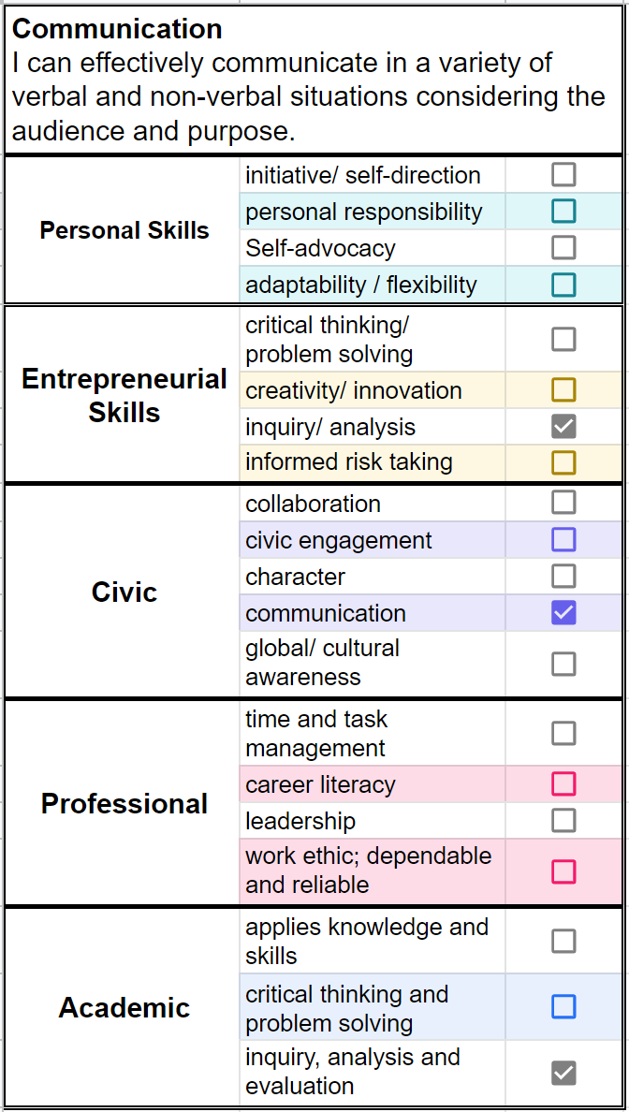
Example: Evidence for Graduation Readiness
As part of a senior defense of learning, a student pulls together artifacts related specifically to the Communication competency.
Grounded in reflections, goal setting and practice, the student identifies work from across content areas to demonstrate growth and mastery.

Slide 9
Example: Evidence for Graduation Readiness (cont.)
In addition to personal reflections, goal setting documents and mentor evaluations, evidence for relevant domains might include the following:
  Communication:
  Research paper from grade 12 English class
  Podcast from grade 12 Public Speaking
  Activism project from grade 10 World Cultures
  Lab report from grade 11 Chemistry
  Inquiry, analysis and evaluation:
  Community outreach project from grade 11 Civics class
  Personal wellness plan from grade 9 Advisory
  Engineering design plan from grade 12 Robotics
  Research proposal from grade 12 AP Biology

Slide 10
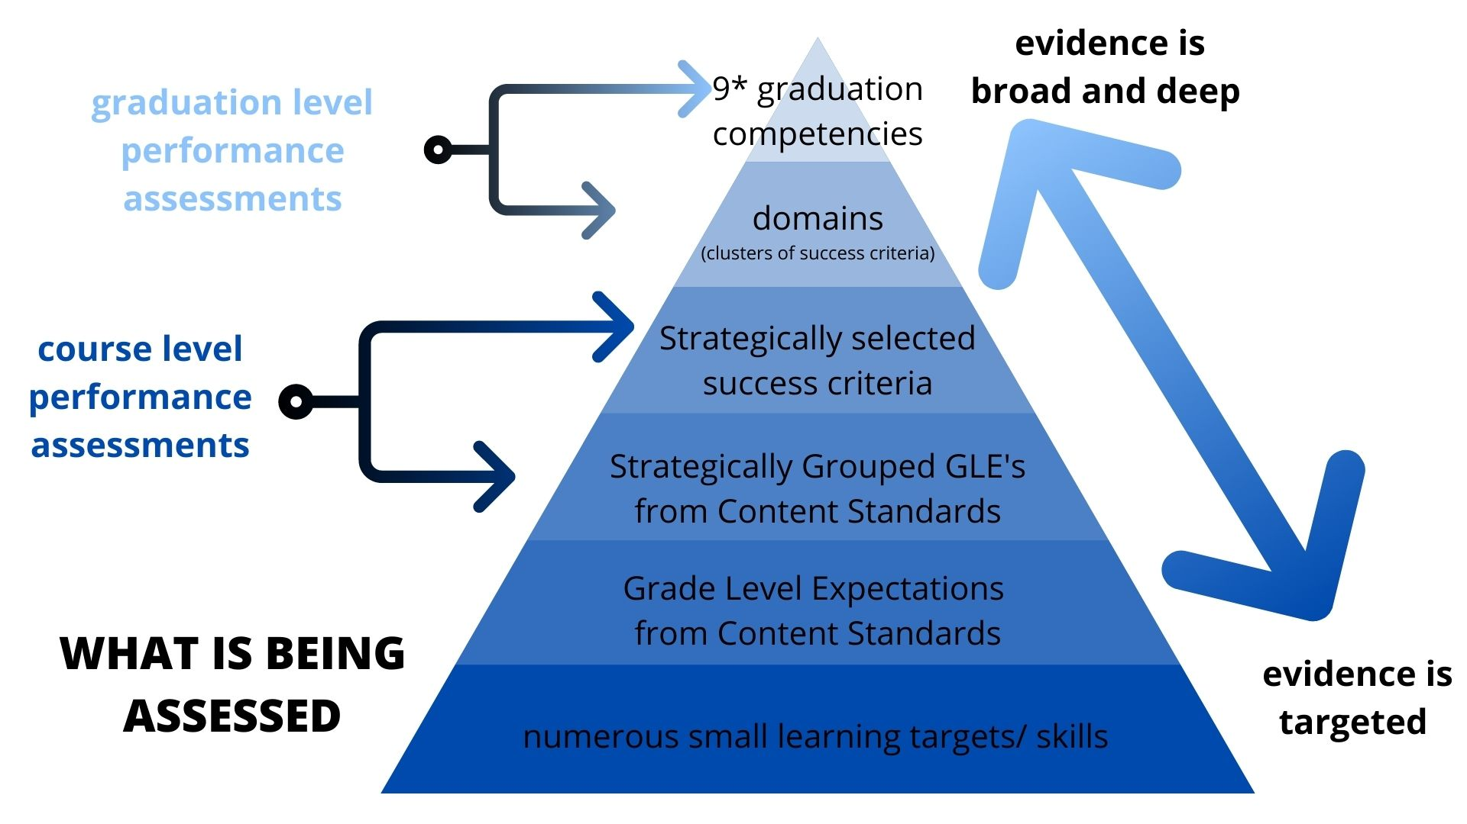

Slide 11
Best Practice
Leverage integration of domains and success criteria to increase learner agency
Personalize the learning by providing students the opportunity to establish individual goals related to each domain/ success criteria
Utilize success criteria at all stages of the learning by providing targeted instruction, feedback and reflection at keys points in the process
Strategically align course level tasks with a small number success criteria that naturally lend themselves to the task (examples)
Further leverage embedded performance tasks as evidence to support growth/ mastery or opportunity to practice graduation level competencies

Slide 12
Common Pitfalls to Avoid
Assuming students know what the domains/ success criteria mean and look like: share anchor products and calibrate with students
Assessing at higher level than practice: when the performance assessment is complex and rigorous, “teaching to the test” is highly effective
Having inconsistent expectations: with appropriate scaffolding, all students can demonstrate deep learning related to the Essential Skills for Post-Secondary and Workforce Readiness

