Slide 1
Prioritization protocol
Notes:
Welcome! In this section of the course, you will learn about the Prioritization Protocol.

Slide 2
Prioritization protocol
The CSSI visit prioritization protocol is designed for the following outcomes:
CSSI team will come to preliminary findings on review criteria.
CSSI team will identify the right key levers and recommendations for targeted school improvement.
CSSI team will prepare to communicate preliminary findings to the school leader.
Notes:
The CSSI visit prioritization protocol is designed for the following outcomes:
The CSSI team will come to preliminary findings on review criteria
The CSSI team will identify the right key levers and recommendations for targeted school improvement
The CSSI team will prepare to communicate preliminary findings to the school leader.

Slide 3
Pre-work:
The CSSI team spends approximately three hours on day 3 completing pre-work and coming to preliminary findings and prioritizing targeted areas for school improvement.
This is a tight timeline, team members must synthesize their data quickly and efficiently and work together urgently. Each team member will be assigned to complete pre-work on a specific section of the rubric.
Each team member should score rubric and color code the Landscape Report in the prioritization document shared by team lead.
Notes:
The CSSI team spends approximately three hours on day 3 completing pre-work and coming to preliminary findings and prioritizing targeted areas for school improvement.
This is a tight timeline, team members must synthesize their data quickly and efficiently and work together urgently. Each team member will be assigned to complete pre-work on a specific section of the rubric.
Each team member should score rubric and color code the Landscape Report in the prioritization document shared by team lead.

Slide 4
Pre-work guidance:
Each team member should score rubric and color code the Landscape Report in the prioritization document shared by team lead.
In their assigned area, they should:
Identify 2 strengths within each reviewed standard to leverage in the school improvement process
Write a findings statement for each standard descriptor and identify three pieces of evidence to support it. The findings statements should read as: the school is (scored 3 or 4), is beginning to (scored 2), or is not yet (scored 1).
Focus on providing data points that “prove” the score given.
Notes:
Each team member should score rubric and color code the Landscape Report in the prioritization document shared by team lead.
In their assigned area, they should:
Identify 2 strengths within each reviewed standard to leverage in the school improvement process.
Write a findings statement for each standard descriptor and identify three pieces of evidence to support it. The findings statements should read as: the school is (scored 3 or 4), is beginning to (scored 2), or is not yet (scored 1).
Focus on providing data points that “prove” the score given.

Slide 5
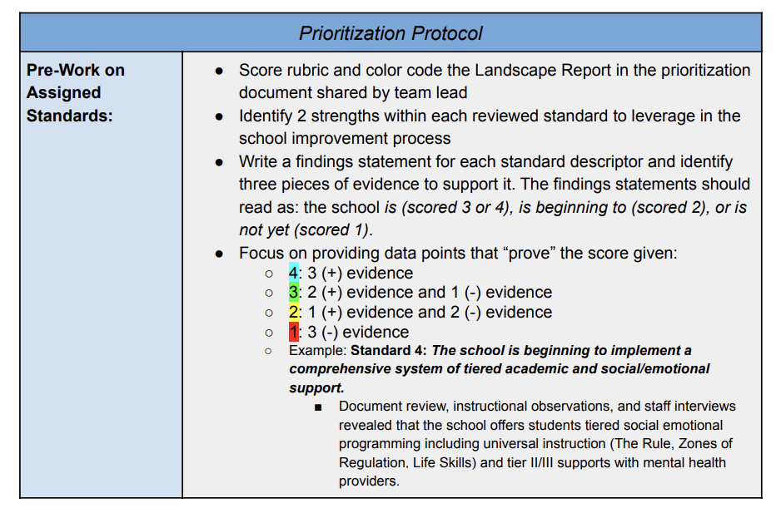
Pre-work color coding:
Notes:
This chart shows the color-coding guides for rubric pre-work. This document is included in the resources folder for this module.

Slide 6
Step One: Prioritization of key levers
After reading through the summary of findings, the CSSI team works through these questions:
What are the most pressing priority performance challenges?
How are these challenges connected to each other?
What are the areas of root cause?
Which root cause areas should they address urgently and why?
What 1-3 key levers/improvement strategies would best address these prioritized areas and why?
What is most likely to result in dramatic change?
Notes:
After reading through the summary of findings, the CSSI team works through these questions:
What are the most pressing priority performance challenges? How are these challenges connected to each other?
What are the areas of root cause?
Which root cause areas should they address urgently and why?
What 1-3 key levers/improvement strategies would best address these prioritized areas and why? What is most likely to result in dramatic change?

Slide 7
Step two: Prepare for Share-out
Next, the CSSI review team should prepare a verbal overview and notes for presentation to school leaders.
They should prepare:
A list of Strengths
Landscape Report
Summary of Findings
Key Levers for Improvement
Overall Recommendations
Notes:
Next, the CSSI review team should prepare a verbal overview and notes for the presentation to school leaders. They should prepare a list of strengths, the landscape report, a summary of findings, key levers for improvement, and overall recommendations.

Slide 8
Next, Check out the landscape report.
Notes:
This concludes the overview of prioritization protocol. PLease continue on in the course and look at the landscape report.

