Slide 1
Stakeholder Interviews
Notes:
Welcome! In this section of the course, you will learn how to conduct stakeholder interviews.

Slide 2

StakeHolder Interviews
Stakeholder interviews are conducted during the first two days of the CSSI visit.
The CSSI Team Lead creates the interview schedule and assigns team members to certain rubric areas.
CSSI Team Members complete interviews with teachers, parents, students, school leaders, and board members.
As stated in the Team Member Agreement, anonymity is maintained for all interviewees, unless child protection concerns or harm are noted.
Notes:
Stakeholder interviews are conducted during the first two days of the CSSI visit.
CSSI Team Members complete interviews with teachers, parents, students, school leaders, and board members.
As stated in the Team Member Agreement, anonymity is maintained for all interviewees, unless child protection concerns or harm are noted.

Slide 3
Interview protocol:
A variety of stakeholders are interviewed during the school quality visit; the CSSI team aims to interview all leaders, teachers, support staff, business personnel and board members as well as a collection of students and parents.
Review team members use a standardized set of interview questions that are aligned to the assessment rubric. These questions are presented through google forms.
CSSI team members are required to take digital notes during stakeholder interviews and to save them for 90 days after the visit. The manner and method of note-taking is selected by the review member based on personal style and preference. The CDE provides a recommended note-taking tool.
This tool and the interview questions can be found in the documents folder for this section of the course.
Notes:
A variety of stakeholders are interviewed during the school quality visit; the CSSI team aims to interview all leaders, teachers, support staff, business personnel and board members as well as a collection of students and parents.
Review team members use a standardized set of interview questions that are aligned to the assessment rubric.
CSSI team members are required to take digital notes during stakeholder interviews and to save them for 90 days after the visit. The manner and method of note-taking is selected by the review member based on personal style and preference. The CDE provides a recommended note-taking tool.

Slide 4
Interview norms:
● Interviews are 30 minutes for all stakeholders except leaders; we ask school leaders and instructional leaders for 60 minutes
● Stick to the script as much as possible but probe as necessary
● Remind the interviewee of the purpose of the visit and confidentiality (see framing script in Google Drive folder with interview scripts)
● Ask for specific examples (e.g. “give me an example of how you used a formative assessment this quarter to drive your instruction”)
● Stay neutral and be aware of your own body language
● Know when you have your answer and move on (i.e. there may not be an answer) ● Don’t give feedback or affirm/not-affirm questions or answers of the interviewee
● Don’t react or go down a “rabbit hole” with an interviewee that is disgruntled and wants to veer off the script
● Be aware of interviewee emotion and respond accordingly
These norms can also be found in the documents folder.
Notes:
The following are norms for CSSI interviews. ● Interviews are 30 minutes for all stakeholders except leaders; we ask school leaders and instructional leaders for 60 minutes
● Stick to the script as much as possible but probe as necessary
● Remind the interviewee of the purpose of the visit and confidentiality (see framing script in Google Drive folder with interview scripts)
● Ask for specific examples (e.g. “give me an example of how you used a formative assessment this quarter to drive your instruction”)
● Stay neutral and be aware of your own body language
● Know when you have your answer and move on (i.e. there may not be an answer) ● Don’t give feedback or affirm/not-affirm questions or answers of the interviewee
● Don’t react or go down a “rabbit hole” with an interviewee that is disgruntled and wants to veer off the script
● Be aware of interviewee emotion and respond accordingly
These norms can also be found in the documents folder.

Slide 5
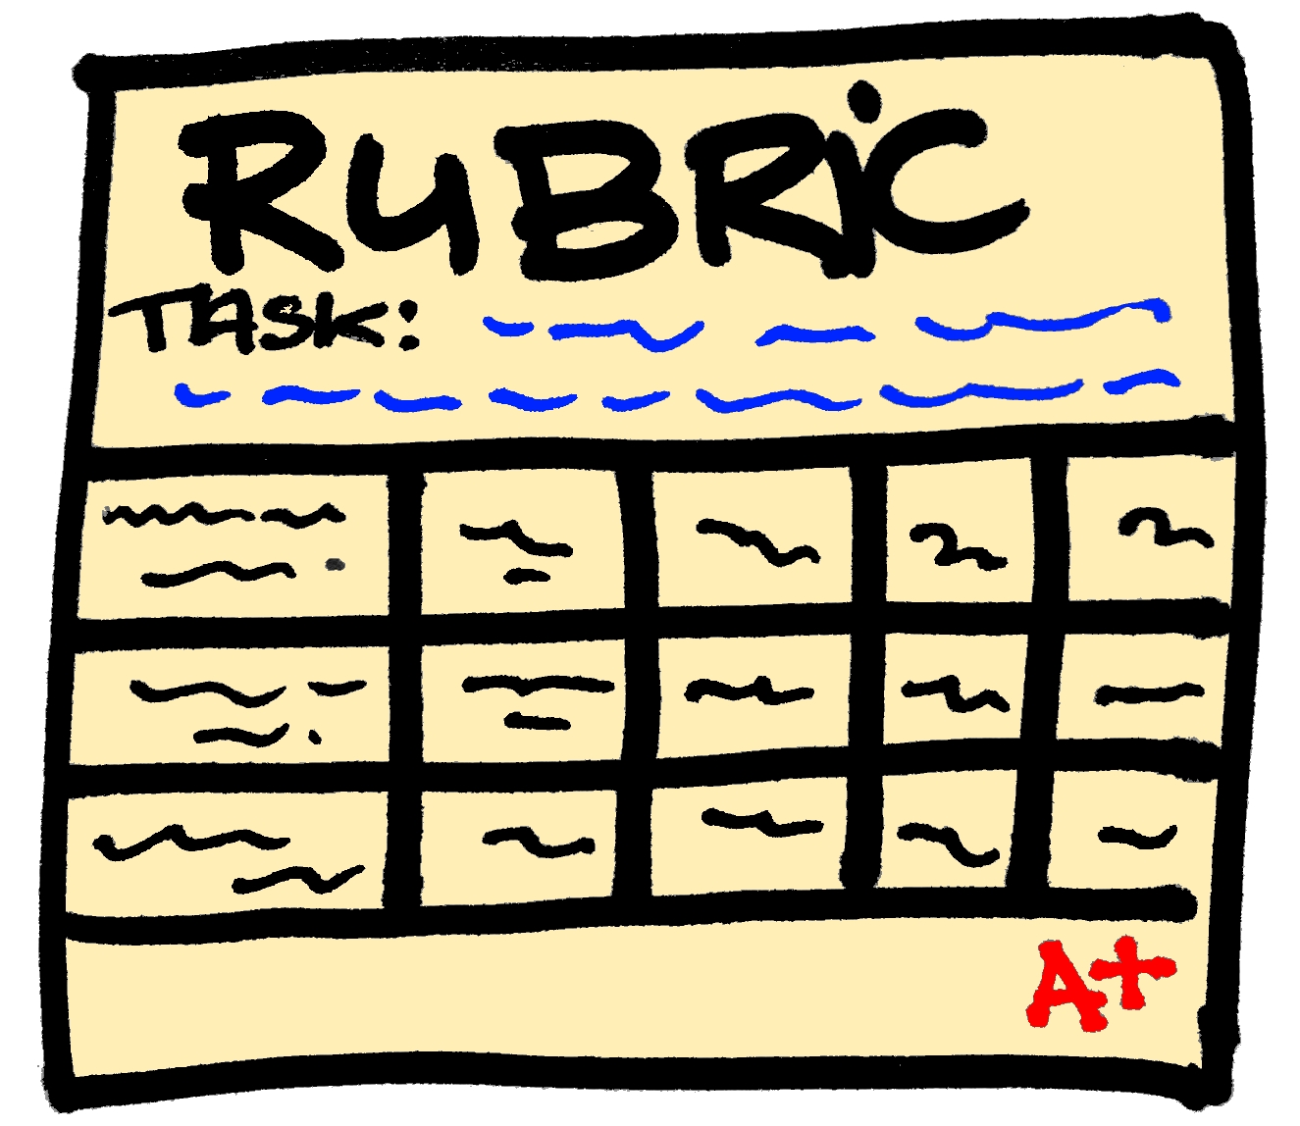
Interview data:
After interviews are completed, team members will complete their assigned section of the Four Domains or Standards rubric.
Team Members should use specific examples from interviews to back up their ratings, and show rather than tell what they learned.
Notes:
Interview data is used to complete the rubric and provide schools with targeted feedback. After interviews are completed, team members will complete their assigned section of the Four Domains or Standards rubric.
Team Members should use specific examples from interviews to back up their ratings, and show rather than tell what they learned.

Slide 6
Open the documents folder to preview interview questions and learn more.

