Slide 1
Module 16:
Implementing and Reflecting on
Best, First Instruction
Best, First Instruction
Part II
Notes:
[Estimated time for this module: 65 minutes]
More time may be needed depending on how many re-groupings of teachers you ask for and how much time you give them in each grouping.

Slide 2
Goals and Objectives
Educators will be able to:
Combine their understandings of the standards and high impact instructional strategies to develop interactive learning opportunities.
Reflect on their current method of instructional planning in comparison to a content and student focused instructional planning process.
Work with the Sample Instructional Planning Process Guide to help make visible the “invisible thinking” which teachers may utilize to provide students with opportunities to demonstrate student learning demands of the standards.
Notes:
[Estimated time: 2 minutes]
There are three goals for this session…Read the slide.

Slide 3
Content Focused Instructional Planning Process
Step 1
Review Standards & Curriculum
Step 2
Step 4
Identify the lesson content
Write the Instructional Plan
Step 3
Determine the Assessment
Notes:
[Estimated time: 5 minutes]
Explain to the educators that oftentimes, instructional planning focuses on the concepts and skills… These focus instructional planning: Look at the standard and curriculum→ Identify the lesson content → determine the assessment → write the instructional plan
Ask the educators to consider their current instructional planning. Does your current instructional planning reflect the standards being addressed? Do your current plans reflect the inclusion of the skills students should be demonstrating based upon the standards?

Slide 4
Student Focused Instructional Planning Process
Step 1
Identify the intent of student learning implicit in the standards.
Step 4
Step 2
Plan for opportunities where students will reflect on their learning.
Consider student learning when planning instruction.
Step 3
Provide students with opportunities to demonstrate the learning demands of the standards.
Notes:
[Estimated time: 5 minutes]
Explain: Different than content focused instructional planning, beginning with the student learning in mind, student focused instructional planning: This process begins with identifying what the students should be doing as evidenced in the standards. What makes this process different than the content focused instructional process is that instructional planning BEGINS with the students rather than content.
Look at the standard - Identify the intent of student learning implicit in the standards. → Consider student learning when planning instruction. → How will your instruction provide students with opportunities to demonstrate (the “doing”) student learning demands of the standards. → Plan for opportunities where students can reflect on their learning. How will students reflect and connect their actions and learning back to standards and BFI instruction?
Ask educators to consider their current instructional planning. How does their current instructional planning reflect the inclusion of the skills students should be demonstrating? For example, if students are to be “evaluating primary sources…”, what will instruction need to look like in order for the students to be doing an evaluation of primary sources?

Slide 5
A Tool for Instructional Planning
Gaps: Content and skills described by the standards that are underrepresented in your curriculum
The Instructional Planning Process Guide is a tool for educators to:
Make visible the ”invisible thinking” or reflect on that which occurs during instructional planning.
Indicate instructional shifts during instructional planning.
Identify the active learning of students during the course of instructional planning.
Illustrate the type of questioning that should consistently occur with any instructional planning process when considering instructional strategies and shifts implicit in the standards.
Act as a valuable tool when used side-by-side with other district instructional planning templates or tools.
Notes:
[Estimated time: 2 minutes]
Give a brief overview of the Instructional Planning Process Guide’s focus.
Explain that the Instructional Planning Process Guide is a tool to guide planning, not a required lesson plan template.
This guide is not intended to suggest that templates in use by teachers or in districts should be replaced.

Slide 6
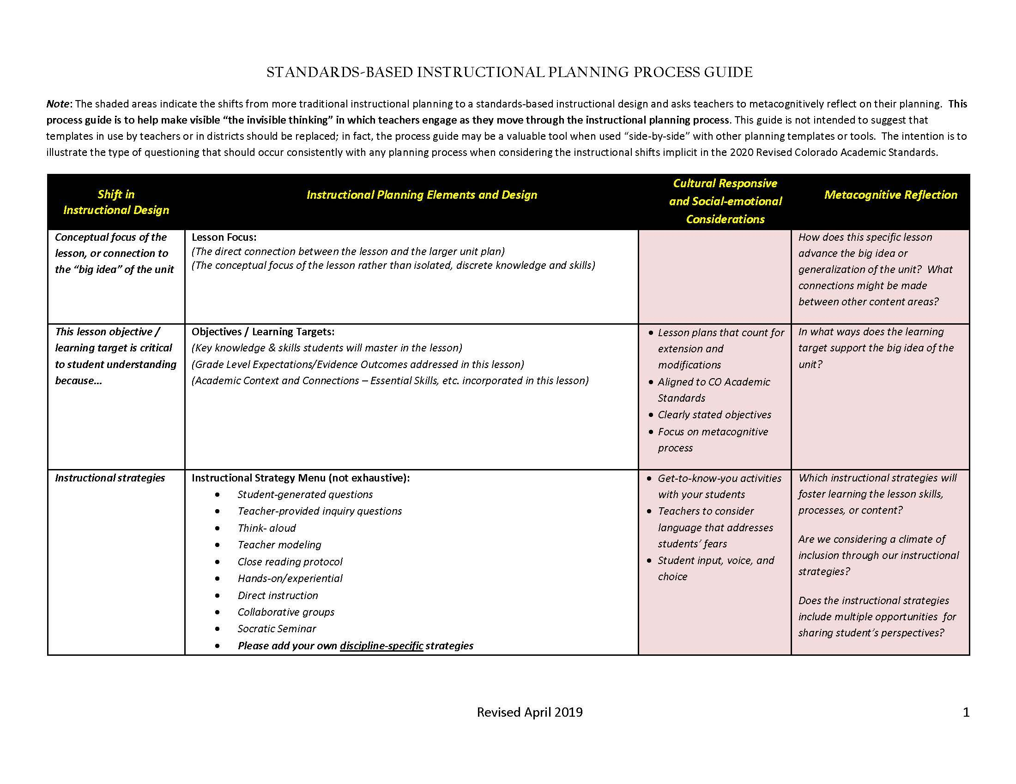
The Instructional Planning Process Guide pg. 1
Gaps: Content and skills described by the standards that are underrepresented in your curriculum
Notes:
[Estimated time: 5 minutes]
Review/Discuss as group
As you proceed through each row you are guided to view each instructional planning element and design with the goal of shifting from more traditional instructional planning to a standards-based instructional design.
This is achieved through two key methods:
The first by guiding you through culturally responsive and social-emotional considerations for each design element.
The second method is through a prompt designed to assist teachers to metacognitively reflect on their planning. The goal here is to develop the habit of reflecting as the planning/decision making is taking place, rather than solely after the completion of the lesson.

Slide 7
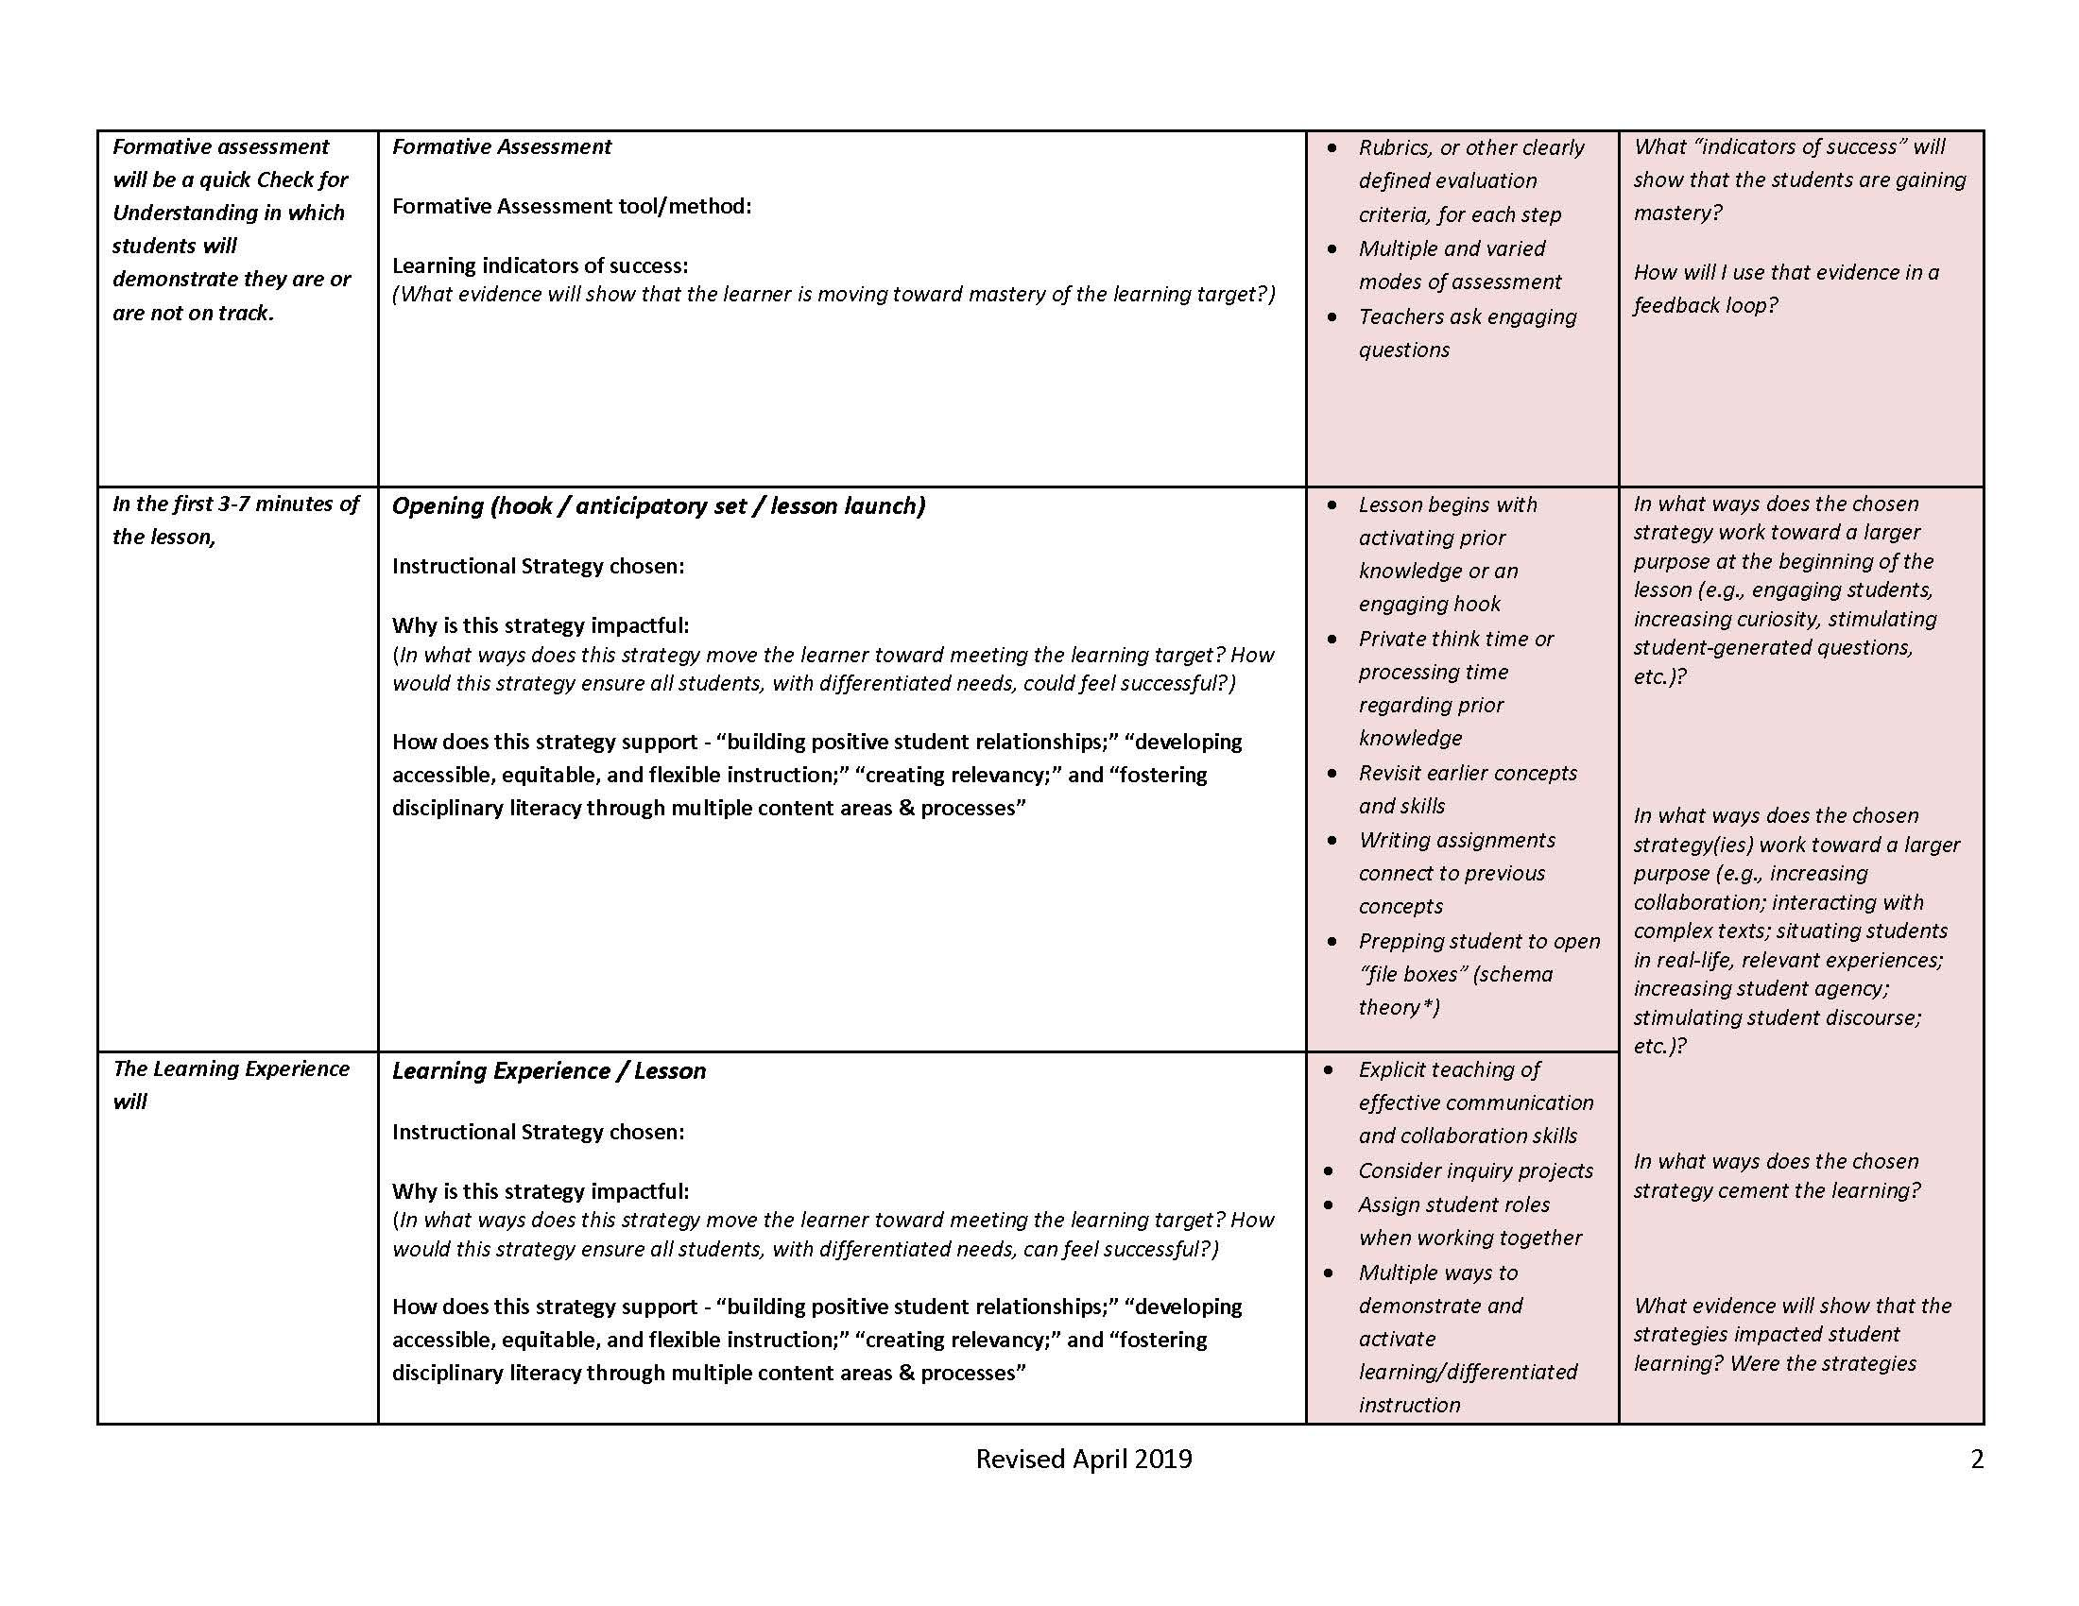
The Instructional Planning Process Guide pg. 2
Gaps: Content and skills described by the standards that are underrepresented in your curriculum
Notes:
[Estimated time: 5 minutes]
Review/Discuss as a group
Look-fors:
When developing an opening/hook or the learning experiences, how does this design element connect the Four Pillars of BFI?
How do the prompts encourage you to examine this design element through a culturally responsive and/or a social-emotional lens?
How do the metacognitive reflection prompts allow you to examine how the design element effects the process of engaging students, increasing curiosity, stimulating student-generated questions, and evidence which shows the strategies impacted student learning, etc

Slide 8
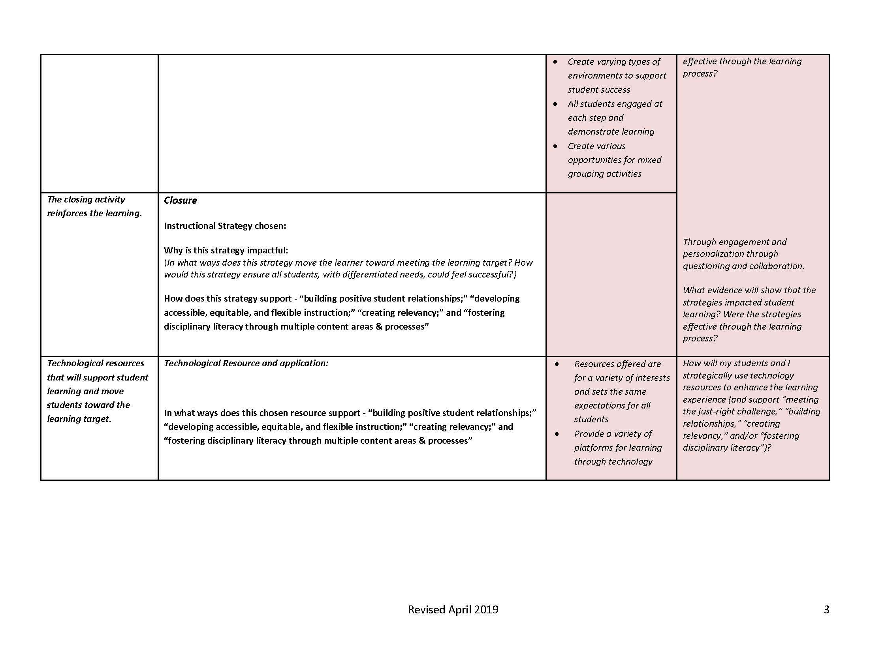
The Instructional Planning Process Guide pg. 3
Gaps: Content and skills described by the standards that are underrepresented in your curriculum
Notes:
[Estimated time: 5 minutes]
Review/Discuss as group
Look-fors
When developing the lesson closure or the technological resources how does this design element connect the Four Pillars of BFI?
How do the prompts encourage you to examine this design element through a culturally responsive and/or a social-emotional lens?
How do the metacognitive reflection prompts allow you to examine how the design element effects the process of engaging students, increasing curiosity, stimulating student-generated questions, and evidence which shows the strategies impacted student learning, etc

Slide 9
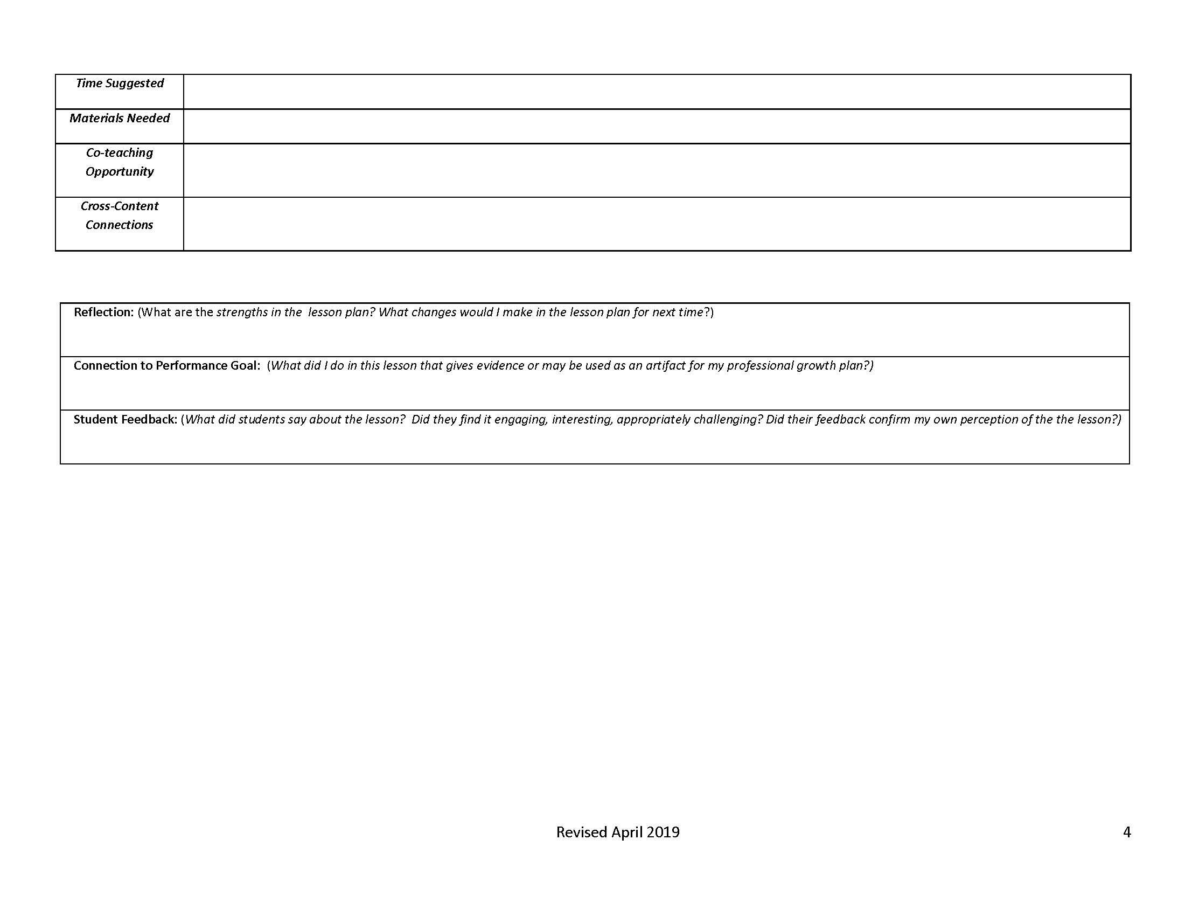
The Instructional Planning Process Guide pg. 4
Gaps: Content and skills described by the standards that are underrepresented in your curriculum
Notes:
[Estimated time: 5-7 minutes]
a. Read the following questions to educators. Give them 5-7 minutes to reflect and capture their thinking on the notecatcher.
How do you envision the post lesson reflection changing due to you reflecting while engaged in the planning/decision making process?
How is this different from your current instructional planning practices? Tell them to consider the following as they answer question #2.
What practice do you need to modify to align to this method of planning?
What benefits does method of instructional planning provide?
What barriers present themselves in this method of instructional planning?
How would you overcome these barriers?

Slide 10
Activity: Understanding the Process Guide
Gaps: Content and skills described by the standards that are underrepresented in your curriculum
Form groups of 3-5.
Each group takes 1 page of the Instructional Planning Process Guide.
Each group reads and discusses each column on their page of the guide.
When each group is finished with their discussion, they share their understandings within their group.
As a reflection of this activity, the small groups discuss how this process guide highlights the elements of BFI?
How does the process guide illuminate the thinking that goes into planning for BFI?
Notes:
[Estimated time: 15 minutes]
Form groups of 3-5.
Each group takes 1 page of the Instructional Planning Process Guide.
Each group reads and discusses each column on their page of the guide.
When each group is finished with their discussion, they share their understandings within their group.
As a reflection of this activity, the small groups discuss how this process guide highlights the elements of BFI?
How does the process guide illuminate the thinking that goes into planning for BFI?

Slide 11
Post-Reading Questions
As a whole group share ideas and answer the questions below:
How does this guide consider student learning and skill building before the planning takes place?
How does this guide help you reflect on your planning process?
How does this planning guide help to align with the standards?
How might you use this tool next to your current planning tool? Would this be a beneficial practice to help you better plan your lessons? Why, or why not?
Are there any columns/sections that are more confusing? Why?
Notes:
[Estimated time: 5 minutes]
As a whole group, share ideas and answer the questions below.
How does this guide consider student learning and skill building before the planning takes place?
How does this guide help you reflect on your planning process?
How does this planning guide help to align with the standards?
How might you use this tool next to your current planning tool? Would this be a beneficial practice to help you better plan your lessons? Why, or why not?
Are there any columns/sections that are more confusing? Why?

Slide 12
Tips
DO:
Consider student engagement, as intended by the standards, prior to planning instruction
Integrate high impact instructional strategies that you’ve not used before
Reflect on how instructional strategies might be received by different types of student learners
Think of the Instructional Planning Process Guide as a tool to highlight the elements of BFI and how to plan for it
DON’T:
Think of standards as a checklist of topics to be taught one by one
Hold too tight to activities and lessons that aren’t aligned to the standards.
Notes:
[Estimated time: 3 minutes]
Read the “Dos” and “Don’ts.” Then, check for educator understanding.

Slide 13
Assessment: 3-2-1 Countdown
Each person should take 3 index cards. On these cards you should respond by writing:
3 things you didn't know before
2 additional things that you want to learn about this topic
1 thing you want to implement with this information
Notes:
[Estimated time: 5 minutes]
Each person should take 3 index cards. On these cards you should respond by writing:
3 things you didn't know before
2 additional things that you want to learn about this topic
1 thing you want to start doing with what you've learned
Cards can be collected at exit and/or shared orally.

Slide 14
Questions, Comments, & Concerns
Please contact the Office of Standards and Instructional Support for additional information. Refer to the Standards Implementation guide for contact information.
Notes:
[Estimated time: 5 minutes]
Address any Parking Lot questions, comments, and/or concerns

