Slide 1
Module 15:
Planning for Best, First Instruction (BFI)
Understanding and Applying High Impact Instructional Strategies for Standards-Based Learning
Notes:
[Estimated time for this module: 45-60 minutes ]
Primary Resource: Knight, J. (2013). High impact instruction. Corwin: Thousand Oaks, CA.
Note: It would be useful for each participant to have an existing lesson plan with them (or in mind) as they review these instructional strategies.

Slide 2
Goals and Objectives
Educators will be able to:
Discuss high impact instructional strategies in relation to Best, First Instruction (BFI).
Consider their students as they identify high impact instructional strategies when planning for BFI.
Apply the design principles of BFI to instructional planning.
Notes:
[Estimated time: 1 minute]
Read the slide.

Slide 3
Introduction
Best, First Instruction includes deliberate planning, enactment, and reflection. These elements are high impact instruction. Planning high impact instruction means teachers develop accessible, equitable, and flexible learning opportunities to meet the changing needs of a diverse student population.
High impact instruction includes:
Culturally Responsive Teaching
High Impact Planning
Student Learning Considerations
Teacher Instructional Practices
Notes:
[Estimated time: 1 minute]
Read the slide.
Possible extension - Have a discussion on these 3 ideas. Educators can define what each idea means to them and provide a classroom example.

Slide 4
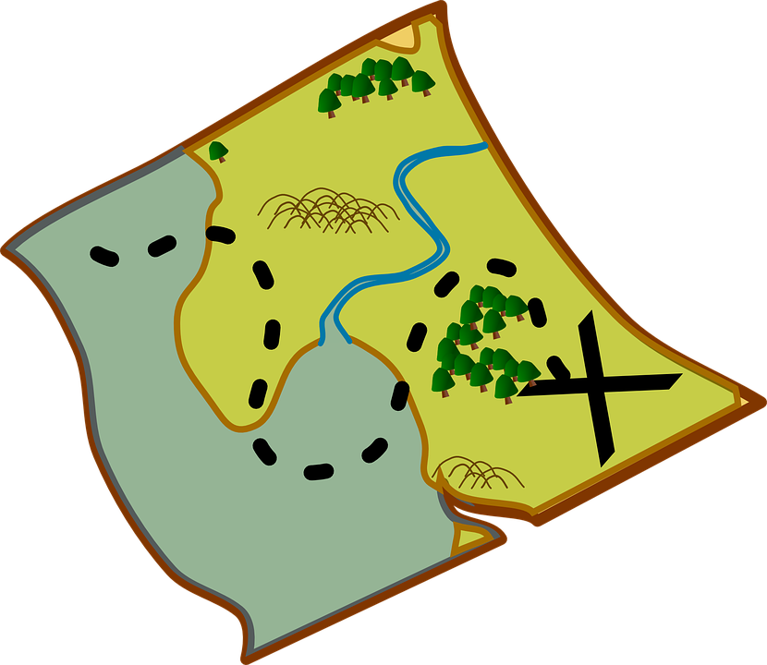
High Impact Instructional Planning
Today, you will ask yourself and others:
The second element of high impact instruction is to intentionally plan for teaching and student learning.
Resources you can use include:
The Colorado Academic Standards; and
District or school curriculum maps; and/or
Content level instructional materials
Where are your gaps? Your overlaps? Why?
Notes:
[Estimated time: 2 - 3 minutes]
Read the slide.
Ask educators to explain high impact instructional planning in their words. Discuss similarities and differences of high impact instructional planning in their content area with someone in another content area.

Slide 5
High Impact Instructional Planning - Standards
Today, you will ask yourself and others:
Where are your gaps? Your overlaps? Why?
Notes:
[Estimated time: 3-5 minutes]
Notes: In the Colorado Academic Standards, the “what” are the Prepared Graduate Statements and the Grade Level Expectations. These help teachers know “what” they are teaching to the students.
The “how” are the evidence outcomes. These identify ways in which educators can determine if students are meeting the “what” of the standard.
The Academic Content and Connections are the “why” of the standards. These ideas can help educators to create relevance for the students and identify guiding questions for the students. These ideas help the standards to be learning focused instead of activity focused.
This level of planning can improve teaching by having emphasis on the concepts of the discipline you are teaching.
Possible Extensions: Critically review the standards (in the Educators’ content areas) to find opportunities to consider a “learning” over “activity” focus. Review Module 10 to make sure your planning is aligned with the standards and there are no “gaps” in your teaching.
PNotes

Slide 6
High Impact Instructional Planning -
Colorado Essential Skills
Today, you will ask yourself and others:
In every content area, the Academic Context and Connections - the “why” of the standards - includes statements related to the Colorado Essential Skills.
The Colorado Essential Skills include:
creative and innovation skills;
critical-thinking and problem solving skills;
communication and collaboration skills;
social and cultural awareness;
civic engagement;
initiative and self-direction
flexibility;
productivity and accountability
character and leadership
the ability to use the information and communication technologies to find, evaluate, create, and communicate information
Where are your gaps? Your overlaps? Why?
Notes:
[Estimated time: 2 minutes]
Notes: Review the Colorado Essential Skills website: https://www.cde.state.co.us/standardsandinstruction/essentialskills to assist with greater understanding of the essential skills and how/why they should be included in standards-based instructional planning.

Slide 7
High Impact Instructional Planning - Curriculum Maps and Other Resources
Consult district or school curriculum maps that may assist in your instructional planning.
Double check to make sure that curriculum maps include all of the standards.
Instructional materials and teaching guides can also provide assistance to planning, as long as they are learning focused.
Notes:
[Estimated time: 1 minute]
Read the slide.

Slide 8
Student Learning Considerations
How can you plan with intentionality so that the focus of instruction is on active student learning?
Students are given opportunities to plan and organize, monitor their own work, direct their own learning, and to self-reflect along the way.
When we provide students with time and space to be aware of their own knowledge and their own thinking, student ownership increases.
Notes:
[Estimated time: 5 minutes]
Ask participants to discuss and connect to the ideas of emotions, interest, perceived importance, and perceptions of efficacy in their own classrooms and teaching.
Source: Marzano, R.J. & Pickering, D.J. (2011). The Highly Engaged Classroom. Marzano Research Laboratory, Bloomington, IN.

Slide 9
High Impact Instructional Strategies
High Impact Instructional Strategies are tools to increase active learning in every content area.
Most strategies may fall into these categories (Knight, 2013):
Thinking prompts (cues, advanced organizers, nonlinguistic representations)
Questioning (posing problems)
Stories (to clarify and reinforce learning; allow students to express their point of view)
Cooperative learning (learning is mediated through peers)
Authentic learning (relevant applications of learning)
Disciplinary Literacy (engaging in the academic discipline through reading and writing)
Notes:
[Estimated time: 3-5 minutes]
Note: Teachers use high impact instructional strategies in their teaching every day; however, they do not always think about how, when, and why they utilize them.
At tables, have educators brainstorm the different ways they can or do engage students using these six categories of instructional strategies. Chart your brainstorm.

Slide 10
High Impact Instructional Strategies - Thinking Prompts
Thinking prompts are “devices that provoke conversation, dialogue, and deep thought” (Knight, 2013, p. 132).
In the visual and performing arts, thinking prompts may include:
brainstorming
compare and contrast
improvisation
Prompts could be:
videos
photographs
works of art or dance
music
other artifacts
Notes:
[Estimated time: 3-5 minutes]
Explain to the educators that these thinking prompt strategies could be aligned with the following Colorado Essential Skills:
creativity and innovation
critical thinking and problem-solving
flexibility
productivity and accountability
Ask: What are some thinking prompts that are used in your discipline?

Slide 11
High Impact Instructional Strategies - Questioning
Questioning is “asking the right question at the right time” (Knight, 2013, p. 154). This includes the type (open or closed), kind (opinion or right/wrong), and level (idea, skill, or knowledge) of question.
In the visual and performing arts, questioning may include (Marzano & Pickering, 2011):
calling on students randomly
paired responses
providing wait time
building on student responses
simultaneous individual response
Notes:
[Estimated time: 3-5 minutes]
Explain to the educators that these questioning strategies could be aligned with the following Colorado Essential Skills:
critical thinking and problem-solving
communication and collaboration
social and cultural awareness
flexibility
Note: When teachers develop questions as teaching strategies, it is important to be mindful of the kind of questions, the types of questions, and the level of the questions.
The type of question refers to open-ended or closed-ended questions. Open-ended questions have and unlimited number of responses, while closed-ended questions have a finite number of answers.
The kind of question refers to opinion questions or right/wrong questions. Opinion questions do not have a right or wrong answer, while right and wrong question have correct and incorrect answers.
The level of question is the idea, skill, or knowledge of the question. Idea questions are about themes, concepts, overarching ideas, and content that occurs throughout the course. Skill questions allow students to apply their knowledge in new situations. Knowledge questions are recall questions about information.
Ask the educators: What kinds of questions do you usually use in teaching? Could you construct other types of questions?

Slide 12
High Impact Instructional Strategies - Stories
Stories are about using narratives to enhance learning (Knight, 2013, p. 174).
In the visual and performing arts, stories may include:
demonstration/modeling
discovery learning
conceptul and project based learning
role play
improvisation
establish and link prior knowledge
create real-world and personal relevance
Notes:
[Estimated time: 3-5 minutes]
Explain to the educators that the use of stories as high impact instructional strategies could be aligned with the following Colorado Essential Skills:
critical thinking and problem-solving
communication and collaboration
social and cultural awareness
character and leadership
the ability to use the information and communications technologies to find, evaluate, and communicate information
Note: Stories can be used to connect learning to students’ prior knowledge and experiences. Stories can be told in an open ended way that allows students to draw their own conclusions. Stories can be told in a more direct way that explicitly connects the elements of the story to the content being learned.
Stories can be used to (a) anchor new knowledge, (b) build prior knowledge, (c) prompt thinking and dialogue, (d) generate interest, (e) inspire hope, (f) offer new perspectives, (g) describe epiphanies, and (h) build community (Knight, 2012, p. 193).
Ask the educators: What are stories you use in teaching?

Slide 13
High Impact Instructional Strategies - Cooperative Learning
Cooperative learning is successfully guiding students to work together to achieve a common goal (Knight, 2013, p. 196).
In the visual and performing arts, cooperative learning may include:
imagining/brainstorming
compare and contrast
discovery learning
role play
providing feedback
reflective discussion
create real-world and personal relevance
Notes:
[Estimated time: 3-5 minutes]
Explain to the educators that these cooperative learning strategies could be aligned with the following Colorado Essential Skills:
critical thinking and problem-solving
communication and collaboration
social and cultural awareness
initiative and self-direction
flexibility
productivity and accountability
character and leadership
the ability to use the information and communications technologies to find, evaluate, and communicate information
Note: In cooperative learning, student work in groups of various sizes and control their own learning. Students work together to accomplish a shared goal.
Cooperative learning assists teachers with fostering student engagement, formative assessment, differentiated instruction, construction of knowledge among students, and communication skills among students.
Ask the educators: What are cooperative learning strategies that you use in your classroom? What are some that you have thought about using, but have never tried?

Slide 14
High Impact Instructional Strategies - Authentic Learning
Authentic learning is about designing real-world learning opportunities
(Knight, 2013, p. 220).
In the visual and performing arts, authentic learning may include:
imagining/brainstorming
compare and contrast
discovery learning
role play
providing feedback
reflective discussion
conceptual and project based learning
establish and link prior knowledge
create real-world and personal relevance
Notes:
[Estimated time: 3-5 minutes]
Explain to the educators that these authentic learning strategies could be aligned with the following Colorado Essential Skills:
creativity and innovation skills
critical thinking and problem-solving
communication and collaboration
social and cultural awareness
initiative and self-direction
flexibility
productivity and accountability
character and leadership
the ability to use the information and communications technologies to find, evaluate, and communicate information
Note: According to Knight (2012), authentic learning involves a real-world issue, a real world product, a real-world assessment, and real student engagement. This means that it is focused on questions or problems with the central concepts and principles of a discipline.
Ask educators: What are ways that you can use authentic learning in your classroom?

Slide 15
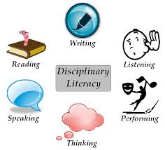
High Impact Instructional Strategies - Disciplinary Literacy
Educators engage in the standards through disciplinary literacy practices that respects the multiple and diverse ways in which educators will read, reason, write, think, speak, and most importantly, participate in learning the revised CAS from the perspective of their content area.
For example, students will read and write narratives, poetry, and speeches within an English classroom, be expected to read and perform musical scores in their orchestra classroom, read and write about scientifically-based phenomena in their science classroom, and understand and generate art in their art class.
Notes:
[Estimated time: 1 minute]
This slide is a reminder to educators that disciplinary literacy is a foundational element of the revised 2020 CAS; therefore, thoughtful, intentional incorporation of disciplinary literacy practices should be part of instructional planning.
Ask the educators: How are you currently applying disciplinary practices into your classroom? What might you need to improve upon the inclusion of disciplinary literacy practices in your classroom?

Slide 16
High Impact Instructional Strategies - Application
How can you plan to use high-impact instructional strategies in your content area?
Think of a lesson you teach.
Keeping your students needs in mind, identify how students will be engaged.
Consider the high-impact instructional strategies that will engaged your students.
Write down your ideas and think about how you might implement these different strategies. (e.g., Do you need a different amount of time? Do you need more resources? Do you need to configure your classroom environment differently? Do you need professional development?)
Notes:
[Estimated time: 10 minutes]
Note: It’s good to have a lesson or lesson plan in mind as you are thinking about how to apply high-impact instructional strategies.
Ask the educators to write their thoughts down on the notecatcher.

Slide 17
Assessment: Exit Ticket
List 5 strategies that you consider to be high impact strategies in your content area.
Add at least 2 skills that match each high impact strategy that you listed.
Notes:
[Estimated time: 2 minutes]
Following the completion of the exit ticket, provide teachers with the high impact instructional strategies grid for their content area.

Slide 18
Questions, Comments, & Concerns
Please contact the Office of Standards and Instructional Support for additional information. Refer to the Standards Implementation guide for contact information.
Notes:
[Estimated time: 2-3 minutes]
Address any Parking Lot questions, comments, and/or concerns

