Slide 1
Module 3:
The Birds & the Bees of the Colorado Academic Standards

Slide 2
Goals & Objectives
Provide an overview of the standards review and revision process
Review the high level plan for implementation support
Notes:
[Estimated time: 1 min]

Slide 3
History of CAP4K & the CAS
§2008: CAP4K passes; school readiness and postsecondary workforce readiness defined by the State Board of Education
§2009: Standards revision process conducted; new standards adopted in all ten content areas (called the Colorado Academic Standards)
§2010: Standards in mathematics and English/language arts adopted; standards in these two content areas reissued
§2011-13: Transition process to new standards and assessments
§2013-14: Full implementation of standards and continued transition to new assessment system
§July 1, 2018: The first review and revision cycle for the Colorado Academic Standards is set to conclude (and every six years thereafter)
Notes:
[Estimated time: 5 min]

Slide 4
CAS Revision Process & Timeline
2016 - 2017
2017 - 2018
Public Input
Public Input
Notes:
As part of the revision process, the public was asked, on 2 occasions, to provide feedback on the standards via an online system. CDE received thousands of comments regarding the standards.
The State Board of Education (SBE) was presented with the proposed revised standards for approval. By June 2018, all content area standards had been approved by the SBE.
[Estimated time: 2 min]

Slide 5
Committee Selection
Applications were considered using a blind-review process considering only the applicants’ qualifications.
Committees included educators (across all grade bands P – 12), business leaders, representatives from higher education, and parents/community members.
Consideration was given to applicants representing different geographic regions and student populations (i.e., gifted and talented, students with disabilities, English Learners).
Notes:
[Estimated time: 2 min]

Slide 6
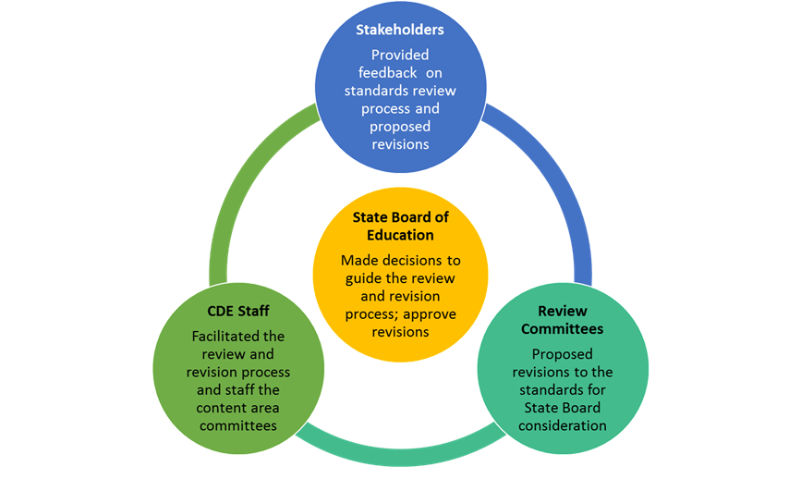
Standards Review and Revision:
Roles and Responsibilities
Notes:
[Estimated time: 2 min]

Slide 7
Committee Decision Making Process
The committees considered the following factors as they proposed revisions to the standards:
How high is the demand for change (i.e., number of stakeholders, variety of stakeholders, number of sources)?
What is the scope of the proposed change (i.e., one grade level, many grade levels, many subject areas)?
What would be the effect (positive or negative) on classroom teaching and student learning?
What might be the potential cost (i.e., financial, staff time and training)?
Do the benefits of a proposed change outweigh the costs?
Notes:
[Estimated time: 2 min]

Slide 8
Guiding Principles for the Review and Revision
⇒ Transparent
⇒ Inclusive
⇒ Research-informed
⇒ Consistent
⇒ Substantive
⇒ Improvement-oriented
Notes:
Transparent: The department will make every attempt to ensure the decisions and processes for the standards review and revision process are public.
Inclusive: The department will strive to engage key stakeholders in each phase of the standards review and revision process. The review process will include substantial and frequent opportunities for the public to weigh in on every standard.
Research-informed: Throughout the standards review and revision process, the department will base its recommendations on research, lessons learned from other states, and objective, third-party reviews of the Colorado Academic Standards.
Consistent: The standards review and revision process will be consistent with statutory requirements and with past standards reviews.
Substantive: The standards review and revision process will focus on the substance of the actual standards themselves.
Improvement-oriented: The purpose of the standards review and revision process is to improve what exists today rather than start from scratch. The review process will improve Colorado’s current standards based on the feedback of Colorado educators, education leaders, parents, students, community and business leaders, and higher education leaders.
[Estimated time: 4 min]

Slide 9
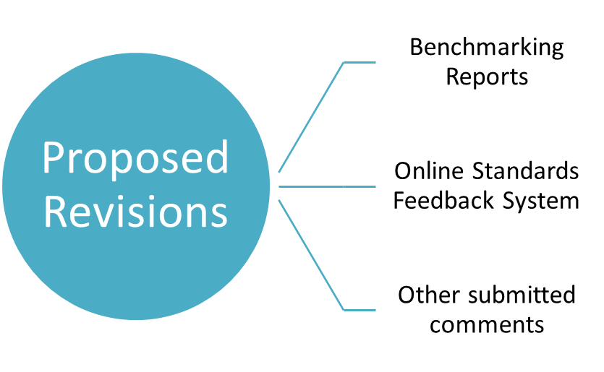
Data Sources for Revision
Notes:
[Estimated time: 2 min]

Slide 10
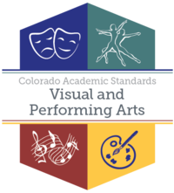
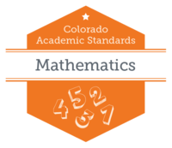
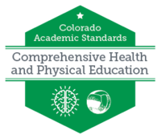
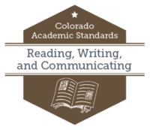
Standards Final Approval
8 Sets of Standards/16 Content Areas
Drama/ Theatre
Dance
Music
Visual Arts
2
4
History
Geography
Economics
Civics
Financial Literacy
5
Notes:
Explain:
The Standards Review Committees revised standards in 16 content areas and developed new standards in 1 content area (computer science) over the past 1 ½ years!
[Estimated time: 2 min]

Slide 11
Implementation Timeline
District Transition: 1. review and revise local standards ; 2. revise local curriculum
Districts implement
2020 CAS
2018-2019
2020 - Fall
2019 - 2020
2021- Spring
District Transition: 1. review and revise local standards ; 2. revise local curriculum
State assessments reflect revisions to the CAS
Notes:
Explain:
School districts have 2 years to implement the revised 2020 CAS. Full implementation of the 2020 CAS begins in the 2020-2021 school year. Notice that the CMAS will reflect the revised CAS in the Spring of 2021 test administration.
[Estimated time: 3 min]

Slide 12
Before leaving, are there any...
Please contact your Content Specialist in the Office of Standards and Instructional Support for additional information. Refer to the Standards Implementation guide for contact information.

