Slide 1
Facility Schools 101
Spring 2021

Slide 2
Facility Schools 101 What is a Facility School
Course Outline
What is a Facility School?
History of Facility Schools prior to 2008
2008 Legislative Changes
Facility Schools Board
Office of Facility Schools
Current District Map/Directory
Communications

Slide 3
Facility Schools

Slide 4
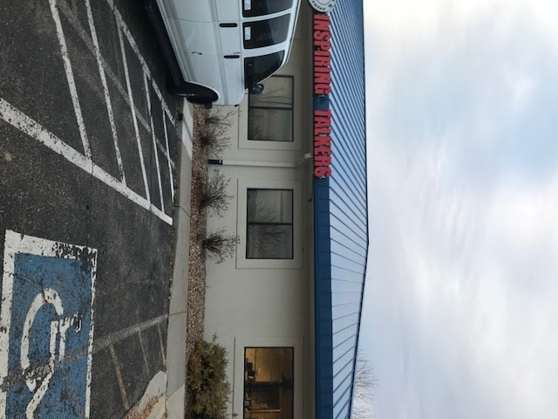
Facility Schools 101 What is a Facility School
Inspiring Talkers
Location: Firestone
Average number of students: 6
Day Treatment
Male and female
Grades: K-12
Serves students who are nonverbal and have multiple disabilities
Age of school: 2 years

Slide 5
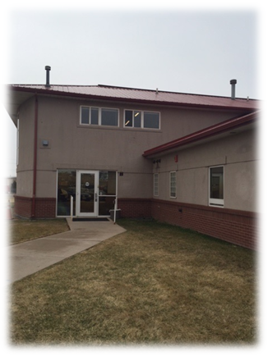
Facility Schools 101 What is a Facility School
North Greeley Academy (Alternative Homes for Youth)
Location: Greeley
Average number of students: 8
Residential and Day Treatment
Male only
Grades: 5-12
Serves students with sexually abusive behaviors, substance abuse challenges, mental health challenges and challenges with other criminogenic behaviors.
Age of school: 33 years

Slide 6
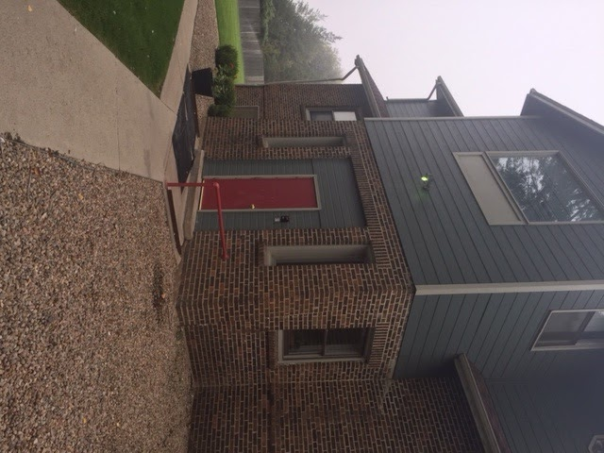
Facility Schools 101 What is a Facility School
Shiloh Longmont
Location: Longmont
Average number of students: 20
Residential and Day Treatment
Male only
Grades: 6-12
Serves students with emotional/behavioral disorders who need mental health support and stabilization
Age of school 33 years

Slide 7
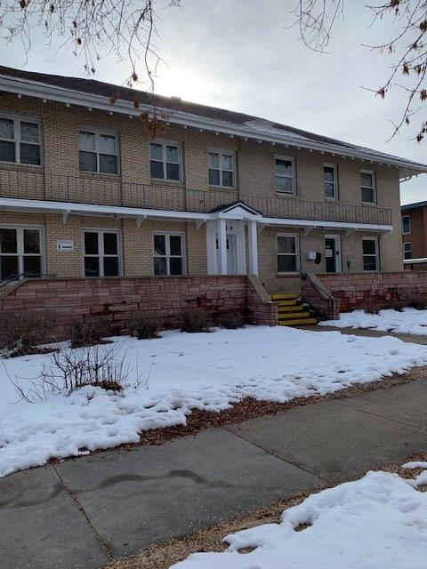
Facility Schools 101 What is a Facility School
Turning Point Waverly School
Location: Ft. Collins
Average number of students: 25
Residential and Day Treatment
Male and female
Grades: 8-12
Serves students who have emotional and behavioral needs and substance abuse issues
Age of school: 50 years

Slide 8
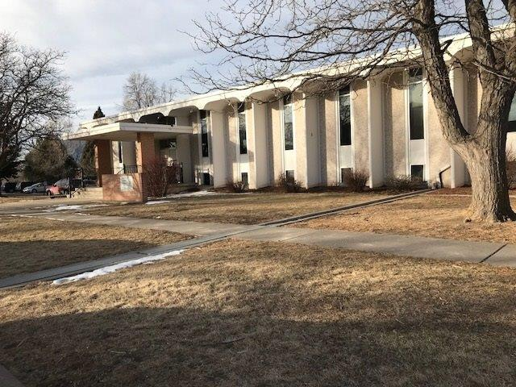
Facility Schools 101 What is a Facility School
J. Wilkins Opportunity Schools (formerly Griffith Center)
Location: Colorado Springs
Average number of students: 41
Residential and Day Treatment
Male and Female
Grades: K-12
Serves students who have emotional and behavioral needs and/or offense-specific behaviors
Age of school: 91 years

Slide 9
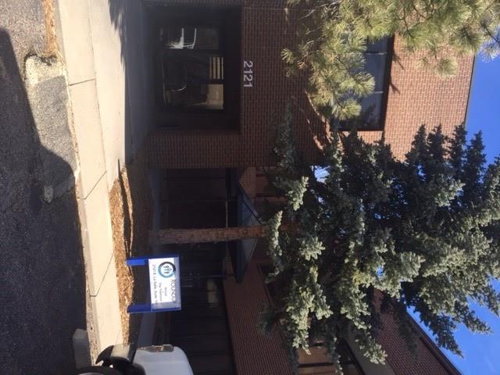
Facility Schools 101 What is a Facility School
Round Up
Location: Colorado Springs
Average number of students: 20
Residential and Day Treatment
Male and female
Grades: K-12
Serves students who have a cognitive and developmental disability
Age of school: 44 years

Slide 10
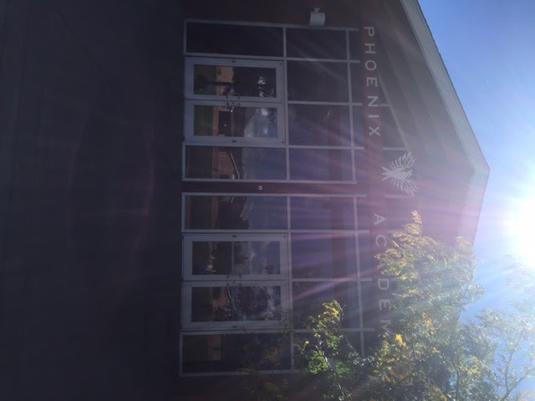
Facility Schools 101 What is a Facility School
Southern Peaks
Location: Canon City
Average number of students: 107
Residential and Day Treatment
Male and female
Grades 5-12
Serves students who have emotional and behavioral needs as well as offense-specific, gender identify and human trafficking issues
Age of school: 23 years

Slide 11
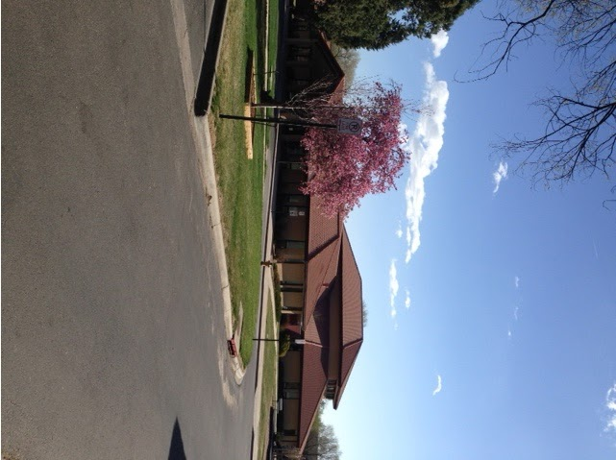
Facility Schools 101 What is a Facility School
Cedar Springs
Location: Colorado Springs
Average number of students: 24 residential; 38 acute unit
Residential and Hospital
Male and female
Grades: K-12
Serves students who have acute psychiatric disorders, substance abuse issues or emotional difficulties
Age of school: 24 years

Slide 12
Facility Schools 101 What is a Facility School
Hilltop
Location: Grand Junction
Average number of students: 12
Residential
Male and female
Grades: 6-12
Serves students who have emotional and behavioral needs
Age of school: 24 years

Slide 13
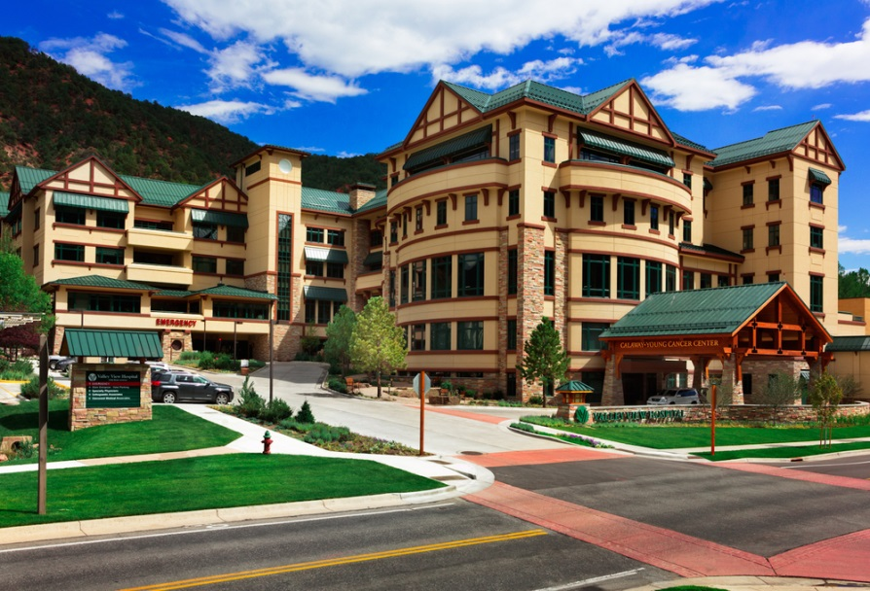
Facility Schools 101 What is a Facility School
Youth Recovery Center at Valley View Hospital
Located in Glenwood Springs
Average number of students: 16
Hospital
Male and female
Grades 5-12
Serves students diagnosed with substance abuse and mental illness
Age of school: 25 years

Slide 14
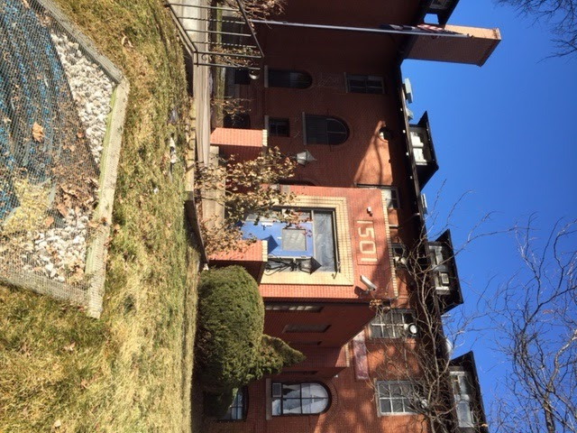
Facility Schools 101 What is a Facility School
Bansbach Academy at Denver Children’s Home
Location: Denver
Average number of students: 55
Residential and Day Treatment
Male and female
Grades: 4-12
Serves students who have emotional and behavioral needs and those who have a dual diagnosis
Age of school: 141 years

Slide 15
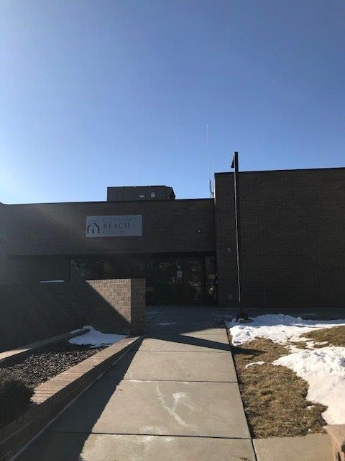
Facility Schools 101 What is a Facility School
Community Reach Center
Location: Northglenn
Average number of students: 20
Day Treatment
Male and female
Grades: K-12
Serves students who have emotional and behavioral needs and are receiving special education services
Age of school: 34 years

Slide 16
Facility Schools 101 What is a Facility School
Elevation Ability Services
Location: Aurora
Average number of students: 6
Day Treatment
Male and female
Grades: 1-10
Serves students who have an intellectual disability with emotional and behavioral issues
Age of school: 1 year

Slide 17
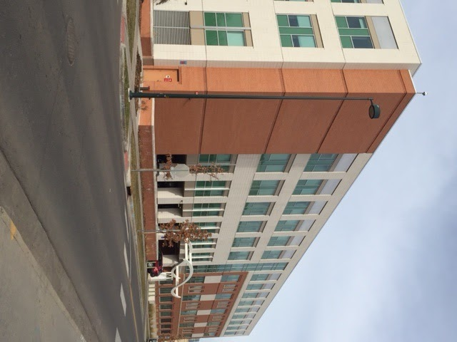
Facility Schools 101 What is a Facility School
Denver Health Medical Center
Location: Denver
Average number of students: 21
Hospital
Male and female
Serves students who have acute mental health and behavioral issues
Grades: 6-12
Age of schools: 16+ years

Slide 18
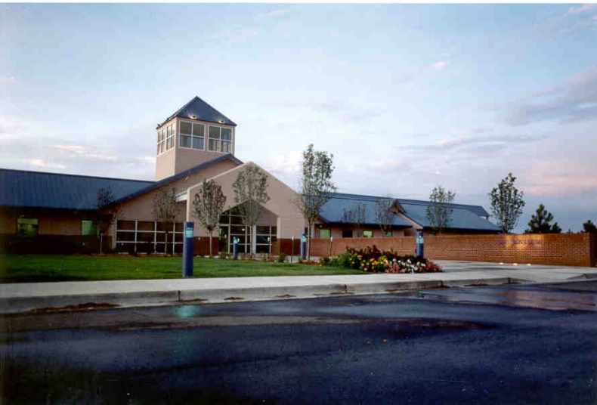
Facility Schools 101 What is a Facility School
Devereux Cleo Wallace
Location: Westminster
Avg. number of students: 100
Residential and Day Treatment
Male and female
Grades: 5-12
Serves students who have emotional and behavioral needs as well as those with Autism Spectrum Disorders
Age of school: 74 years

Slide 19
Facility Schools 101 What is a Facility School
Forward Learning Academy
Location: undisclosed
Average number of students: 5
Residential
Female only
Grades: 6-12
Serves students who are survivors of sex trafficking
Age of school: 2 years
This Photo by Unknown Author is licensed under CC BY

Slide 20
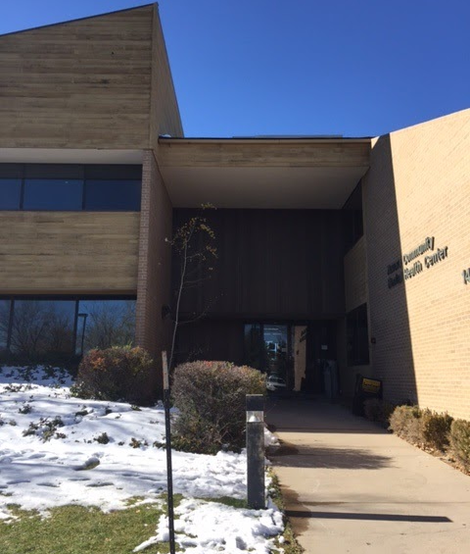
Facility Schools 101 What is a Facility School
Hampden Academy
Hampden Youth Campus
Location: Aurora
Average number of students: 15
Day treatment
Male and female
Grades: 7-12
Serves students who have emotional and behavioral needs
Age of school: 34 years

Slide 21
Facility Schools 101 What is a Facility School
Metro Children’s Center Hampden Youth Campus
Location: Aurora
Average number of students: 15
Day treatment
Male and female
Grades: K-8
Serves students who have emotional and behavioral needs
Age of school: 32 years

Slide 22
Facility Schools 101 What is a Facility School
Jefferson Hills Lakewood
Location: Lakewood
Average number of students: 16
Day treatment
Male and female
Grades: 5-12
Serves students who have Autism Spectrum Disorders and/or students who have emotional and behavioral needs
Age of school: 8 years

Slide 23
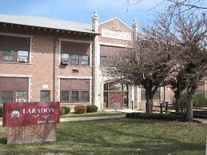
Facility Schools 101 What is a Facility School
Laradon Hall
Location: Denver
Average number of students: 70
Day treatment
Male and female
Grades: K-12
Serves students who have intellectual disabilities and/or Autism Spectrum Disorders
Age of school: 68 years

Slide 24
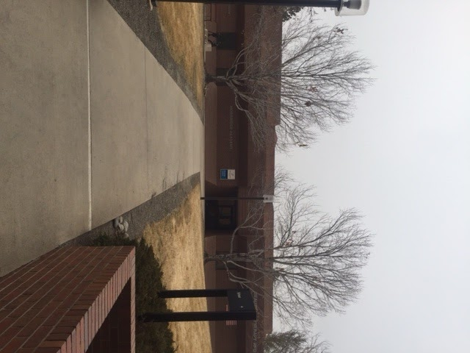
Facility Schools 101 What is a Facility School
Morgridge Academy
Location: Denver
Average number of students: 70
Day treatment
Male and female
Grades: K-8
Serves students who have chronic illnesses
Age of school: 39 years

Slide 25
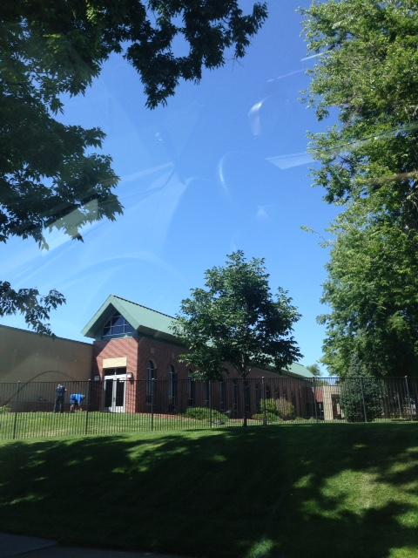
Facility Schools 101 What is a Facility School
Mt. St. Vincent Home
Location: Denver
Average number of students: 45
Residential and Day Treatment
Male and female
Grades: K-8
Serves students who have emotional/behavioral needs
Age of school: 135 years

Slide 26
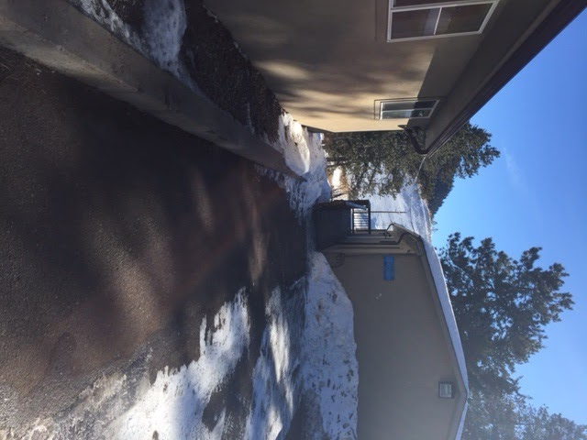
Facility Schools 101 What is a Facility School
Rite of Passage Jeffco
Location: Morrison
Average number of students: 6
Residential
Male only
Grades: 5-12
Serves students who have behavioral issues and an intellectual disability.
Age of school: 1 year

Slide 27
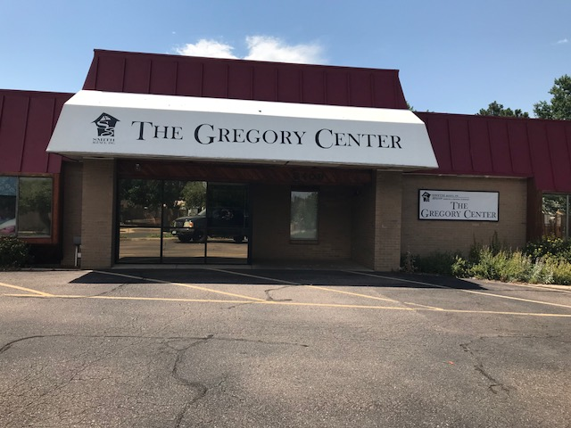
Facility Schools 101 What is a Facility School
Location: Aurora
Average number of students: 70
Day Treatment
Male and female
Grades: K-12, 18-21
Serves students who have Autism Spectrum Disorders, and/or low emotional and cognitive skills combined with a mental health diagnosis
Age of school: 17 years
Serenity

Slide 28
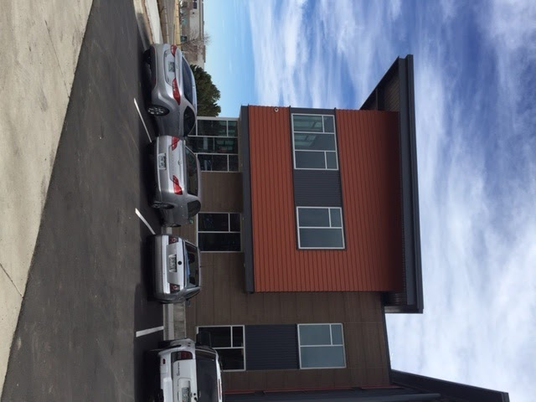
Facility Schools 101 What is a Facility School
Shiloh Family Resource Pavilion
Shiloh Family Resource Pavilion
Location: Centennial
Average number of students: 25
Residential and Day Treatment
Male and female
Grades: 5-12
Serves students who have emotional and behavioral needs
Age of school: 3 years

Slide 29
Facility Schools 101 What is a Facility School
Shiloh Littleton
Location: Littleton
Average number of students: 35
Residential and Day Treatment
Male and female
Grades: K-12
Serves students who have emotional and behavioral needs
Age of school: 28 years

Slide 30
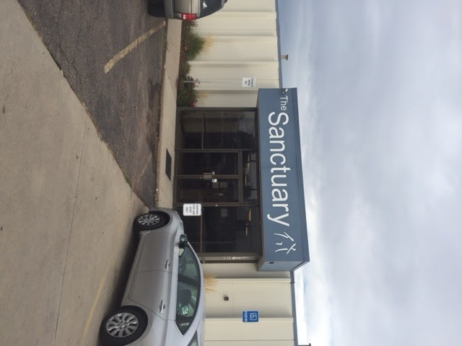
Facility Schools 101 What is a Facility School
Shiloh Sanctuary
Location: Thornton
Average number of students: 16
Residential and Day Treatment
Male and female
Grades: 6-12
Serves students who have emotional and behavioral needs
Age of school: 28 years

Slide 31
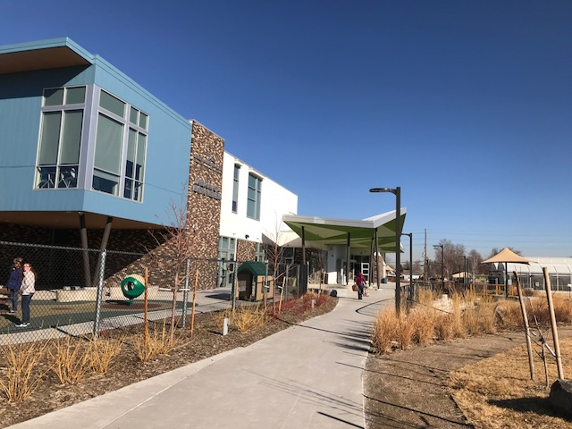
Facility Schools 101 What is a Facility School
Skyline Academy at MHCD
Location: Denver
Average number of students: 24
Day Treatment
Male and female
Grades: 1-8
Serves students who have emotional or behavioral needs
Age of school: 14 years

Slide 32
Facility Schools 101 What is a Facility School
The Joshua School Englewood
Location: Englewood
Average number of students: 32
Day Treatment
Male and female
Grades: 1-12
Serves students who have Autism Spectrum Disorders, emotional and behavioral needs and developmental disabilities
Age of school: 12 years

Slide 33
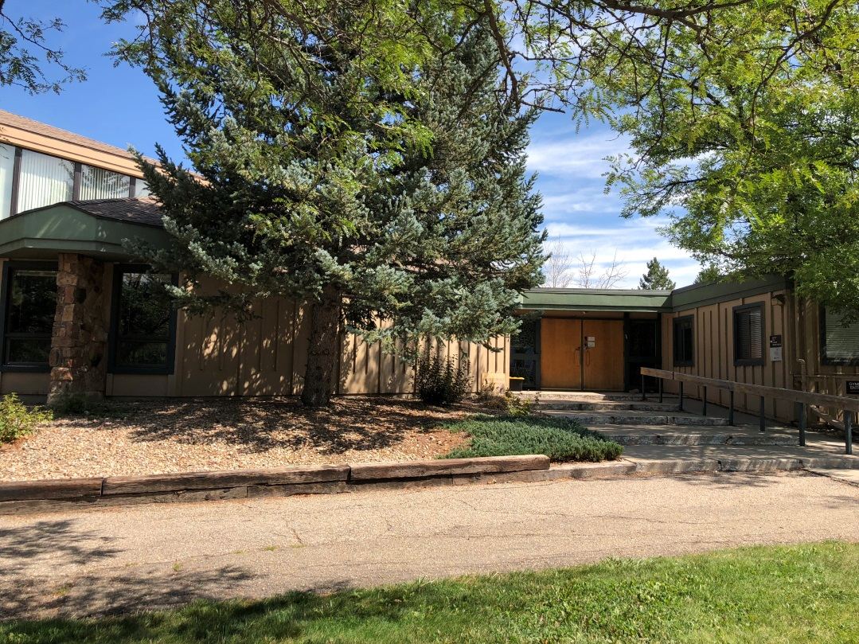
Facility Schools 101 What is a Facility School
The Joshua School Boulder
Location: Boulder
Average number of students: 16
Day Treatment
Male and female
Grades: 1-12
Serves students who have Autism Spectrum Disorders, emotional and behavioral needs and developmental disabilities
Age of school: 5 years

Slide 34
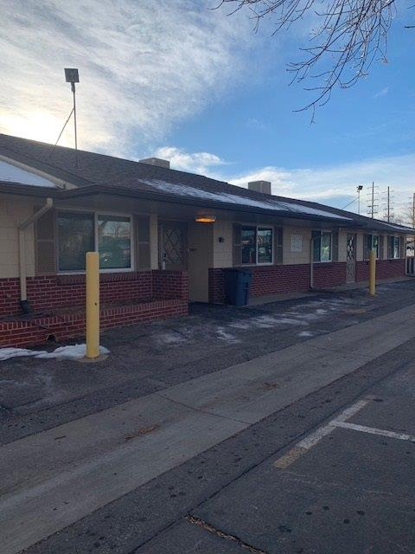
Facility Schools 101 What is a Facility School
Spectra
Location: Broomfield
Average number of students: 55
Day Treatment
Male and female
Grades: K-12
Serves students who have intensive behaviors related to Autism Spectrum Disorders, neurodevelopmental disorders and/or serious emotional disorders
Age of school: 8 years

Slide 35
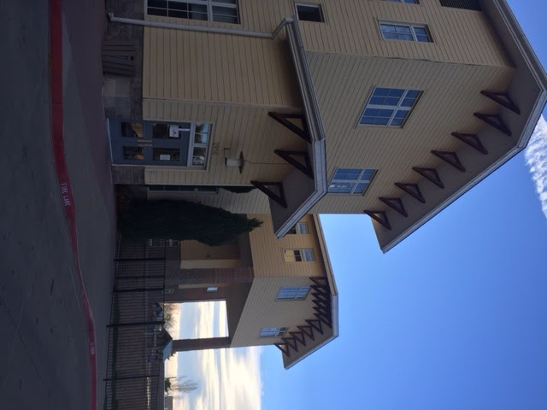
Facility Schools 101 What is a Facility School
Tennyson Center
Location: Denver
Average number of students: 93
Residential and Day Treatment
Male and female
Grades: K-12
Serves students with emotional and behavioral needs and students with a dual diagnosis
Age of school: 112 years

Slide 36
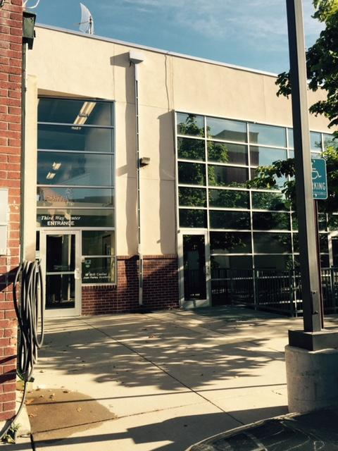
Facility Schools 101 What is a Facility School
Third Way Center Joan Farley Academy
Location: Denver
Average number of students: 35
Residential
Male and female
Grades: 8-12
Serves students with emotional and behavioral needs
Age of school: 48

Slide 37
Facility Schools 101 What is a Facility School
Third Way Center Joan Farley Academy Lowry
Location: Denver
Average number of students: 30
Residential
Male and female
Grades: 8-12
Serves students with emotional and behavioral needs
Age of school: 10 years

