Slide 1
Module 14:
Overview of Best, First Instruction
Building positive student relationships for accessible, equitable, and flexible instruction
Notes:
[Estimated time for this module: 60 minutes]
More time may be needed depending on how much time you give them in activities suggested.

Slide 2
Goals and Objectives
Educators will be able to:
Define Best, First Instruction.
Identify the 4 principles of significant relationship building with their students in order to shift to a more equitable and responsive environment.
Explain the importance of being a culturally responsive educator.
Notes:
[Estimated time: 1 minute]
Read the slide.

Slide 3
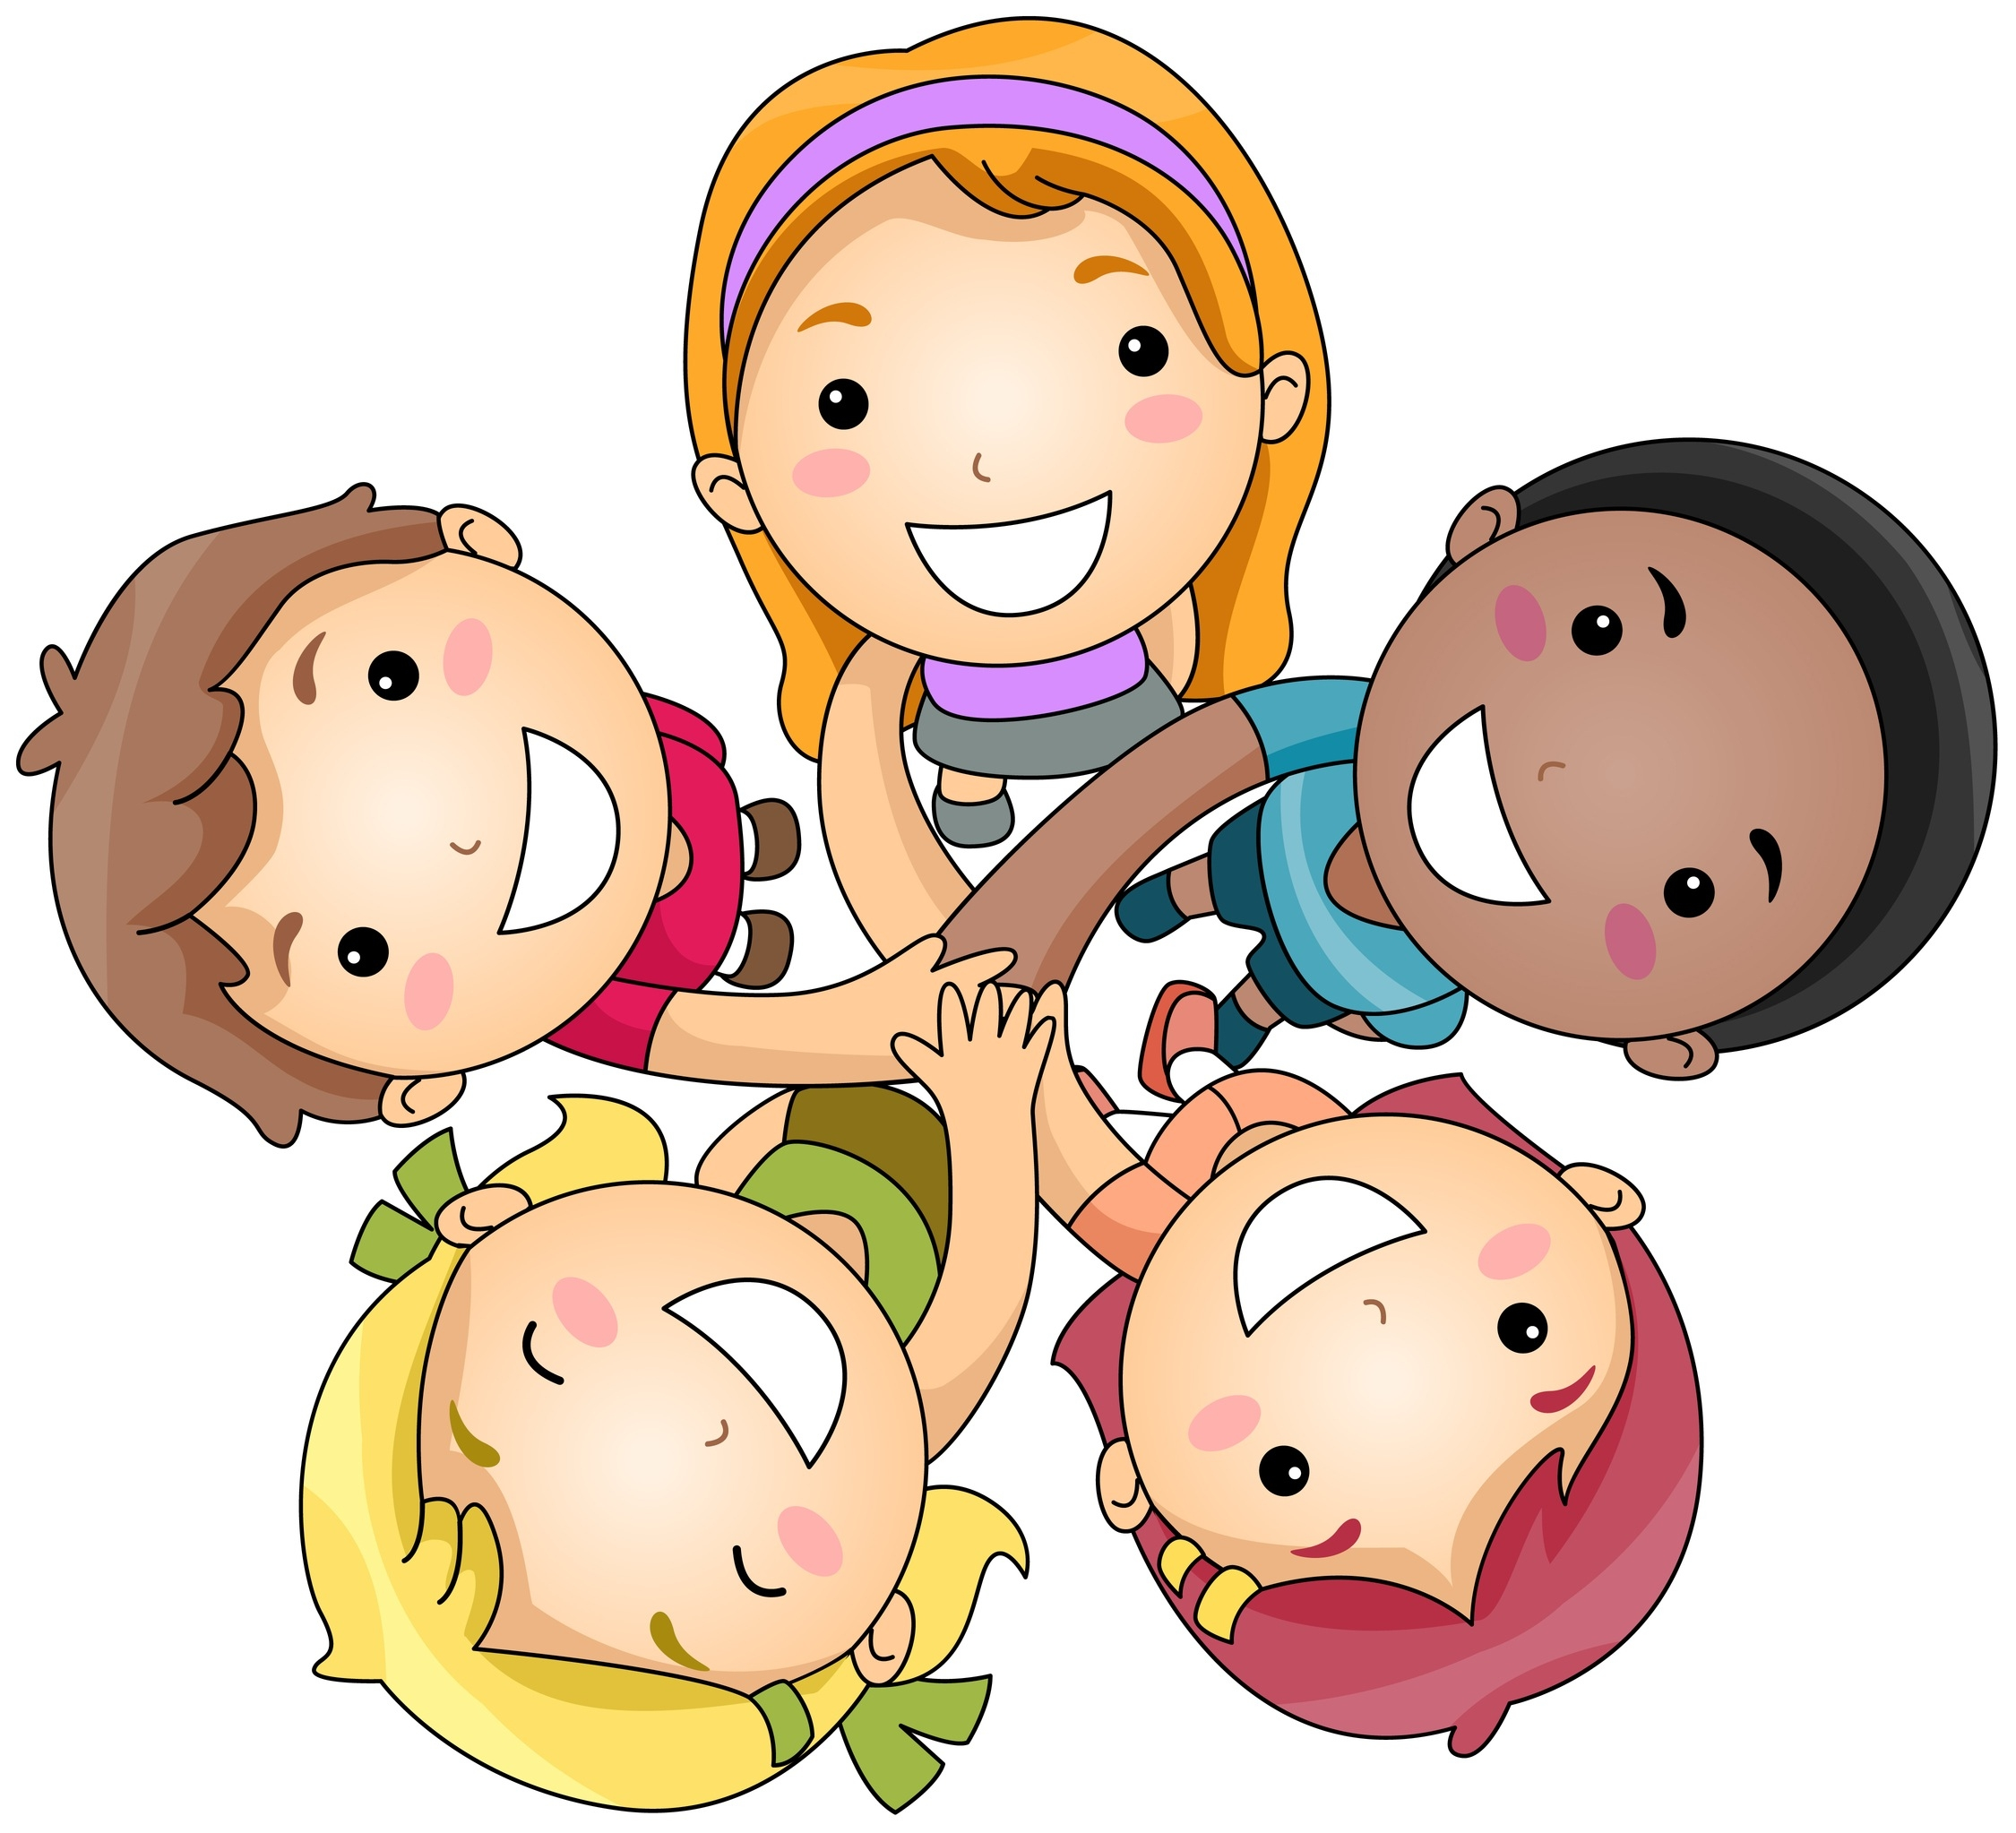
Equitable & Responsive Teaching:
The Foundation for BFI
When planning for Best First Instruction (BFI), the foundation requires educators to build meaningful relationships with all students, address individual needs, create relevancy by allowing students to see themselves in their learning, and provide opportunities for exploration and expression. The educator also utilizes instructional materials and strategies that honors the diversity of their classroom.
Notes:
[Estimated time: 5-7 minutes]
Say: I am going to read this statement. As I read, annotate it on your notecatchers using the following key:
Underline the verbs or verb phrases that requires an educator action.
Place a star (*) next to a phrase or statement that reflects your approach to providing best, first instruction.
Read the slide slowly, allowing for educators to annotate the statement.
Next, have educators synthesize their understanding by answering the following question:
What does it mean to be a “culturally responsive” educator? Give them 3 minutes to write their answer on their notecatchers.
Once the 3 minutes has expired, ask for 2 volunteers to share their synthesis with the whole group. This will be the perfect transition into the next slide.

Slide 4
Cultural Responsiveness
Creating classroom environments that foster a sense of belonging
Students with a sense of belonging in school
Feel socially connected, supported, and respected.
They trust their teachers and their peers, and they feel like they fit in at school.
They are not worried about being treated as a stereotype and are confident that they are seen as a person of value.
(Romero, 2015)
Notes:
[Estimated time: 5-7 minutes]
Have teachers skim the handout by Romero, C.
Reflect on how the sense of Belonging is central to culturally responsive teaching.

Slide 5
Culturally Responsive Educators
Create a classroom learning community of trust, ownership, and belonging.
Know their students well academically, socially, and emotionally.
Build on their students’ life experiences.
Hold high academic standards and expectations for all their students.
Source: https://blog.nationalequityproject.org/2012/08/22/5-ways-to-create-a-culturally-responsive-classroom/
Notes:
[Estimated time: 10 minutes]
Have educators check their synthesis from the previous slide with CDE’s definition of what it means to be a “culturally responsive” educator. Next, discuss the practices of a culturally responsive educator. Use the following questions to frame the discussion.
Ask: Which of these practices do you already implement in your classroom? Which practices might you be able to implement immediately? Which practices may take more time? Why? What type(s) of support do you think you need to be a culturally responsive educator?
Possible extension - Have a discussion on these 5 statements. Educators can define what this means to them and provide classroom example. Then click on link and educators can read short blog on these 5 tips.

Slide 6
Characteristics of “Best, First Instruction?”
Best, First Instruction is:
Designed to meet the needs of all students
Deliberate planning, enactment, and reflection
The assurance of safe and equitable learning culture
High-quality, effective, and engaging
Students’ first opportunity to learn standards and meet grade-level expectations
Aligned to the Colorado Academic Standards
Grounded in research-based methodology
Notes:
[Estimated time: 1 minutes]
Explain to educators that, from the student perspective, this should be the teacher’s A game everyday… this practice is consistent.
Best-First Instruction, (also referred to as first, classroom, Tier I, core, or universal instruction), is designed to meet the needs of all students. Universal Tier Instruction is high-quality, effective, and engaging instruction provided in the general education classroom as outlined in a class or course curriculum. It provides students with their first opportunity to learn standards and grade-level expectations. All first instruction should be grounded in research-based methodology.

Slide 7
The 4 Pillars of Best, First
Instruction (BFI)
All Students, All Standards
4 Instructional Pillars
Building Relationships: Deepening student agency through caring, positive and authentic connections.
Meeting the needs of ALL students: Developing accessible, equitable and flexible instruction in meeting the changing needs of a diverse populations and closing learning gaps.
Creating Relevancy: Authentic, meaningful, real-world and engaging work.
Fostering Disciplinary Literacy: Working, thinking, talking, and planning through multiple content areas & processes.
Notes:
[Estimated time: 1 minute]
Read the slide.
Say: In determining the 4 Pillars of Best, First Instruction, the Colorado Department of Education considered “big pillar” ideas that are in our Colorado Academic Standards, Curriculum Overviews, and Instructional Units. These pillars are important regardless of content area and are beyond discrete skills. They emphasize that . . .
All student learning is driven by standards and measurable and achievable objective(s).
All student learning is driven by research-based, highly effective, and efficient instructional practices.
All student learning is driven by regular assessment, which determines instructional modifications.
All student learning is driven by a positive climate and culture.
All students, all standards, equitable, culturally responsive.

Slide 8
Building Relationships & Meeting the Needs of All students
Best, first instructional planning:
builds on student strengths and cultures to appropriately challenge and develop students who will be competing in a rapidly changing global society.
engages teachers in ongoing critical reflection and learning in order to create a productive learning environment that meets the needs of all students.
(Edwards, S. & Edick, N. 2013)
Notes:
[Estimated time: 5-10 minutes]
Read this slide and the next one. Then, discuss whole group using the questions below to structure the conversation. Capture their thoughts on chart paper. This means you will need 2 separate sheets of chart paper with either the question or part of the question prewritten at the top. You may also want to ask for a volunteer to serve as the scribe to capture the thoughts of educators in the room.
Why are building relationships and meeting the needs of all students so foundational to student learning?
How might you improve upon your current practices of building relationships and meeting the needs of all your students?
Emphasize that the goal is “All students, all standards, equitable, and culturally responsive.”
Source: Edwards, S. & Edick, N. (2013) "Culturally Responsive Teaching For Significant Relationships," Journal of Praxis in Multicultural Education: Vol. 7: No. 1 , Article 4. DOI: 10.9741/2161-2978.1058 Available at: https://digitalscholarship.unlv.edu/jpme/vol7/iss1/4

Slide 9
Building Relationships & Meeting the Needs of All students
The four principles of relationship building are:
Interaction
Accommodation
Ownership
Opportunity

Slide 10
Relationship Building is the Foundation of a Culturally Responsive Classroom
Form groups of 5.
In the center of your table is an article with 5 individual sections.
Each individual in the group takes one section and reads it silently.
When group is finished reading, summarize your portion of the article to your group and capture the following questions on poster paper.
Notes:
[Estimated time: 20 minutes]
Read Slide.
Note: If doing this activity individually - read UNLV Journal of Praxis in Multicultural Education Volume 7 Number 1 Article 4 “April 2013 Culturally Responsive Teaching for Significant Relationships” article and reflect on questions on next slide.
Article is sectioned in 5 parts labeled with numbers for jigsaw activity. Have educators count 1 to 5 until all educators have a number. This is the section they will read. Remind them to annotate their section for main idea and supporting details in the section. The estimated time to read a section - 5-10 minutes, so you may want to initially give 5 minutes to read. At the end of the first 5 minutes, check with educators to see how much additional time is needed. Ask them to indicate how many additional minutes they need. One finger representing one minute. Give them the range from 1 to 5 minutes.
At the conclusion of reading, have educators share the details of the section they read with their table mates. If a number is not represented, for example, number 5, then you will need to make adjustments and pull from a table that has more than person who read that section to share with the table. The jigsaw activity shouldn’t take longer than 10 minutes.
Summarizing sections - jigsaw - 5-10 minutes.

Slide 11
Post Reading Questions
Do you disagree with any statements in the sections? If so, what and why?
What components do you see implemented in your classrooms already? Provide examples worth sharing with the group. List specific lesson plans, activities and/or ideas?
List areas for improvement based on each section.
Be prepared to share with whole group.
Notes:
[Estimated time: 15 minutes]
Read the slide
Note: 5 minutes to build ideas on group poster.
Ask for 2-3 volunteers to share their posters. Share out or gallery walk - 10 minutes

Slide 12
Reflection
Make a prediction: In what ways should your instructional planning reflect the characteristics of a culturally responsive educator?
Notes:
[Estimated time: 5 minutes]
Read slide and then give educators a few minutes to record their answers on their notecatcher.

Slide 13
Questions, Comments, & Concerns
Please contact the Office of Standards and Instructional Support for additional information. Refer to the Standards Implementation guide for contact information.
Notes:
[Estimated time: 2-3 minutes]
Address any Parking Lot questions, comments, and/or concerns

