Slide 1
Module 2:
Are You Literate?
Using Social Studies to Highlight Disciplinary Literacy & the CAS

Slide 2
Goals & Objectives
Educators will be able to:
Describe the importance of disciplinary literacy in the classroom
Discuss ways to incorporate disciplinary literacy strategies into the classroom
Define “text”
Notes:
Go over the goals and objective of this module with participants.
[estimated time: 1 min]

Slide 3
Defining Disciplinary Literacy
Disciplinary literacy is the intersection of content knowledge, experiences, and skills necessary to demonstrate understanding through the ability to read, write, communicate, and think critically using approaches unique to a specific discipline.
Notes:
Review the definition of literacy. Ask: Are there any thoughts or questions about disciplinary literacy?
[Estimated time: 2 min]

Slide 4
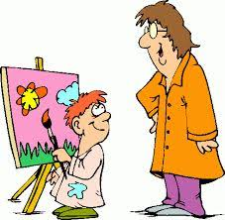
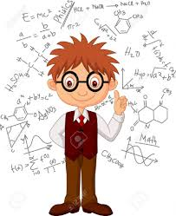
But What Exactly Does That Mean?
It means that one can read, write, think, act, and communicate like a ___________ (historian, mathematician, scientist, etc.)
Notes:
After reading the slide, have participants discuss the answer to the question: What does it mean to read, write, think, act, and communicate like a ___________? Why are these important skills?
Share: Why is disciplinary literacy important? National Assessment of Educational Progress (NAEP) - NAEP scores in reading scores have remained flat since 1998, with just a third or so of students performing at a level the NAEP defines as “proficient.” “Daniel Willingham, a psychology professor at the University of Virginia who writes about the science behind reading comprehension. Willingham explained that whether or not readers understand a text depends far more on how much background knowledge and vocabulary they have relating to the topic than on how much they’ve practiced comprehension skills. That’s because writers leave out a lot of information that they assume readers will know. If they put all the information in, their writing would be tedious. But if readers can’t supply the missing information, they have a hard time making sense of the text. If students arrive at high school without knowing who won the Civil War they’ll have a hard time understanding a textbook passage about Reconstruction.” Source: Why American Students Haven't Gotten Better at Reading in 20 Years. Schools usually focus on teaching comprehension skills instead of general knowledge—even though education researchers know better. https://www.theatlantic.com/amp/article/557915/
[Estimated time: 5 min]

Slide 5
Who Should Be Involved?
The teaching of disciplinary literacy skills belongs to all grade levels and content areas, from kindergarten to twelfth grade, from mathematics to agriculture, and from science to social studies.
Notes:
After reading this slide to the participants. Ask them what they think about this statement. Thoughts, comments, concerns?
[Estimated time: 2 min]

Slide 6
What It Isn’t...
It is not just having students read and write more - it is not giving students Venn diagrams and sentence diagramming assignments in social studies
It is not conducting basic literacy techniques to struggling readers during social studies time.
Notes:
Ask: How are your responses the same or different from what is discussed on this slide?
Next, ask participants to answer the following question on the notecatcher: What might disciplinary literacy “look like” in your classroom? Have participants share their answer with a partner.
[Estimated time: 5 min]

Slide 7
Digging Deeper
Vocabulary posted on a word wall
Reading for understanding a historical work such as a primary source
Writing in the discipline using evidence to support a claim or argument
Analyzing by drawing conclusions, making inferences, and synthesizing information
Communicating through a disciplinary lens by reading, writing, thinking, speaking, acting like a .….
Notes:
What does disciplinary literacy look like in a classroom?
Posting vocabulary words on a Word Wall is just the tip of the iceberg… the starting point for incorporating disciplinary literacy in the classroom.
To “dig deeper” into disciplinary literacy, consider the following skills necessary for demonstrating mastery within a discipline:
Reading for understanding
Writing
Analyzing
Communicating through a disciplinary lens
Teachers need to intentionally plan for and be explicit when teaching the above skills to students
All of the above skills:
Supports students’ literacy, learning, and ability to more readily engage in the disciplines they study (Moje, 2008).
Develops teachers’ instruction so they can apprentice students to negotiate and create texts in discipline-specific ways (Brozo, Moorman, Meyer, & Stewart, 2013).
Reading for understanding is a disciplinary literacy expectation across the disciplines. Generally speaking, when we think of reading, we think of reading text…. but what is “text”?
[Estimated time: 7 min]

Slide 8
Texts in the CAS
Compare and contrast the most important points and key details presented in two texts on the same topic.
Integrate information from two texts on the same topic in order to write or speak about the subject knowledgeably.
Based on the 2 statements above from the 2020 CAS in Social Studies, how would you define “text”?
Notes:
After participants have had a chance to read the two statements, ask them the question at the bottom of the slide and have them record their answer on the notecatcher and then discuss.
Next, ask the audience for examples of texts they would use to teach to the listed statements.
Most answers will probably include items such as books, documents, letters, etc. (anything that has words on it or in it). While those answers are not incorrect, the definition for text expands beyond just those artifacts containing words.
[Estimated time: 3 min]

Slide 9
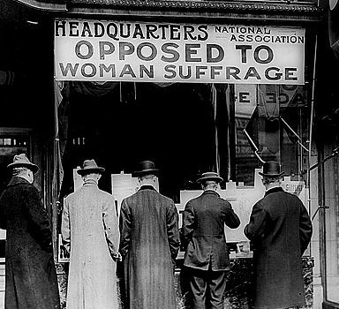
Texts…
Compare and contrast the most important points and key details presented in two texts on the same topic.
Notes:
Explain that while “reading” is used mainly to identify the act of decoding the written word, we can also consider “reading” as the process toward “making meaning of ” – comprehending -- the communication. We may watch a video or view a photograph, but if our purpose is to actively study “the text” to reach a level of comprehension requiring analysis and interpretation, then we have moved beyond an informal viewing.
Comparing these two images on women’s suffrage is a disciplinary skill - the student is asked to analyze the “texts” (primary source images) by comparing the different viewpoints represented in the images.
[Estimated time: 2 min]

Slide 10
Definition of “text”
“Any media, print or non-print, used to communicate an idea, emotion, or information”
In essence, a text can be a speech, a video, a chart or a graph, an infographic, a photograph, a painting - communications that ask students to “make meaning” or comprehend a message.
Notes:
Ask: Are you surprised about this definition of text? How does this definition of text compare to your definition of text?
[Estimated time: 3 min]

Slide 11
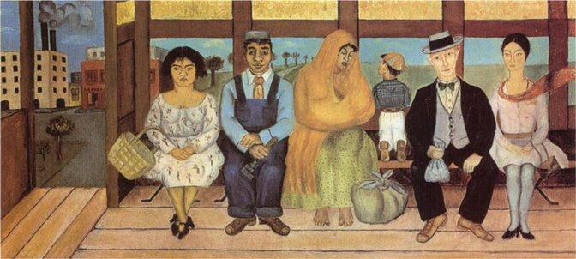
Another Text Example
Frida Kahlo “the Bus”
Notes:
Explain:
If we ask students to “make meaning of” Frida Kahlo’s painting, we may ask them to consider
what Frida Kahlo may have intended with the use of color in the painting (“The Bus”);
or the effect on our understanding by how she positioned the people in the painting;
or about the contrast of the factory/urban background and the more rural landscape on our understanding,
then we have moved beyond a casual viewing of the painting into what we could call as “reading” the painting. In particular, when we ask about the decisions “the writer” (or, in this case, “the artist”) has made in the creation of “the text,” then we are delving into the territory of disciplinary literacy.
We are studying craft, analyzing parts-to-whole, wondering about decisions made by the author/painter, all in an effort to comprehend the painting.
[Estimated time: 2 min]

Slide 12
2020 Colorado Academic Standards (CAS)
In the revision process of the 2020 CAS, disciplinary literacy skills were intentionally included in all 16 content area standards
The skill of reading and understanding text is represented throughout the standards ~ Consider how you will incorporate disciplinary skills in your classroom
Notes:
After reading the slide, ask participants to consider what texts they already use in their classroom and what new texts they can bring into their classroom.
[Estimated time: 2 min]

Slide 13
Standards Literacy
Share with a partner: What do you think you will need to know to be standards literate?
2. What knowledge and skills would an educator possess to demonstrate that they are standards literate?
The CDE Modules that follow are intended to guide educators towards standards literacy.
Can you read, understand, and apply the CAS?
Notes:
Explain and ask:
If the expectation is to become standards literate, what would you need to be able to understand, know and do in relation to the standards document?
The discipline is “standards” and these modules are intended to support your understanding of disciplinary literacy and how it is incorporated throughout the revised standards.
[Estimated time: 2 min]

Slide 14
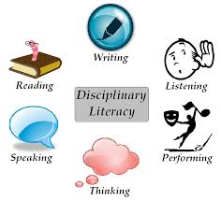
How is Disciplinary Literacy Fundamental to Standards Literacy?
Disciplinary literacy engages educators in a manner that respects the multiple and diverse ways in which educators will read, reason, write, think, speak, and most importantly, participate in learning from the perspective of their discipline.
Thus, it is important for educators to have a working knowledge of the terms, categories, and meaning of the elements of standards in order to effectively apply standards to developing and revising curriculum and to demonstrate the instructional innovations in the standards within their disciplines and classrooms.
Notes:
Read this slide outloud and ask if there are any questions
[Estimated time: 1 min]

Slide 15
Before leaving, are there any...
Please contact your Content Specialist in the Office of Standards and Instructional Support for additional information. Refer to the Standards Implementation guide for contact information.

