Slide 1
Classroom observations
Notes:
Welcome! In this section of the course, you will learn how to complete classroom observations.

Slide 2
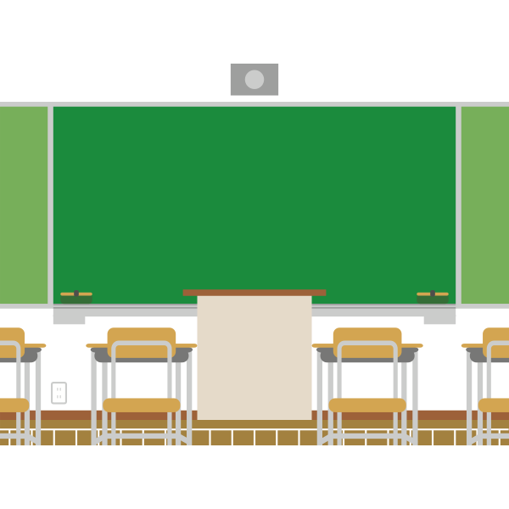
Classroom observations
In addition to interviews and document review, classroom visits are another important aspect of the CSSI review.
The CSSI team will use the Classroom Visit Tool (CVT) to score and record evidence for instructional observations.
All teachers are observed for at least one 20 minute observation. Observations will span the beginning, middle, and end of the lesson cycle.
Notes:
In addition to interviews and document review, classroom visits are another important aspect of the CSSI review.
The CSSI team will use the Classroom Visit Tool (CVT) to score and record evidence for instructional observations.
All teachers are observed for at least one 20 minute observation. Observations will span the beginning, middle, and end of the lesson cycle.

Slide 3
Observation protocol:
Before the visit, the CSSI team lead will use the school’s interview schedule and class/bell schedule to schedule instructional observations for team members assigned to standards 1-8. The team lead will ensure that all core teachers are observed (as well as specials teachers when feasible) with these parameters:
● Observations are 25-30 minutes long
● Each content will be observed at each grade level
● If a teacher teaches more than one grade level or content, the team will attempt to observe them in each area they teach
● Observations will span the beginning, middle, and end of the lesson cycle.
CSSI team members will use the Classroom Observational Tool to score and record evidence for every observation.
Notes:
Before the visit, the CSSI team lead will use the school’s interview schedule and class/bell schedule to schedule instructional observations for team members assigned to standards 1-8. The team lead will ensure that all core teachers are observed (as well as specials teachers when feasible) with these parameters:
● Observations are 25-30 minutes long
● Each content will be observed at each grade level
● If a teacher teaches more than one grade level or content, the team will attempt to observe them in each area they teach
● Observations will span the beginning, middle, and end of the lesson cycle.
CSSI team members will use the Classroom Observational Tool to score and record evidence for every observation.

Slide 4
Observation tools:
The observation tool provides the sub-indicator descriptor and specific “look-for” statements. Each sub-indicators’ “look-fors” are scored on the same 1-4 scale as the rubric.
● 4 = All look-fors are present
● 3 = Most look-fors are present
● 2 = Some look-fors are present
● 1 = None or minimal look-fors are present
Team members are encouraged to note as much concrete evidence on the observational tool as possible in order to justify the score given. It is very helpful to note which parts of the indicator were present and effective, and which were not.
Notes:
The observation tool provides the sub-indicator descriptor and specific “look-for” statements. Each sub-indicators’ “look-fors” are scored on the same 1-4 scale as the rubric.
A score of 4 indicates All look-fors are present.
A score of 3 indicates most look fors are present.
A score of 2 indicates some look fors are present.
A score of one indicates there are minimal or no look fors present.
Team members are encouraged to note as much concrete evidence on the observational tool as possible in order to justify the score given. It is very helpful to note which parts of the indicator were present and effective, and which were not.

Slide 5
Classroom visit norms:
Do not engage with the teacher
Don’t be intrusive; be a fly on the wall during teacher directed learning.
Ask students questions about their learning and check for understanding only during partner or independent practice (unless otherwise requested by the school)
Look at student output and work and determine their progress towards mastery (unless otherwise requested by the school)
Pay attention to what is on the wall and used by students, and what materials and scaffolds they have
Keep a neutral and friendly face.
Notes:
These are the norms for classroom observations:
Do not engage with the teacher.
Don’t be intrusive; be a fly on the wall during teacher directed learning.
Ask students questions about their learning and check for understanding only during partner or independent practice (unless otherwise requested by the school).
Look at student output and work and determine their progress towards mastery (unless otherwise requested by the school)
Pay attention to what is on the wall and used by students, and what materials and scaffolds they have
Keep a neutral and friendly face.

Slide 6
Please go review the classroom visit and tally sheet.

