Slide 1
Module 4:
The Highlights!
High Level Overview of What is Different Between the 2009/2010 and the 2020 CAS: A Science Example
Notes:
[Estimated time of this module: 20-30 minutes]

Slide 2
Goals and Objectives
Educators will be able to demonstrate, by comparing and contrasting the 2009/2010 CAS and the 2020 CAS, their understanding of the following:
The similarities and differences between the 2009/2010 and the 2020 CAS at a high level;
The organization of the standards framework; and,
Why revisions were made.
Notes:
There are three goals for this session…{Read Slide}
[estimated time: 1 min]

Slide 3
Introduction
In order to implement the 2020 Colorado Academic Standards (CAS) with fidelity and transform teaching and learning as the standards intend, the Office of Standards & Instructional Support believe educators at all levels should gain a deep understanding of the intentional design principles used to develop the standards.
Notes:
Today we will be exploring the main differences between the 2009/2010 Colorado Academic Standards (CAS) framework and the 2020 CAS framework through a science example. All subject areas of the CAS were revised and have changes to the standards framework.
Educators will receive a note catcher to capture their thinking and understandings.

Slide 4
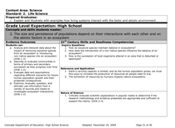
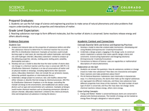
What is the Difference?
Using a page from the 2009 science standards and the 2020 science standards, compare and contrast major differences you find between the documents.
Notes:
Purpose: Educators will compare and contrast the major differences between the 2009/2010 and the 2020 CAS. (Boundary: This does not extend into the changes within the actual Grade Level Expectations and Evidence Outcomes of the standards, just the framework.)
Materials: Get one page of a 2009/2010 standards document and then get a page from the 2020 standards document. NOTE: choose the same content area for both, but choose different strands/topics or grades. For example, in science I chose a High School Life Sciences example from the 2009 CAS and a Middle School Physical Science example from the 2020 CAS. Highlighters may be helpful to have on hand. Note catchers for educators to capture their thinking and understanding will be provided.
Set up: Have educators explore the documents alone for 2-3 minutes, then share their observations with a partner for 2-3 minutes.
[estimated time: 4-6 minutes]

Slide 5
Observations
What observations did you make while comparing and contrasting the two documents?
Notes:
Once pairs have had a chance to discuss observations, then bring the discussion whole group and whip around to share out (9-11 minutes).
Main differences:
Color branding on 2020
Wording “concepts and skills students master:” under the Grade Level Expectation (GLE) is no longer present
The Heading, “21st Century Skills and Readiness Competencies” on the 2009 changed to “Academic Context and Connections”
The subheadings under the section mentioned above have changed. For Science...2009 CAS: Inquiry questions, relevance and applications, nature of science. 2020 CAS: Colorado essential skills and Science and Engineering Practices, Elaboration on the GLE, and Cross cutting concepts.
IMPORTANT MESSAGE: Each academic content area will have different subheadings based on their needs.
Prepared Graduate Statements are numbered in the 2020 CAS
The table format with distinct cells in the 2009 CAS is not present in the 2020 CAS
For Science: on the 2020 CAS, the evidence outcomes now include “clarification statements” and/or “Boundary Statements” and cross coding to the NGSS (Example: MS-PS1-2)
The 2020 CAS have a code associated with each standards page in the bottom right hand corner.
IMPORTANT NOTE: Reference each content areas. “What to Look For” document within the resources. In addition to the document, a video walk-through is also available.
[estimated time: 10 minutes]

Slide 6
Quick Walk-Through
Notes:
The next set of slides walk through the sections of the standards framework providing definitions of each section.
At the top of the document you see the subject area, the grade level, the standard number and strand/topic.
The Prepared Graduate Statements are: The preschool through twelfth-grade concepts and skills that all students who complete the Colorado education system must master to ensure their success in a postsecondary and workforce setting.
Grade Level Expectations: The articulation (at each grade level), concepts, and skills of a standard that indicate a student is making progress toward being ready for high school. What do students need to know from preschool through eighth grade?
[estimated time: < 1 minute]

Slide 7
Quick Walk Through
Notes:
Evidence Outcomes: The indication that a student is meeting an expectation at the mastery level. How do we know that a student can do it?
[estimated time: < 1 minute]

Slide 8
Quick Walk Through
Notes:
Academic Context and Connections: Academic context and connections are the subject-specific elements needed to create context for learning. This right side section highlights essential skills, practices and other important connections necessary for students to understand, apply and transfer the knowledge and skills within the Grade Level Expectation.
Colorado Essential Skills and Science and Engineering Practices: Skills and major practices that scientists employ as they investigate and build models and theories about the world. These terms are used to emphasize that engaging in scientific investigation requires not only skill but also knowledge that is specific to each practice.
Elaboration on the GLE: This section provides greater context for the Grade Level Expectation (GLE) through a description of the understanding about the core ideas that should be developed by students.
Cross Cutting Concepts: The crosscutting concepts have application across all domains of science. As such, they provide one way of linking across the domains through core ideas.
NOTE: Within the on-line standards system, you can click on the “i” for definitions of each subheading for all other content areas.
[estimated time: 2 minutes]

Slide 9
Quick Walk Through
Notes:
For Science ONLY: These sections of the 2020 science standards provide educators more context and information about the expectations within the GLE and evidence outcomes.
Clarification Statements: Clarifies the expectations within the evidence outcome.
Boundary Statements: Demonstrates the boundary for the concept at that particular grade level.
Elaboration on the GLE: Provides more information around the expectation of the GLE.
[estimated time: 1 minute]

Slide 10
Preschool Standards
Notes:
The Preschool template of the standards is the same for all academic content areas.
All headings and subheadings, with the exception of the Prepared Graduate statements, have been changes for the 2020 CAS. These changes were made to better align with the Early Childhood and Head Start Frameworks.
Take 1 minute to select the correct label for each section of the sample standards document.
[estimated time: 3 minutes]

Slide 11
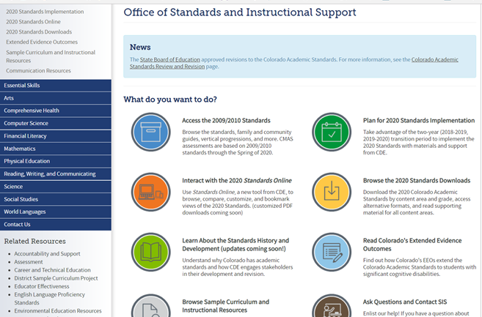
Standards Online
Notes:
This is the main webpage for the Office of Standards and Instructional Support. http://www.cde.state.co.us/standardsandinstruction
You will see navigation icons. You will notice that there are various ways you can access the standards. The Blue Icon is for the current CAS (2009/2010). The Yellow Icon is for the 2020 CAS in Word or PDF formats. The Orange Icon is for the on-line standards system. Let’s select the Orange icon, “Interact with the 2020 Standards Online.”
[estimated time: < 1 minute]

Slide 12
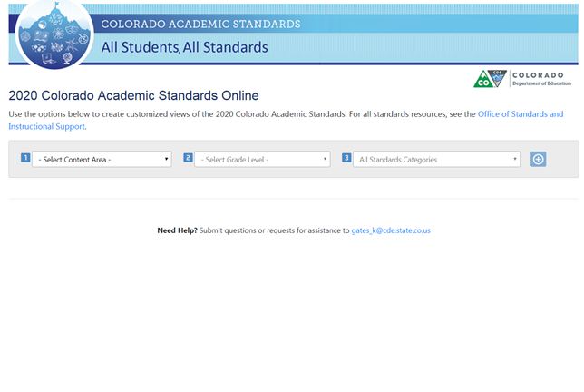
Standards Online
Notes:
Walk through the on-line system demonstrating how it works. https://www.cde.state.co.us/apps/standards/
Select a content area
Select a grade level
Select a strand/topic or all
Expand all or one GLE at a time to view
Click on the “i” in each section to get definitions of sections
You can add another content area by going back to the top and making selections within each section
[estimated time: 2 minutes]
Notecatcher: V. Interaction with the Online Standards System
Go to the CDE website link, http://www.cde.state.co.us/standardsandinstruction
Bookmark the Office of Standards and Instructional Support Page
Take 5 minutes to interact with your content area standards.

Slide 13
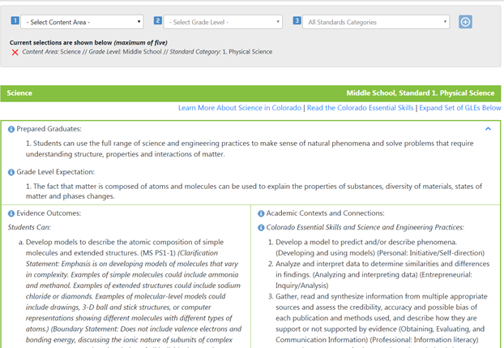
Standards Online
Notes:
Walk through the on-line system demonstrating how it works.
Select a subject area
Select a grade level
Select a strand/topic or all
Expand all or one GLE at a time to view (the one on the screen is GLE 1 from middle school physical science)
Click on the “i” in each section to get definitions of sections
You can add another content area by going back to the top and making selections within each section
[estimated time: 2 minutes]

Slide 14
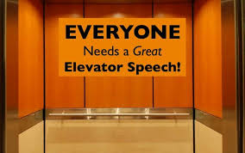
Assessment: Elevator Speech
Instructions: Using your notes, craft a one paragraph elevator speech that answers the following question. Consider what it looks like for your discipline:
What is different about the 2020 Colorado Academic Standards?
What are the different ways I can access the standards?
Notes:
Educators will write their elevator speeches on the note catcher.
[estimated time: 2 minutes]

Slide 15
Before leaving, are there any...
Please contact your Content Specialist in the Office of Standards and Instructional Support for additional information. Refer to the Standards Implementation guide for contact information.

